Slide 1
Embracing New Innovation in Veterinary Drug Evaluation
Steven D. Vaughn, DVM
Director
Office of New Animal Drug Evaluation
Center for Veterinary Medicine
U. S. Food and Drug Administration
June 6, 2012

Slide 2
Four Critical Standards for Evaluating Veterinary Drugs
Safety
Human Food
Target Animal
Environmental
User Safety
Effectiveness
Quality Manufactured Product
Properly Labeled Product

Slide 3
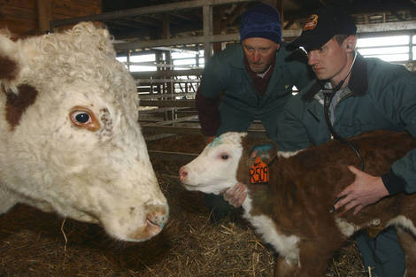
Core Mission
Our public health mission succeeds when we put in the hands of the user:
an approved,
safe and effective,
quality manufactured,
properly labeled
new animal drug to meet therapeutic and production needs of animals

Slide 4
Core Mission Meeting the Therapeutic and Production Needs of Animals
For companion animals:
increase the level of high quality medical care for companion animals
increase in quality of life through medical interventions for companion animals
impact of animal health on the Human-Animal Bond

Slide 5
Core Mission Meeting the Therapeutic and Production Needs of Animals
For food-producing animals:
improve animal welfare and health
improve animal health and production toward increasing the availability of an affordable, abundant and wholesome food supply to meet the needs of a growing human population

Slide 6
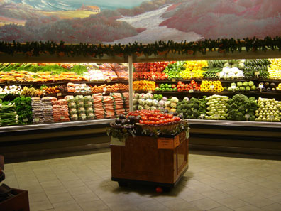
The Challenge – Feeding People
Ensuring an Affordable and Adequate Food Supply to Prevent Hunger is a Public Health Mission
This is both a domestic and an international challenge

Slide 7
Status of Veterinary Drug Development
Concern over antimicrobial resistance
Limited development of new antimicrobials
Increase in novel alternatives to antimicrobials
Concern over antiparasitic drug resistance

Slide 8
Status of Veterinary Drug Development
Change in Pharmaceutical Company Portfolios
Increase in non-traditional entities
Biotechnology, nanotechnology, immunological drugs
For food animals more production enhancing indications and indications for environmental sustainability
For non-food producing animals more non-traditional indications
Chronic disease treatments, cancer therapy, life quality enhancements

Slide 9
Future Animal Health Environment
New products will more likely come from acquisitions then discovery. CVM will work with more venture capital companies.
Further consolidation/tighter financial accountability is highly likely.
The future animal health industry will consist of a few large animal health companies, numerous small venture firms and coalitions of individual public and private organizations.
More sponsors will be global firms and many will be from outside of the US.

Slide 10
Our Challenge
To engage in the development and evaluation of new animal drugs, especially new innovative technologies, to meet the demand for increased safe, affordable and abundant food production

Slide 11
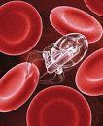
Future Animal Health Environment
The products of the future will not fit the current paradigm.
Products of the future will deploy new technologies for which we have not considered the critical safety and effectiveness standards for evaluation

Slide 12
New Model for Success
As the industry changes so must we
Challenge to efficiently adapt policy and review standards to meet new technologies
Employ new scientific approaches to proving safety and effectiveness
Provide predictability in regulatory decisions
Avoid the lure of increasing scientific rigor beyond that which is necessary
Address ambiguity

Slide 13
CVM’s Innovation Initiative Is
An attempt to position CVM where it needs to be in the future
An attempt to work smarter at engaging new technology
An attempt to move forward when the status quo is not meeting our needs
Based on trust that people have good intentions and talent to make this happen

Slide 14
Innovation Initiative
CVM created and is implementing processes to enable global availability of safe, effective, quality manufactured, properly labeled new animal drugs.
Working with international partners, CVM is addressing challenges in a global animal health environment to meet our public health mission.
CVM re-designed its drug evaluation process for new technologies to enable new technologies to reach the market to impact these public health challenges on a global basis.
Overcome obstacles to ensure access to veterinary drugs and their proper use in food-producing animals.

Slide 15
What’s the Win?
Develop new approaches and engagement to enable a new technology to be met with the same predictability and seamless regulatory process that a traditional animal drug meets at CVM
Remove barriers that prevent a pharmaceutical company from filling their pipeline with new innovative products

Slide 16
Agree on Specific Risk Questions and Plan for Answers
Continued
Evaluation
of Safety and
Effectiveness
Extensive Scientific Interaction between Sponsor and CVM
Predictable/ Seamless Reviews
Knowledge
Acquisition
Formulation of
Risk Questions
Review Process
Conditional
Approval
(Phase IV)
Data Collection
TECH TEAM
Risk Analysts
REVIEW TEAM
Current
Review Process
Discovery/
Proof of
Concept
Regulatory
Submission
Launch
Marketing
Development
Sponsor Decision
To Develop Product
Presubmission
Conference
NADA
Approval

Slide 17
Global Animal Health Current Activities
Codex Alimentarius Commission
VICH
Inter-government Coordination
Outreach
World Organization for Animal Health (OIE)
Food and Agriculture Organization (FAO)
National and Regional Capacity Building Efforts

Slide 18
Global Animal Health The Future
What challenges in a global animal health environment have to be addressed to meet our public health mission?
Are we adequately addressing the challenges of the future?
What steps need to be taken to enable new technologies to reach the market to impact these public health challenges?
What obstacles need to be overcome to ensure access to veterinary drugs and their proper use in food-producing animals?

Slide 19
Global Animal Health The Future
What regulatory structures/approaches need to be developed and enhanced to enable the expansion of food production?
What has to be initiated and what needs to be changed to meet the needs of the future?
What is/are the necessary venues for us to intentionally and aggressively meet these new challenges internationally?

Slide 20
Questions???

