Slide 1

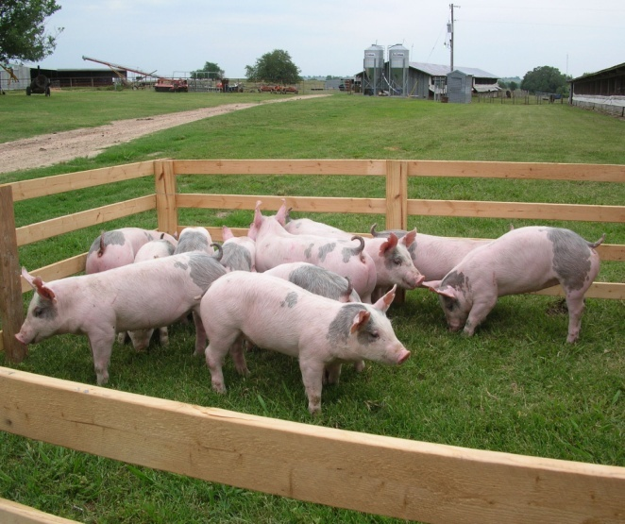
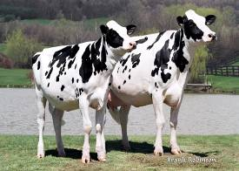
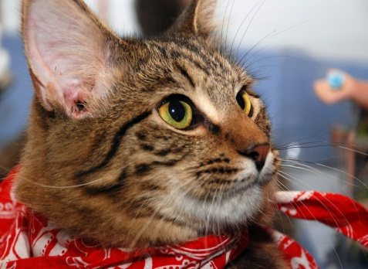



Welcome to the Center for Veterinary Medicine
Comments by
Bernadette M. Dunham, D.V.M., Ph.D.
Director, Center for Veterinary Medicine

