Slide 1
Effectiveness Evaluation for Production Drugs
Crystal Groesbeck, Ph.D
Division of Production Drugs

Slide 2
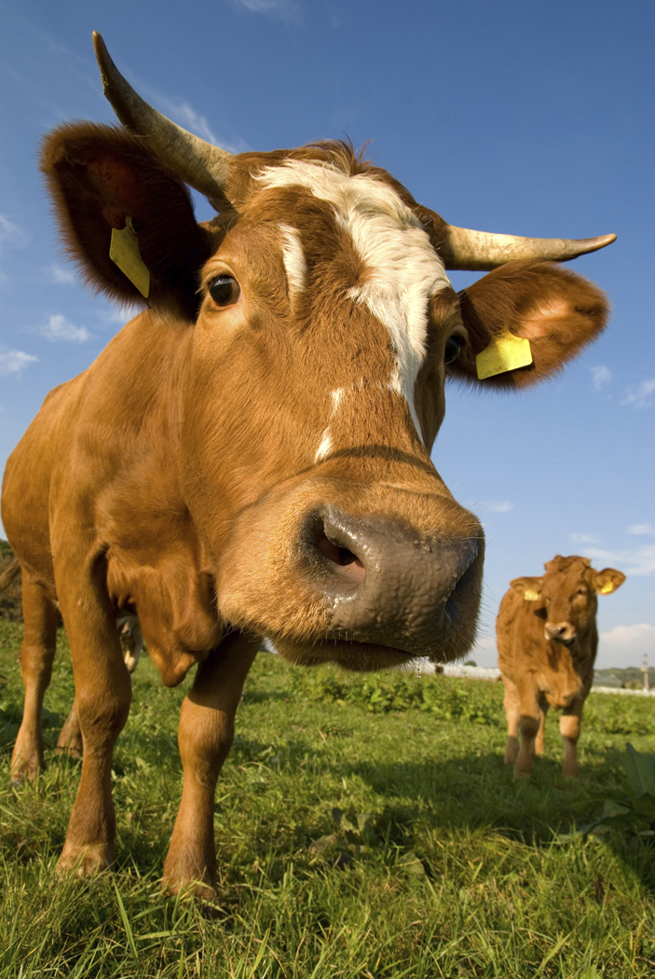
What are Animal Production Drugs?
Articles, other than food, intended to affect the structure or function of the body of an animal
Administered to enhance the production of edible or non-edible products, or to increase the efficiency of a particular phase of life, including reproduction
Different from therapeutic animal drugs which are intended to diagnose, cure, mitigate, treat, or prevent disease in animals

Slide 3
Common Indications for Animal Production Drugs
Increased rate of weight gain
Improved feed efficiency
Synchronization of estrus
Increased production of marketable milk
Carcass characteristics (e.g. carcass leanness)

Slide 4
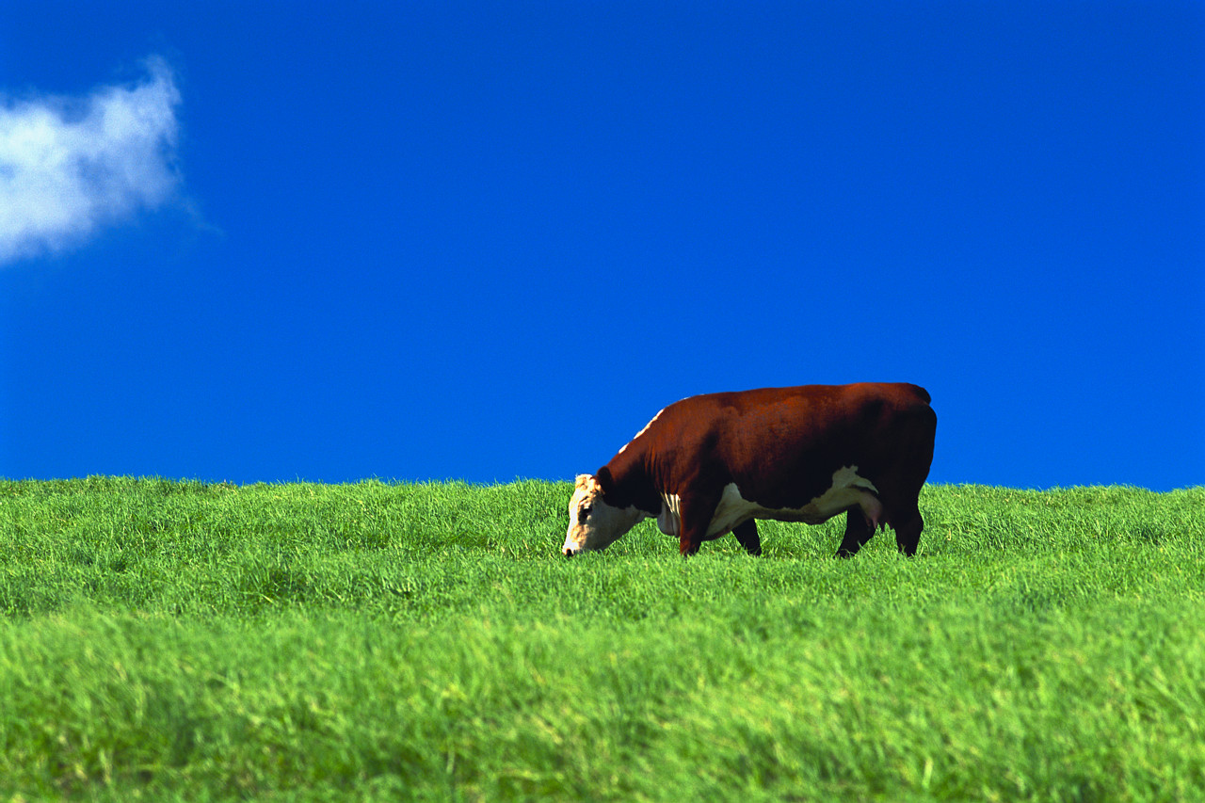
Field Effectiveness Studies for Animal Production Drugs
Purpose
  To evaluate the indications proposed for the new animal production drug under expected conditions of use
  Can also provide information for product labeling that is helpful to the user of the drug

Slide 5
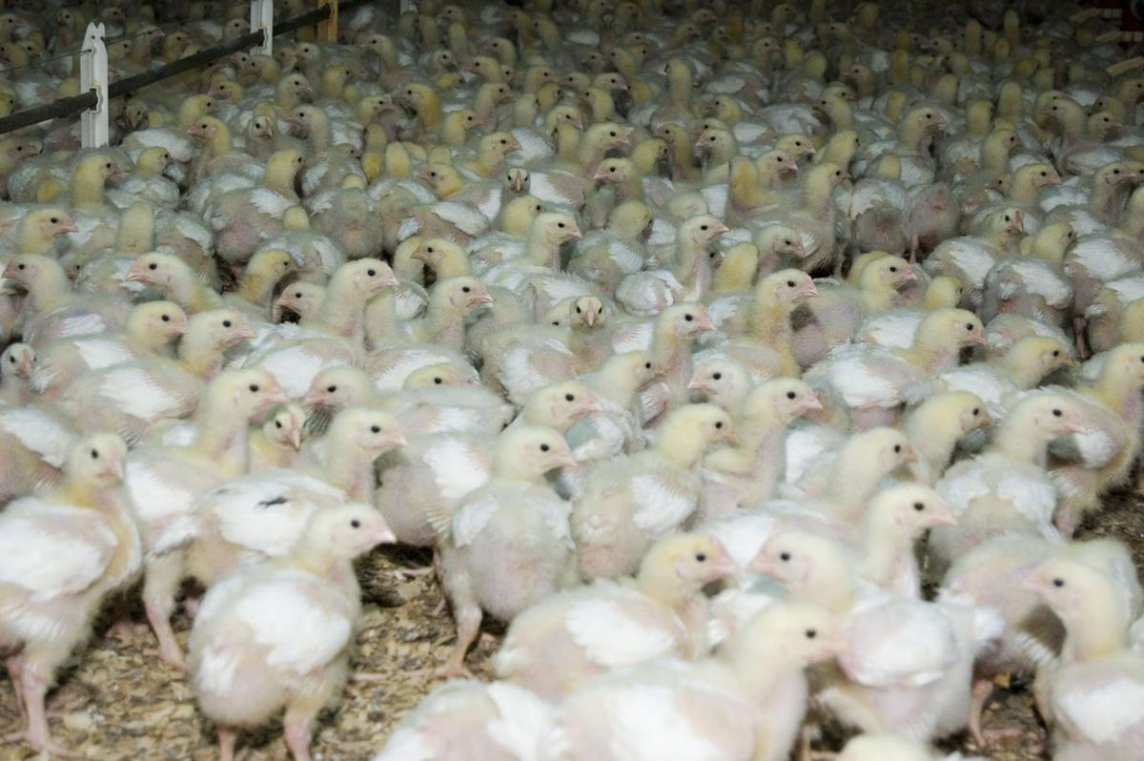
Field Effectiveness Studies for Animal Production Drugs
The large number of animals often used in effectiveness studies provides the opportunity for the detection of low frequency adverse events
Therefore, the effectiveness study may also provide information on the potential adverse effects of a new animal production drug on animal product quality, such as meat quality or milk composition

Slide 6
Dosage and Dose Selection
The intended dosage of the new animal production drug should be determined, including the chosen drug concentration, dose, route of administration, frequency of treatment, and the duration of treatment
A dose or dose range is approvable up to a maximum dose that is effective and does not cause human or target animal safety concerns

Slide 7
Study Design
A protocol can be developed and used as a guide so that all sites perform their studies similarly

Slide 8
Number of Animals
Sufficient numbers of animals should be included in the treatment groups to accommodate loss during the study due to death or removal from the study
When pen, pasture, or cage is the experimental unit, the number of animals per pen, pasture, or cage should mimic common commercial practices for stocking density, taking research facility limitations into account

Slide 9
Animal Selection Criteria
Effectiveness studies for new animal production drugs should use normal, healthy animals that are representative of their class
Other selection criteria such as age or weight range, gender, previous milk production, and previous exposure to production drugs should be clearly identified and defined

Slide 10
Length of Study
For indications associated with meat production, treatment usually will be conducted until animals reach a terminal weight (slaughter or market)
For reproductive indications, the study length should be sufficient to evaluate effectiveness and reproductive target animal safety
For dairy production indications, the length of the study will generally be long enough to evaluate drug effects on the “production lifespan” of the animal

Slide 11
Feeding and Nutrition
Water and feed should be provided to study animals for ad libitum consumption or in accordance with current industry practices for the species/class
Rations should be formulated to meet or exceed the animals’ nutrient requirements and reflect current industry practice
The particle size, texture, form of the feed, and the feeding routine should be similar across all treatment groups

Slide 12
Feeding and Nutrition
If necessary, feeds should be assayed for nutrient composition at intervals appropriate for the species, class, and production phase to ensure that the ration meets nutrient requirements
Feeds or feed ingredients should be assayed for anti-quality factors (e.g. mycotoxins, gossypol), as appropriate, for each feed ingredient and/or the environmental conditions under which it was raised and stored

Slide 13
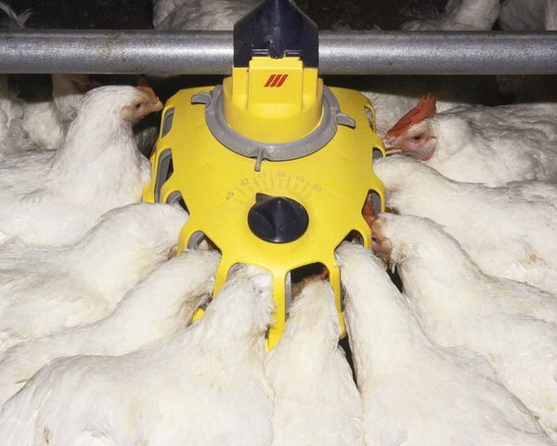
Feeding and Nutrition
If the production drug is delivered via medicated feed, the Type B (intermediate mix) and Type C feeds (what is fed to the animal) should be assayed for drug concentration at appropriate intervals
For indications involving production efficiency (efficiency of weight gain or milk production efficiency), feed intake should be accurately measure and are obtained per experimental unit

Slide 14
Feeding and Nutrition
At a minimum, record all feed offered during the study and all feed remaining in feeders at the end of the study
If the indication is to extend over several production phases, feed intake should be collected for each phase

Slide 15
Health Observations
All study animals should be observed at planned periodic intervals appropriate for the management and experimental conditions
All abnormal signs should be recorded, such as reduced feed intake, lameness, abnormal respiration, and discharges

Slide 16
Health Observations
Animals may be treated with appropriate doses of therapeutic drugs for all their labeled indications.
Acceptable concomitant therapies should be incorporated into the protocol before initiating the study

Slide 17
Animal Removals
Once animals begin treatment they should only be removed from the study due to illness or injury that, in the opinion of a qualified veterinarian, will interfere with their ability to function normally or for humane reasons
Animals removed from the study after the initiation of treatment should not be replaced
Animals should not be removed from the study simply because of poor performance

Slide 18
Animal Removals
Death or removal of animals from the study due to an illness or injury should be recorded along with the reason for removal
Necropsies should be performed on all animals that die or are euthanized to determine the cause of the mortality or morbidity, respectively

Slide 19
For Additional Information:
“Principles of New Animal Drug Effectiveness: An Overview”
“Effectiveness Evaluations for Therapeutic Drugs for Food Animals”
“Effectiveness Evaluations for Therapeutic Drugs for Non-Food Animals”

