Slide 1

Human Food Safety of New Animal Drugs: Microbial Food Safety
Heather Harbottle, PhD
Division of Human Food Safety
Microbial Food Safety Team

Slide 2

Human Food Safety Evaluation
The purpose of a human food safety evaluation is to determine when the edible tissues in food-producing animals treated with a new animal drug are safe for humans to consume.
2
6/14/2012
FDA/CVM
Notes:
2
2

Slide 3
Human Food Safety Evaluation
3
6/14/2012
FDA/CVM
The evaluation of safety is based on risk assessment principles
Risk = Hazard x Exposure
Hazard: toxicity, antimicrobial resistance
Exposure: potential human exposure to drug residues through consumption of edible tissues
Notes:
3

Slide 4

Definition of Residue:
Any compound present in the edible tissues after treatment with the new animal drug.
Includes parent drug, metabolites, and any substance formed in or on food.
The definition is broad enough to include resistant bacteria.
Notes:
4
First, it’s important to define what a residue is. The definition of a residue is shown in this slide. A residue is the compound present in the edible tissues after treatment with the drug. Residues are the parent drug, metabolites, and any substances formed in or on food. The definition is broad enough to include resistant bacteria.

Slide 5
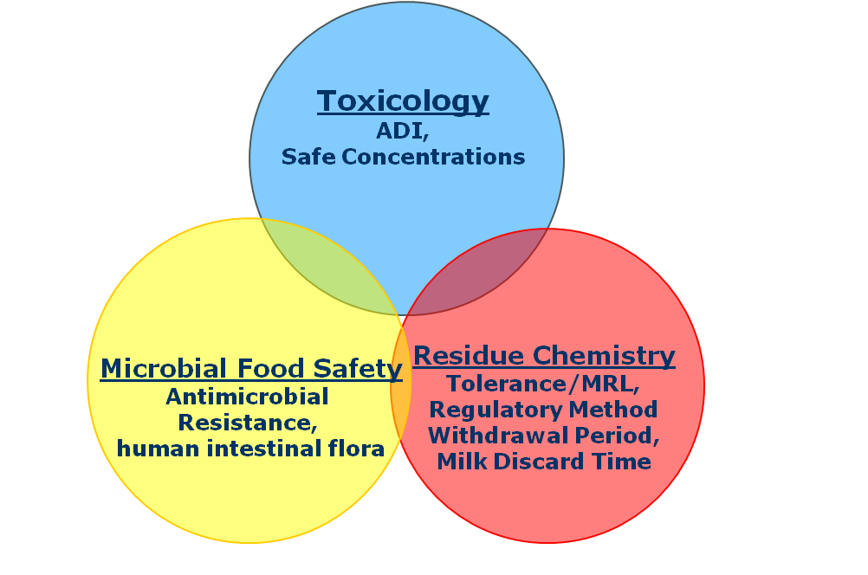
Human Food Safety Assessment

Slide 6
Microbial Food Safety Analysis
Assess the Microbial Food Safety of New Animal Drugs in the following categories:
Antimicrobial resistance development in drugs of human concern
Potential disruption and/or development of antimicrobial resistance in the human intestinal bacteria

Slide 7
Objective of Microbial Food Safety Assessment
Mitigate the hazard identified in the microbial food safety studies by controlling exposure.
Risk = Hazard x Exposure
Notes:
7

Slide 8
Hazard: Development of Resistance
Using a Qualitative risk assessment approach
Assess antimicrobial drugs intended for food-producing animals regarding the development of antimicrobial resistance
Address human exposure to antimicrobial resistant microbes through ingestion of animal-derived food
Notes:
Developed to address the public health concern that human medical therapy may be compromised from use of antimicrobial drugs in animals

Slide 9
Hazard Characterization
Qualitative Risk Assessment
Step 1. Release Assessment
Step 2. Exposure Assessment
Step 3. Consequence Assessment
Risk Estimation

Slide 10
Hazard Identification
The hazard has been defined as human illness
caused by an antimicrobial-resistant bacterium
attributable to an animal-derived food commodity
treated with a human antimicrobial drug of concern.
In some instances, a hazard characterization is sufficient for a particular antimicrobial drug
Notes:
“The hazard has been defined as human illness, caused by an antimicrobial-resistant bacteria, attributable to an animal-derived food commodity, and treated with the human antimicrobial drug of interest. (page 9)”.
The hazard characterization may be submitted as a stand alone document or as an integral part of the QRA

Slide 11
Hazard: Emergence of Antimicrobial Resistance
Describes factors related to an antimicrobial drug and its use in animals that contribute to the emergence of antimicrobial resistant bacteria or antimicrobial resistance determinants in the animal

Slide 12
Factors Contributing to the Emergence of Resistance
Mechanism of Activity
Spectrum of Activity
Pharmacokinetics
Pharmacodynamics
Antimicrobial Resistance Mechanism
Antimicrobial Resistance Transfer
Selection Pressure

Slide 13
Where can we use Surveillance and Research Data?
Hazard: Emergence of Antimicrobial Resistance
Parameters:
Mechanism of Activity – Class of Drug, targeted action
Spectrum of Actvity – Gram +/- activity, susceptibility data
Antimicrobial Resistance mechanisms – Structural, efflux, gene
Antimicrobial Resistance Transfer – chromosomal, mobile element
Selection Pressure – co-selection

Slide 14
Hazard: Exposure to Antimicrobial Resistant Bacteria
Describes likelihood of human exposure to food-borne bacteria of human health concern through animal-derived food products

Slide 15
Exposure Assessment
Probability that humans consuming animal derived foods will be exposed to resistant bacteria of public health concern
Evaluation based on relative consumption and contamination of those commodities
Variety of data sources – all welcome to better address the concern
NARMS, CIPARS, DANMAP, AFSSA FARM Report, etc
Notes:
“The exposure assessment is independent of the use of the antimicrobial drug under review and may be estimated by considering the relative amount of relevant bacterial contamination of the food product and the relative quantity of the food product consumed by humans.” p16
From the Glossary:
Exposure assessment: The exposure assessment describes the likelihood of human exposure to the hazardous agent through food-borne exposure pathways. The exposure assessment should estimate qualitatively the probability of this exposure to bacteria of human health concern through food-related pathways.

Slide 16
Where can we use Surveillance and Research Data?
Exposure Assessment: Human exposure to Antimicrobial Resistant Pathogens
Parameters:
Consumption of commodity
Prevalence of zoonotic pathogens in commodity
Prevalence of antimicrobial resistance in zoonotic pathogens

Slide 17
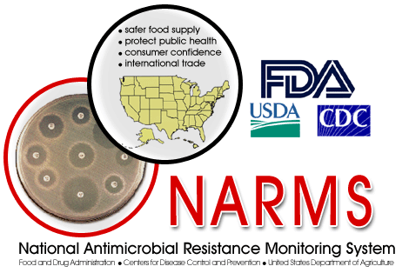
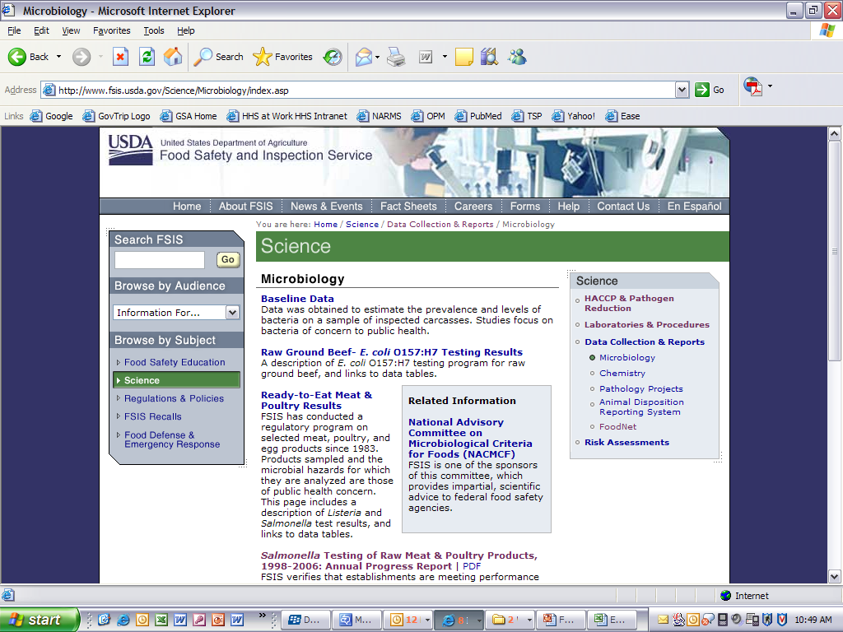
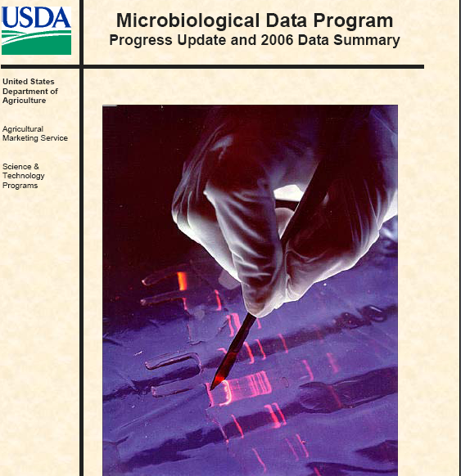
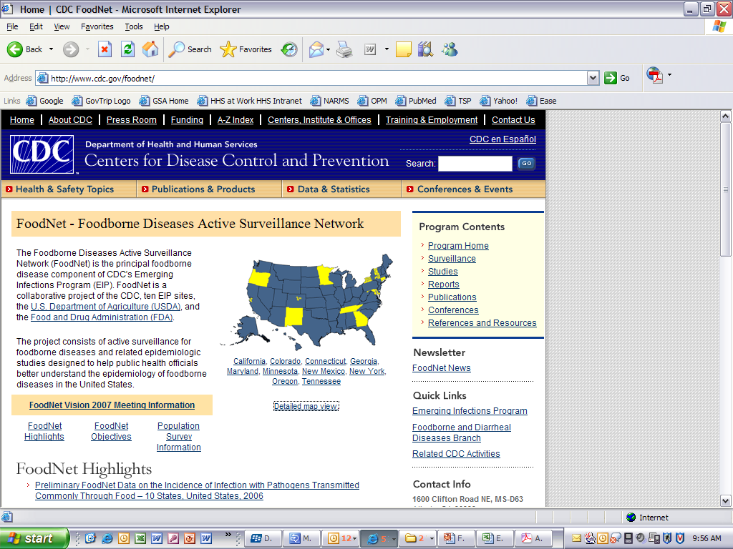

Foodborne Surveillance in the U.S.
Collaborative effort among FDA, USDA, and CDC which monitors antimicrobial susceptibility patterns of zoonotic enteric bacteria
FSIS tests selected meat, poultry, and
egg products for microbial hazards of
public health concern
Voluntary data-gathering program
which tests fresh fruit and vegetables
for targeted foodborne pathogens
and indicator organisms
Collaborative effort among CDC, USDA-FSIS,
FDA, and participating state health departments
Network of public health and regulatory
labs that perform molecular subtyping
of certain foodborne pathogens

Slide 18
Exposure Assessment
Per capita consumption of the food commodity
Probability of food commodity contamination
High
Medium
Low
High
Medium
Low
Medium

Slide 19
How important is the antimicrobial drug for use in human disease?
Consequence evaluation
Describes human health consequence of exposure to antimicrobial resistant bacteria based on importance of drug (or related drugs) to humans (ranking of antimicrobials)
In the FDA, antimicrobials are ranked by the Center for Drug Evaluation according to their importance for use in human disease

Slide 20
Drug Rankings and Examples
Critically Important 3rd Generation cephalosporins, macrolides, fluoroquinolones
Highly Important 4th Generation cephalosporins, aminoglycosides, clindamycin
Important 1st & 2nd Generation cephalosporins, monobactams, quinolones

Slide 21
Qualitative Risk Integration
Release
Assessment
Risk Estimation
Exposure
Assessment
Consequence
Assessment
Risk estimation integrates results from release, exposure and consequence assessments to produce overall measure of risk associated with hazards.
Notes:
The overall risk estimation should “represent the potential for human health to be adversely impacted by the selection or emergence of antimicrobial resistant food-borne bacteria associated with the use of the drug in food-producing animals.” (p 21)
From the Glossary:
Risk: The probability that human food-borne illness is caused by a specified antimicrobial resistant bacteria, is attributable to a specified animal-derived food commodity, and is treated with the human antimicrobial drug of interest.
Risk estimation: The overall estimate of the risk associated with the proposed use of the drug in the target food-producing animals following the integration of the release assessment, exposure assessment and consequence assessment. The risk rankings represent the relative potential for human health to be adversely impacted by the emergence of antimicrobial resistance associated in a food-borne pathogen with the use of the drug in food-producing animals.

Slide 22
Extent-of-use limitations
Possible process for ranking (High, Medium, Low) of extent of antimicrobial drug use in animals based on duration and method of administration (Table 7, Page 23)
Duration of use | Intended administration to individual animals | Intended administration to select groups or pens of animals | Intended administration to flocks or herds of animals
Short (<6 days) | L¹ | M² | H³
Medium (6-21 days) | L | M | H
Long (>21 days) | M | H | H
Notes:
“FDA believes that ‘extent of use’ is an important factor to consider when determining safe conditions of use for an antimicrobial new animal drug.”
“In general, administration to groups or pens of animals is defined as administration to a segregated group of animals within a building, house or feedlot, whereas administration to flocks or herds of animals is defined as administration to all animals within a building, house, feedlot. The sponsor may use another definition of these terms that is more reflective of relevant, current animal husbandry practices.”

Slide 23
Examples of Possible Risk Management Strategies Based on the Level of Risk (H, M, or L).
Approval Conditions | Risk Category 1 (H) | Risk Category 2 (M) | Risk Category 3 (L)
Marketing status | Rx | Rx/VFD | Rx/VFD/OTC
Extra-label use | ELU restriction | Restricted in some cases | ELU permitted
Extent of use | Low | Low, medium | Low, medium, high
Post-approval monitoring | NARMS | NARMS | NARMS
Advisory committee review | YES | In certain cases | NO

Slide 24
Foodborne Pathogens Commonly Addressed as Hazards with Respect to Antimicrobial Resistance
Top pathogens transmitted by food: Salmonella enterica serotypes and Campylobacter sp.
Ground beef, Pork chops, Chicken breast, Ground turkey
Generic E. coli (Gram- antimicrobial resistance marker)
Enterococcus sp. (Gram+ antimicrobial resistance marker)
Other non-foodborne bacterial species if human therapy may be compromised by veterinary use of a particular drug

Slide 25
Example: β-lactams 3rd Generation cephalosporin
Sponsor X wishes to address microbiological food safety concerns in support of approval for a new β-lactam 3rd generation cephalosporin antimicrobial for use in cattle to control disease Y.
Sponsor X must address the effect of the new β-lactam antimicrobial on bacteria that can be transmitted through cattle-associated food (retail ground meat, steak, etc).

Slide 26
Example: β-lactam -3rd Generation cephalosporin
Release Assessment
Antimicrobial Resistance Mechanisms
Antimicrobial Resistance genes bla_{CMY}, bla_{CTX-M}, bla_{TEM}, bla_{SHV}, bla_{OXA}, bla_{PSE}, etc.
Antimicrobial Resistance transfer
Integrons, transposons, plasmids – known carriers of these genes
Selection pressure: co-selection
Presence of other antimicrobial resistance genes on a mobile element with the cephalosporin gene may inadvertently co-select for other drug resistance

Slide 27
Example: β-lactam -3rd Generation cephalosporin
Exposure Assessment
Baseline prevalence of antimicrobial resistance – NARMS data can be used
Prevalence of S. enterica is <5% in ground beef and resistance is 10-15%.
Prevalence of E. coli is 70-80% and resistance is <5%.
http://www.fda.gov/AnimalVeterinary/SafetyHealth/AntimicrobialResistance/NationalAntimicrobialResistanceMonitoringSystem/ucm268951.htm

Slide 28
Example: β-lactam -3rd Generation cephalosporin
Release Assessment: HIGH
Many antimicrobial resistance genes detected and associated with mobile elements
Exposure Assessment: MEDIUM
<5% prevalence S. enterica in meat, 70-80% prevalence in E. coli, with low antimicrobial resistance prevalence
Consequence Assessment: HIGH
Critically Important drug
Risk Estimation: HIGH

Slide 29
Effects on the Human Intestinal Bacteria
Evaluate the acceptable daily intake (ADI) per day of drug that can be consumed by humans in animal-derived food product with no adverse effects
Adverse effects:
Potential disruption of the colonization of the human intestinal bacteria
Potential for development of human intestinal microbe antimicrobial resistance

Slide 30
Scientific Questions to be Addressed
Are residues of a drug (and/or its metabolites) microbiologically active against representative human intestinal bacteria?
Recommended data to answer the question:
Examples of selected intestinal bacteria including:
E. coli, and species of Bacteroides, Bifidobacterium, Clostridium, Enterococcus, Eubacterium, Fusobacterium, Lactobacillus, Peptostreptococcus/Peptococcus.

Slide 31
Scientific Questions to be Addressed
Do residues enter the human colon?
Recommended data to answer the question:
Drug’s absorption, distribution, metabolism, excretion (ADME), bioavailability, or similar data may provide information on the percentage of the ingested residue that enters the colon.

Slide 32
Scientific Questions to be Addressed
Do the residues entering the human colon remain microbiologically active?
Recommended data to answer the question:
Data demonstrating loss of microbiological activity from in vitro inactivation studies of the drug incubated with feces, or data from in vivo studies evaluating the drug’s microbiological activity in feces or colon content of animals.

Slide 33
A scenario where there is reasonable certainty of no microbiological effects
If it can be shown that the antimicrobial drug is not active against human intestinal bacteria, the drug does not enter the colon, or is not active upon reaching the human colon, then the ADI will not be based on microbiological endpoints and remaining questions need not be addressed.
The ADI will be determined using a NOEL derived from traditional toxicology studies.

Slide 34
A Scenario Where the Microbiological ADI Should Be Determined
If it can be shown that microbiologically active drug or metabolites reach the human colon, further scientific questions should be addressed.

Slide 35
Endpoints of Human Health Concern
1. Disruption of the colonization barrier, and
2. Increase in the population of antimicrobial resistant bacteria in the human colon.

Slide 36
Scientific Questions to be Addressed
Provide scientific justification to eliminate the need for testing either one or both endpoints of concern;
If a decision cannot be made based on the available information, both endpoints should be examined.

Slide 37
Addressing Endpoints of Human Health Concern
The microbiolgical ADI can be determined by:
Calculating the MIC_{calc}, a value which will provide information regarding the potential for the drug dose in the human intestine to be bactericidal
Establishing a NOAEC/NOAEL using:
In vitro or in vivo studies examining bactericidal activity mimicking gut conditions
In vitro or in vivo studies examining the potential for antimicrobial resistance development in human intestinal bacteria

Slide 38
Final ADI for an Antimicrobial Drug
The final ADI for total residues of an antimicrobial drug in edible animal tissues will be the toxicological ADI or the microbiological ADI, whichever is the lowest.
tox ADI < micro ADI
Final
ADI
Tox
ADI
Antimicrobial
Drug
Micro ADI < tox ADI
Final
ADI
Micro
ADI

Slide 39
Microbial Food Safety Analysis
Assess the Microbial Food Safety of New Animal Drugs in the following categories:
Antimicrobial resistance development in drugs of human concern
Guidance for Industry #152 –Evaluating the Safety of Antimicrobial New Animal Drugs with Regard to Their Microbiological Effects on Bacteria of Human Health Concern
Potential disruption of the human intestinal bacteria
Guidance for Industry #159 – Studies to Evaluate the Safety of Residues of Veterinary Drugs in Human Food: General Approach to Establish a Microbiological ADI (VICH GL36(R))

Slide 40
Conclusions
Qualitative Risk Assessments aid in science-based decision-making for new animal drug approvals to preserve and protect human health
Using existing surveillance system and research data
Using literature reviews of previous studies
Sponsors voluntarily conducting studies to address concerns
Mitigation for risk can be achieved by
Limiting extra-label use, requiring oversight by a Veterinarian, modifying delivery method, and/or extending withdrawal periods
Microbiological ADIs mitigate the risk of antimicrobial residues effecting the human intestinal bacteria

Slide 41

Summary
A human food safety evaluation is part of the approval process for animal drugs intended for use in food-producing animals.
Risk assessment approach is used to evaluate human food safety of animal drug residues.
The hazard from animal drugs is identified and characterized from microbial food safety and toxicological information, and the exposure of the hazard to humans is mitigated by information from residue chemistry studies.
Notes:
41

Slide 42
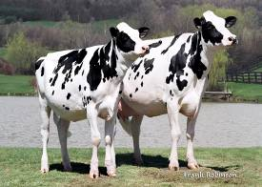
Thank you!

