Slide 1
Target Animal Safety
Laura L. Hungerford, DVM, MPH, PhD
Senior Advisor, Science and Policy, ONADE
Professor, University of Maryland School of Medicine

Slide 2
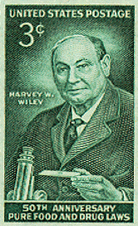
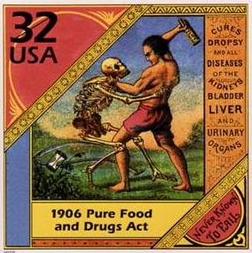
Drug Safety – US path
1906 Pure Food and Drug Law
Focused on labeling as a way to protect consumers
Notes:
Three cent US postage stamp from 1956 showing Harvey W. Wiley at the 50th anniversary of the Food and Drug Laws
Thirty-two cent US postage stamp from 1998 showing label from Hunt’s remedy

Slide 3
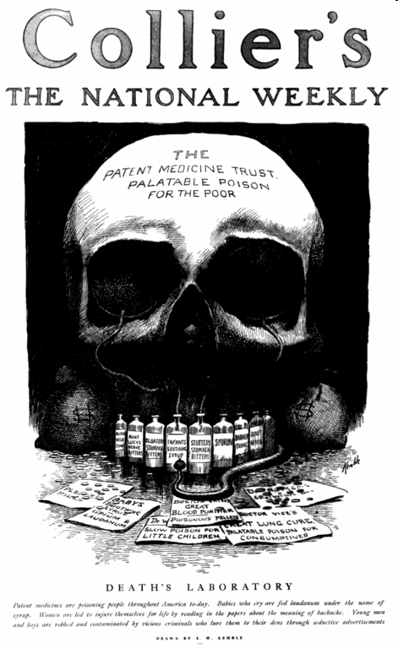
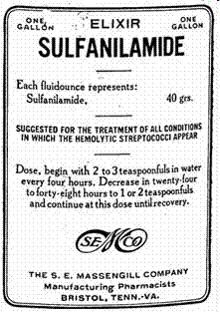
Drug Safety
1906 Pure Food and Drug Law
1938 Federal Food, Drug and Cosmetic Act
Required
investigation of drug safety before approval
Notes:
E.W. Kemble’s 1906 “Death’s Laboratory” cover for Collier's National Weekly;
Label for Sulfanilamide Elixir

Slide 4
Animal Drug Safety
Target Animal Safety
Human Food Safety
Human User Safety
Environmental Safety

Slide 5
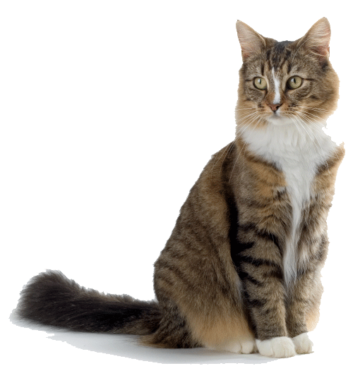
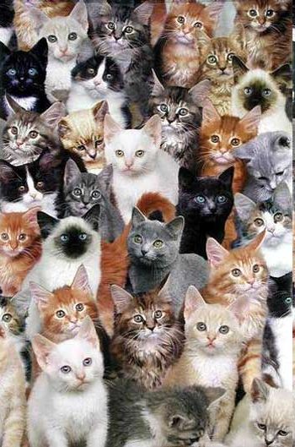
Target Animal Safety
The cumulative effect of the drug on the animal(s), such that the drug does not adversely affect the treated animal(s)
Notes:
Picture of individual cat
Picture of group of cats representing a population

Slide 6
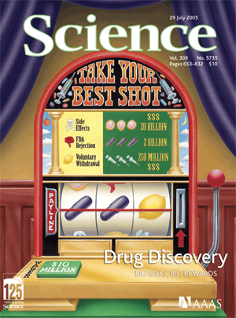
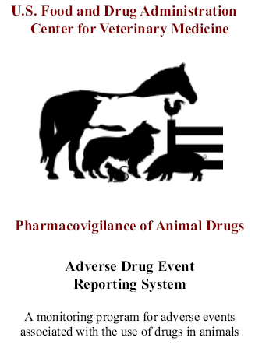
Target Animal Safety
Pre-approval Studies
Drug Approval
Post-approval Surveillance
Notes:
Cover of Science magazine from July 2005 representing a slot machine to express the low probability of success in the drug discovery process
Image representing the CVM post-approval drug surveillance program

Slide 7
Target Animal Safety
Pre-approval Studies
Drug Failure
Post-approval Surveillance
Notes:
Cover of Science magazine from July 2005 representing a slot machine to express the low probability of success in the drug discovery process
Image representing the CVM post-approval drug surveillance program

Slide 8
Target Animal Safety
Pre-approval Studies
Goal is to predict or infer what will happen when the drug is used in real populations after approval
There are many ways to evaluate this
Notes:
Cover of Science magazine from July 2005 representing a slot machine to express the low probability of success in the drug discovery process

Slide 9
Target Animal Safety
How can safety be predicted?
Margin of safety studies
Relevant published literature
Field trials of effectiveness
Other specialized studies
Validated models of safety
Additional relevant information

Slide 10
Target Animal Safety
How can safety be predicted?
Margin of safety studies
Often 1X, 3X, 5X intended dose
Increasing toxicity
Increasing Dose
Therapeutic effects
No effect on animal
Notes:
Bar graph showing the affect of increasing dose on the toxicity of the animals from no effect on the animal to therapeutic effects to increasing toxicity

Slide 11

Target Animal Safety
International Cooperation on Harmonisation of Technical Requirements for Registration of Veterinary Medicinal Products (VICH)
EU-Japan-USA with other observer nations
Established a TAS Working Group in 1999

Slide 12
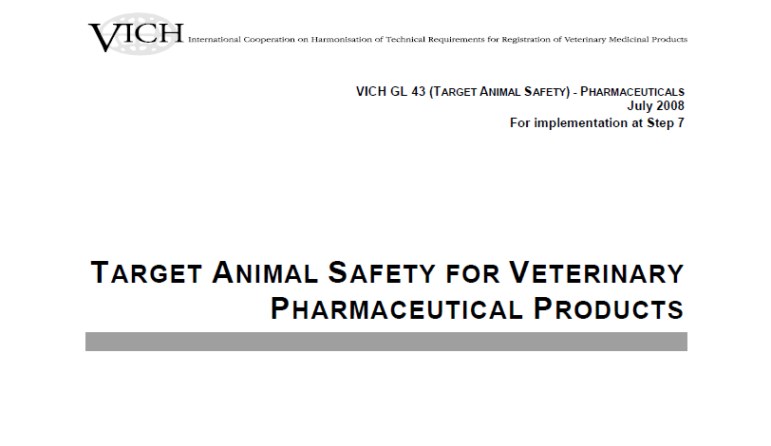
Target Animal Safety

Slide 13
Target Animal Safety
Target Animal Safety for Veterinary
Pharmaceutical Products
VICH GL43
2. MARGIN OF SAFETY STUDIES
The aim of TAS studies is to provide information on the safety of an IVPP in the intended species under the proposed conditions of use. The margin of safety study is indispensable in the approval of an IVPP. Furthermore, adverse effects associated with overdoses and increased duration of administration of the IVPP should be identified, if possible. Dose confirmation and field studies conducted to confirm the effectiveness of the IVPP provide further information on safety in the target species. Depending on the known or suspected properties of the IVPP, it may be necessary to conduct additional toxicologic or specialized tests.

Slide 14
Target Animal Safety
How can safety be predicted?
Relevant published literature
  Not just a ‘stack’ of papers (or pdfs)
  Should be written as a referenced and well supported summary of safety
  Should be considered critically and scientifically
  ‘Weight of evidence’ is important

Slide 15
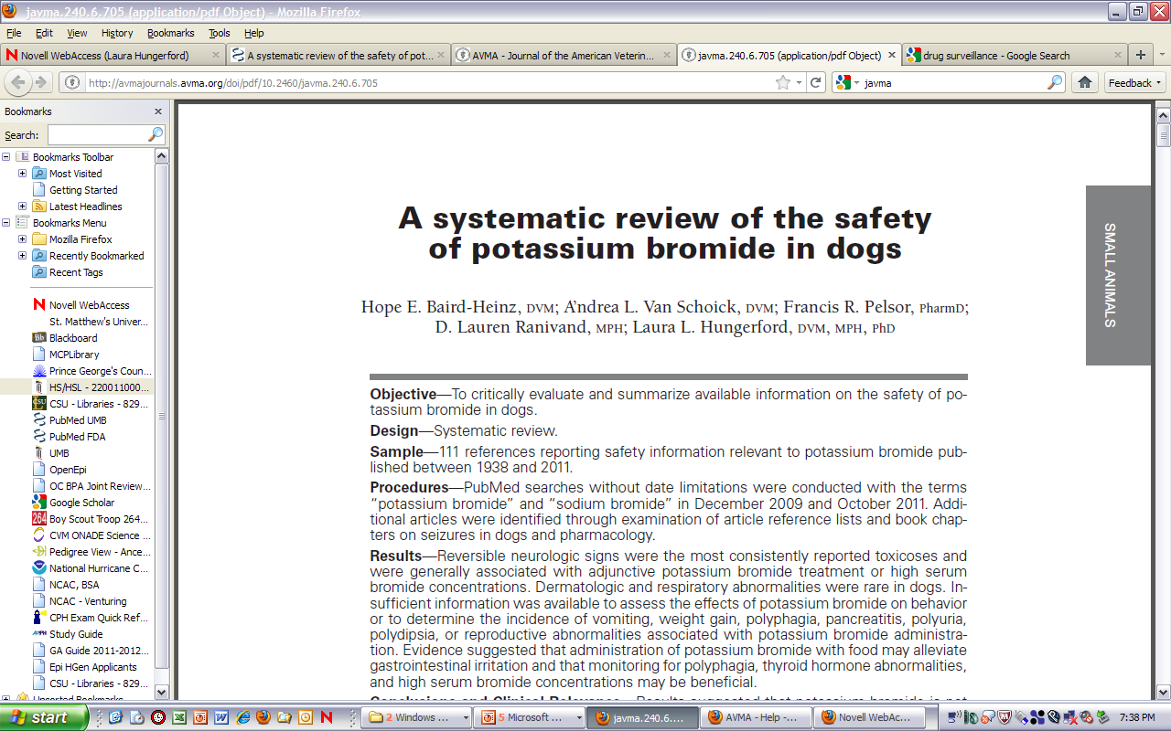
Target Animal Safety
How can safety be predicted?
Relevant published literature

Slide 16
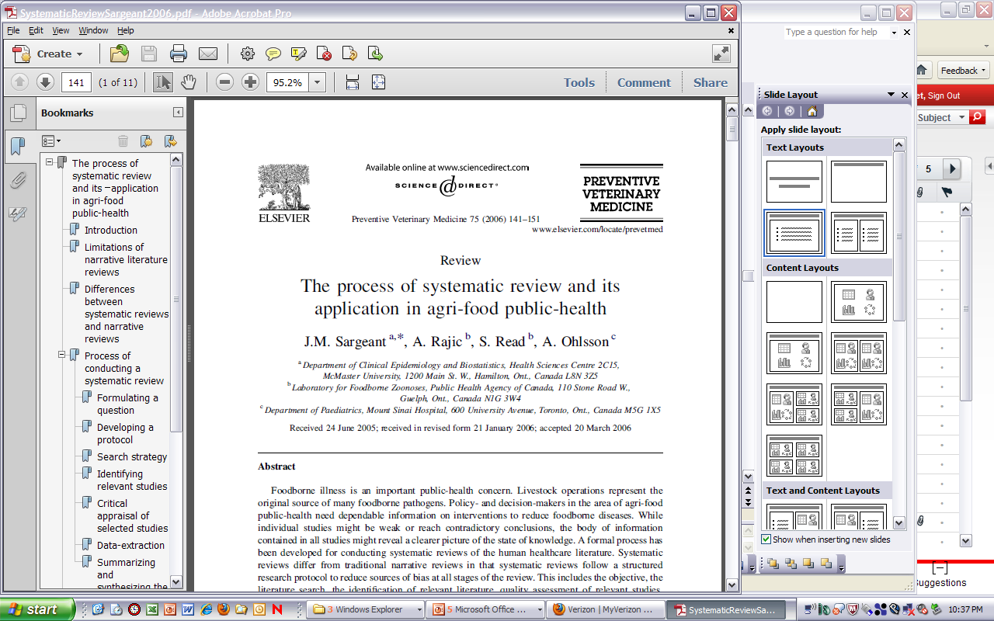
Target Animal Safety
How can safety be predicted?
Relevant published literature

Slide 17
Target Animal Safety
Target Animal Safety for Veterinary
Pharmaceutical Products
VICH GL43
5. RISK ASSESSMENT IN ANIMAL SAFETY EVALUATION
  For some IVPPs, laboratory and field safety data may not alone provide sufficient information to determine if an acceptable safety profile exists in relation to IVPP benefits. In these instances, risk assessment methodologies may provide a means to supplement or augment TAS evaluation. Risk assessment uses the available body of evidence to weigh the severity of an adverse effect (harm), the potential of reversibility, and the probability that it will occur.

Slide 18
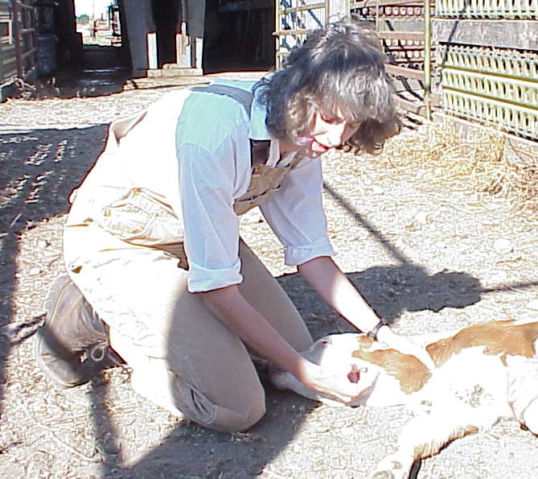
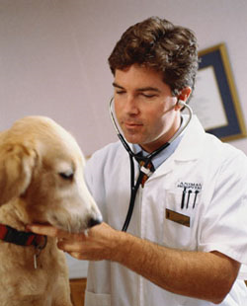
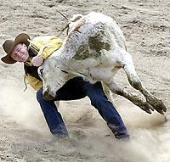
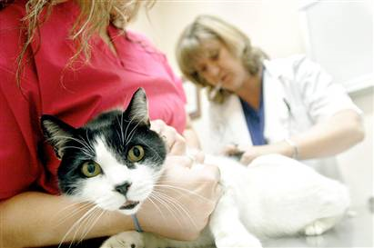
Target Animal Safety
How can safety be predicted?
Field trials of effectiveness
  Adding safety endpoints
  Measurable endpoints
  Observable endpoints
Notes:
Picture of a veterinarian collecting a blood sample from a calf
Picture of a veterinarian doing a physical examination on a dog
Picture of a cowboy preparing to tie a steer to restrain it for examination
Picture of a veterinary technician restraining a cat while a veterinarian collects samples

Slide 19
Target Animal Safety
Target Animal Safety for Veterinary
Pharmaceutical Products
VICH GL43
4. TARGET ANIMAL SAFETY DATA FROM FIELD STUDIES
  Field studies intended to evaluate effectiveness of an IVPP also provide essential TAS data under conditions of intended use. These studies should be conducted in accordance with the principles of GCP.
  Field studies are typically conducted under conditions representative of the target population and provide an evaluation of potential adverse effects at the intended use dosage in a much larger number of animals. Field studies use the target population which, if applicable, includes diseased animals. Where disease and husbandry are similar between regions, international data may be used for field studies, as long as a minimum proportion of the data acceptable to the region is generated within the region where approval is being sought. Including a relatively large number of animals in the study improves the ability to detect relatively low frequency adverse events.

Slide 20
Target Animal Safety
How can safety be predicted?
Field trials of effectiveness
  Adding safety endpoints
  Measurable endpoints
  Observable endpoints
Notes:
Picture of a veterinarian collecting a blood sample from a calf
Picture of a veterinarian doing a physical examination on a dog
Picture of a cowboy preparing to tie a steer to restrain it for examination
Picture of a veterinary technician restraining a cat while a veterinarian collects samples

Slide 21
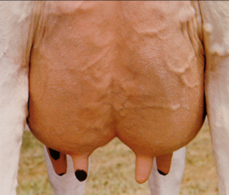
Target Animal Safety
How can safety be predicted?
Other specialized studies
  Injection site
  Reproductive
  Mammary gland
  Sensitive organ systems
  Designed to answer knowledge gaps
Notes:
Picture of a mammary gland of a dairy cow

Slide 22
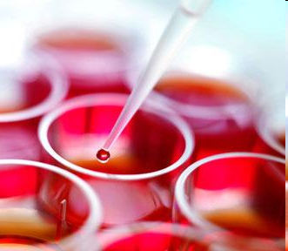
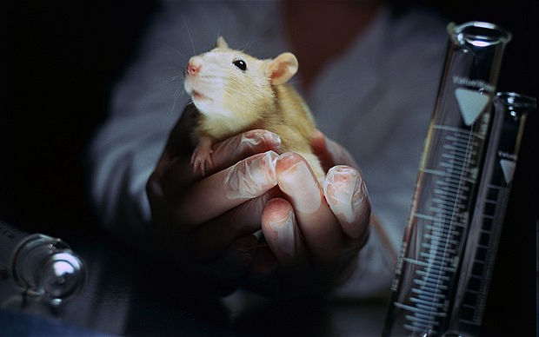

Target Animal Safety
How can safety be predicted?
Validated models of safety
  Reduce, Refine, Replace
  Inferential value
Notes:
Picture of a sample being pipetted into a well of a test plate to do a model test for safety
Picture of a laboratory mouse being held by a researcher
Picture of mechanical dogs to illustrate concept of a model dog

Slide 23
Target Animal Safety
How can safety be predicted?
Additional relevant information
  Linked to the information gaps, summary and proposed
  Can be outside-the-box
  Novel information types
  Special populations

Slide 24
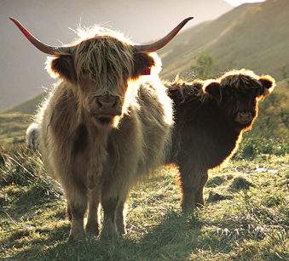
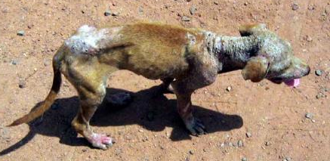
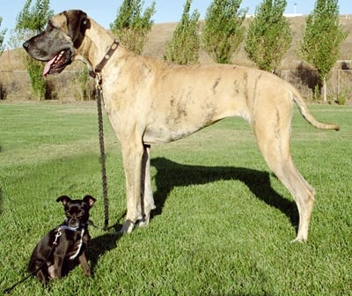
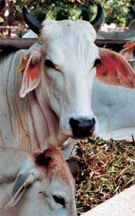
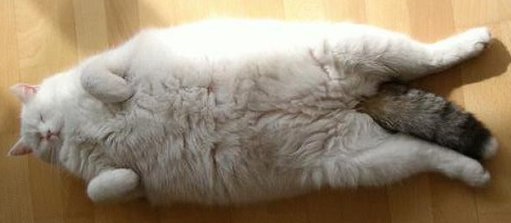
Target Animal Safety
How can safety be predicted?
Additional relevant information
Notes:
Picture of Brahman cows that are very thin with loose skin
Picture of Scottish cattle with a high body condition score and very thick hair
Picture of an obese cat
Picture of two dogs, one that is very large and one that is very small
Picture of a dog that is very thin and in poor health with skin disease

Slide 25
Target Animal Safety
How can safety be predicted?
Margin of safety studies
Relevant published literature
Field trials of effectiveness
Other specialized studies
Validated models of safety
Additional relevant information
Notes:
Picture of individual cat
Picture of group of cats representing a population

Slide 26
Animal Drug Safety
Target Animal Safety
Human Food Safety
Human User Safety
Environmental Safety

Slide 27
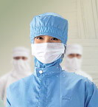
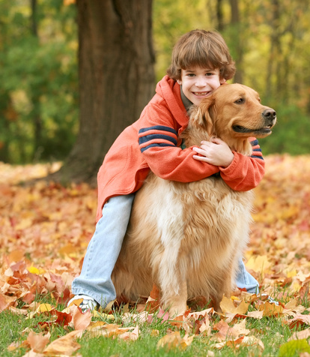
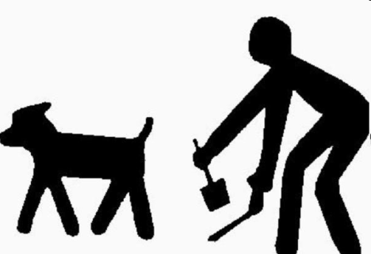
Human User Safety
Hazards associated with manufacturing
Hazards associated with administration to animals
Hazards associated with wastes
and disposal of drugs
Notes:
Picture of a person wearing a protective suit and mask
Picture of a boy hugging a dog
Graphic of a man picking up feces behind a dog

Slide 28

Human User Safety
How can safety be predicted?
Hazard assessment
Hazard
Exposure Assessment
RISK
Exposure
Vulnerability Assessment
Vulnerability
Notes:
Venn diagram showing the overlap of 3 circles representing Exposure, Hazard and Vulnerability with the center overlap labeled to represent Risk

Slide 29
Human User Safety
How can safety be predicted?
Hazard assessment
Can the drug cause an increased incidence of adverse health effects in humans? What evidence is there?
Exposure Assessment
What is the extent of exposure of human users to the drug or its components under actual conditions of use?
Vulnerability Assessment
What are the characteristics of the users?

Slide 30
Human User Safety
How can safety be predicted?
Hazard assessment
Generally a property of the drug; may be no hazard; more information may be needed in some cases
Exposure Assessment
May label or package to decrease exposure; may change formulation or indication
Vulnerability Assessment
May identify and protect or train vulnerable humans

Slide 31
Human User Safety
How can safety be predicted?
Hazard assessment
Hazard
Exposure Assessment
RISK
Exposure
Vulnerability Assessment
Vulnerability
Notes:
Venn diagram showing the overlap of 3 circles representing Exposure, Hazard and Vulnerability with the center overlap labeled to represent Risk

Slide 32
Human User Safety
How can safety be predicted?
Hazard assessment
Hazard
Exposure Assessment
Exposure
Vulnerability Assessment
Vulnerability
Notes:
Venn diagram showing the overlap of 3 circles representing Exposure, Hazard and Vulnerability with the center overlap labeled to represent Risk

Slide 33
Human User Safety
How can safety be predicted?
V. USER SAFETY:
  The product labeling contains the following information regarding safety to humans handling, administering, or exposed to SUCROMATE Equine:
    Not for use in humans. Keep this and all drugs out of reach of children. Pregnant women and women of childbearing age should exercise caution when handling this product. Accidental administration may lead to a disruption of the menstrual cycle. Direct contact with the skin should be avoided. If exposure occurs, contact areas should be washed immediately with alcohol followed by soap and water, as this product is insoluble in water. In case of accidental human injection, consult a physician immediately.
  The data submitted in support of this NADA were examined to ensure human user safety.

Slide 34
Animal Drug Safety
Animal Drug Approval
Summary
Pathway to regulation
Evidence-based evaluation
Model to incorporate risk into decision-making

