Slide 1
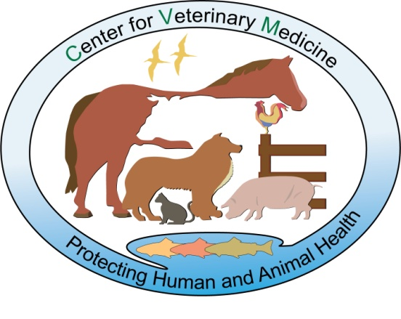
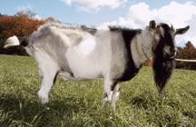
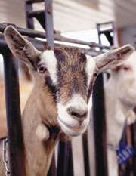
Regulation of Genetically Engineered Animals at FDA: A Case Study
Jeff Jones, DVM, PhD
Animal Biotechnology Interdisciplinary Group
Center for Veterinary Medicine
U.S. Food and Drug Administration

Slide 2
Our First Approval: GE Goats Producing Human Antithrombin

Slide 3
GE Animals for Biopharmaceutical Production
Considerations
Two regulated articles
Characteristics and intended use of second article determine that review
Goals
Risk-based, non-duplicative reviews
Coordinated with “Final Product” Center
Harmonized data/review requirements

Slide 4
Our First Approval: GE Goats Producing Human Antithrombin

Slide 5
Overarching Conclusions
No hazards identified
Under GTC Management/procedures
Safe to the animal
Food/Feed Safety addressed (not for food)
Safe for the environment
Effective
rhAT in the milk

Slide 6
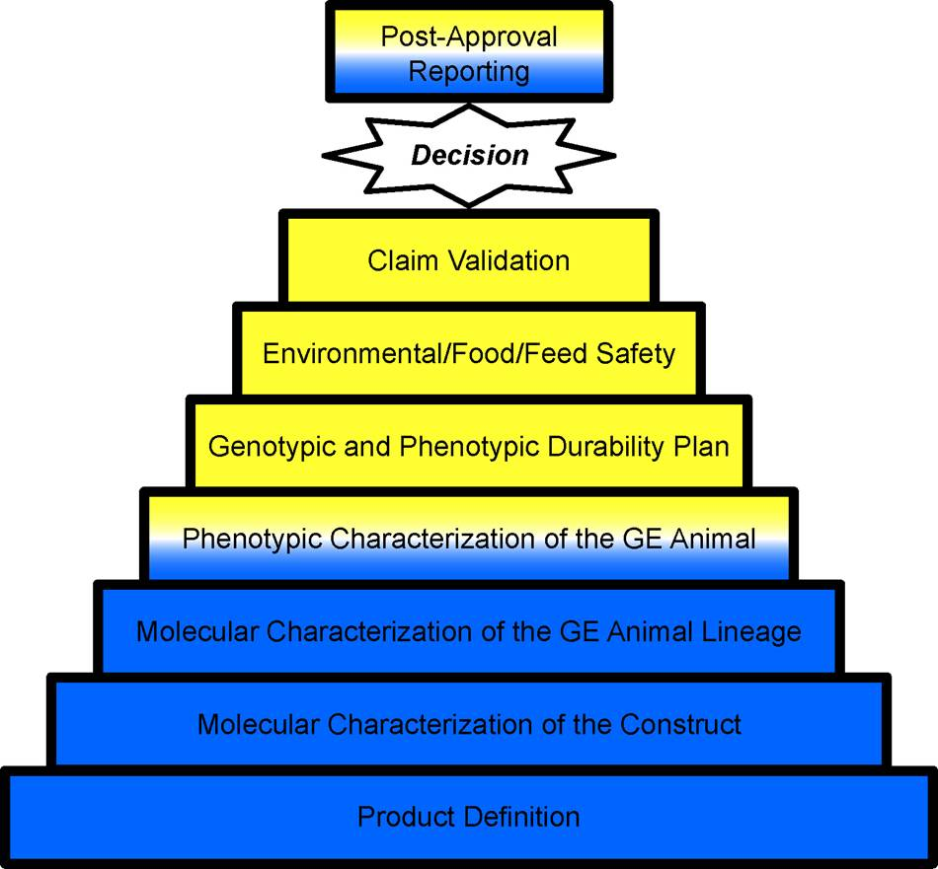
Hierarchical Risk-Based Evaluation (by level)

Slide 7
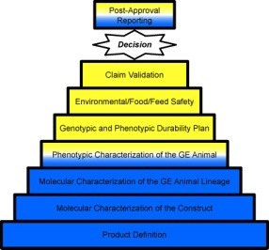
-Product Definition
Broad statement identifying GE animal and claim A specific hemizygous diploid line of domestic goats (Capra aegagrus hircus) containing 5 copies of the Bc6 construct located at the GTC 155-92 site, directing the expression of the human gene for antithrombin (which is intended for the treatment of humans) in the mammary gland of goats derived from Founder 155-92.

Slide 8
Molecular Characterization of the Construct
What is the construct? How is/was it made?
Data/Information Reviewed
Source and description of rDNA intended for GE animal
Construction, including method and intermediate organisms
Sequence of the final product
Potential contaminants in the injection solution
Conclusions
Data adequate to support the Molecular Characterization of the Construct
No hazards intrinsically present in the construct; no
hazardous contaminants

Slide 9
Molecular Characterization of the GE Animal Lineage
What was the result of integration? (including
stable inheritance?)
Data/Information Reviewed
Characterization of construct in the animal
Stability over multiple generations
Expression of the rDNA construct in the animal
Characterization of the expression product
Conclusions
Data adequate to support the Molecular Characterization of the GE Animal Lineage
No hazards posed by the presence of this rDNA
rDNA construct stable over multiple generations

Slide 10
Phenotypic Characterization
Safe for the animal? Does it still function as
a goat? Effect of introduction of rDNA construct?
Health, Husbandry Data/Information Reviewed
Animal breeds, sources
Husbandry methods (e.g., animal identification, housing, feed)
Health management (e.g., health evaluations, preventative procedures, biosecurity measures, health observations)
Animal performance (e.g., growth, reproduction, feed consumption)
Milk production and composition
Production of rhAT in milk

Slide 11
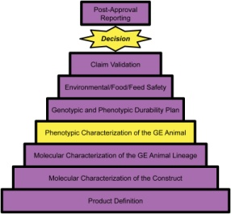
Phenotypic Characterization (2)
Conclusions
Animals housed in high quality conditions; biosecure; highly contained
General health, growth, milk production, and reproduction of multiple generations the 155-92 line of goats comparable to non-GE herd-mates and/or historical comparators
Milk composition of the 155-92 line of goats is comparable to non-GE herd-mates or historical comparators (except for the presence of rhAT)

Slide 12
Genotypic and Phenotypic Durability Plan
Future GE animals equivalent to approved animals?
Information Reviewed
Sponsor-developed plan including:
Testing frequency,
Validated test methods,
Test specifications and reporting schedule,
Lineage replacement and out-of-specification procedures
Conclusion
Submitted plan expected to ensure future consistency of the approved GE animal lineage

Slide 13
Food/Feed Safety
Approval specifically prohibits the use of these animals for food or feed
Information Reviewed
Sponsor affirmation
Animal ID; facilities; containment procedures
Animal/product disposition methods and records
“Regulatory Method” for rDNA identification
Conclusions
Plan submitted expected to ensure that materials from this GE animal lineage will not enter food/feed
Regulatory method available if needed

Slide 14
Environmental Safety
Environmental risks while under confinement?
Likelihood of escape? Potential adverse outcomes associated with escape?
Data/Information Reviewed
Gene construct, GE animal, goat farm (previous steps of review process); containment, handling/disposal of wastes & carcasses
Two site visits; focus on animal health/containment
Conclusions
No environmental risks associated with confined rhAT goats, waste products
Multiple levels of containment make escape unlikely In event of escape without recapture, survival, reproduction, and population establishment in the surrounding environment is highly unlikely

Slide 15
Claim Validation
GE animal does what the product definition claims?
Data/Information Reviewed:
Materials and conclusions of the previous steps
Molecular identification of expression product
Conclusion
155-92 lineage produces rhAT in milk
Data support the product definition for the 155-92 line of goats

Slide 16
Overall Conclusions (NADA)
Characterization of rDNA construct/lineage acceptable
Insertion is stable; adequate plan to ensure that future animals are equivalent to those evaluated for safety and effectiveness
No identified risks to GE animals or the environment
Affirmation of exclusion from food/feed
Acceptable controls and procedures by sponsor
Regulatory method available
rDNA construct effectively produces rhAT

Slide 17
Contact Information
Adrianne.Jacobs@fda.hhs.gov

Slide 18
Acronyms
CBER: US FDA Center for Biologics Evaluation and Research
CVM: US FDA Center for Veterinary Medicine
GE: Genetically Engineered
GFI: Guidance for Industry
ID: Identification
NADA: New Animal Drug Application
rDNA: Recombinant Deoxyribonucleic Acid
rhAT: Recombinant Human Antithrombin
US FDA: United States Food and Drug Administration

