Slide 1
Aquaculture
Jennifer Matysczak, VMD
Leader, Aquaculture Drugs Team
US Food and Drug Administration
Center for Veterinary Medicine
Office of New Animal Drug Evaluation

Slide 2
Topics that will be discussed
Uniqueness of aquaculture drugs
Judicious use of antimicrobials
Sources of information regarding aquaculture drugs

Slide 3
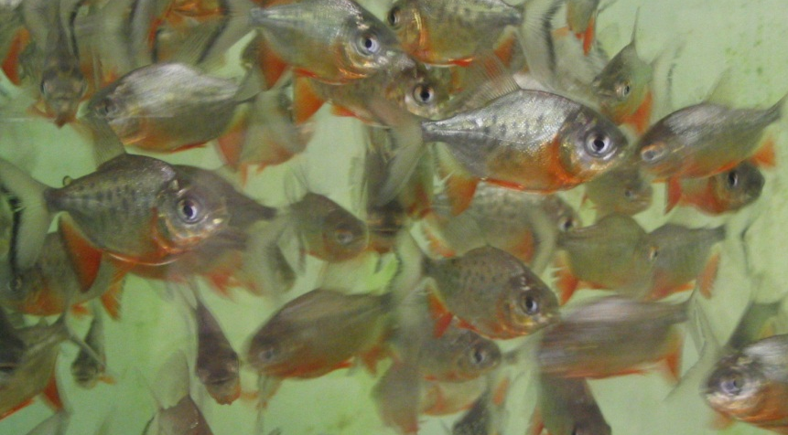
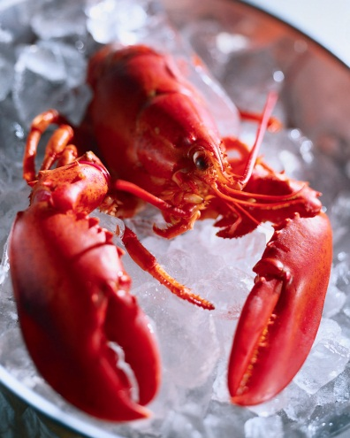
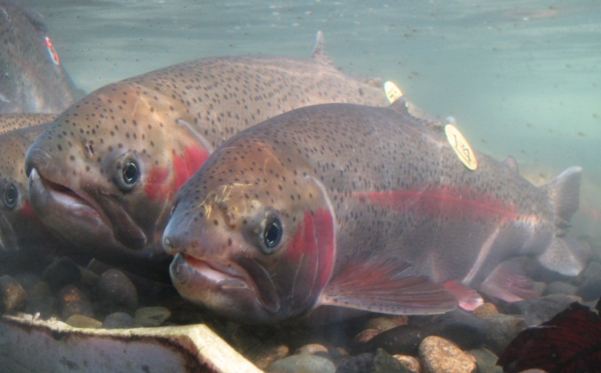
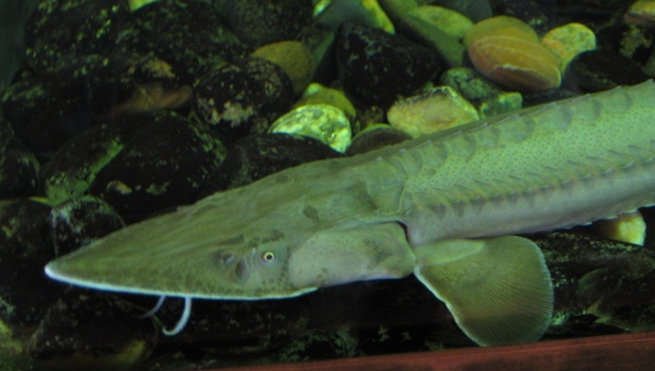
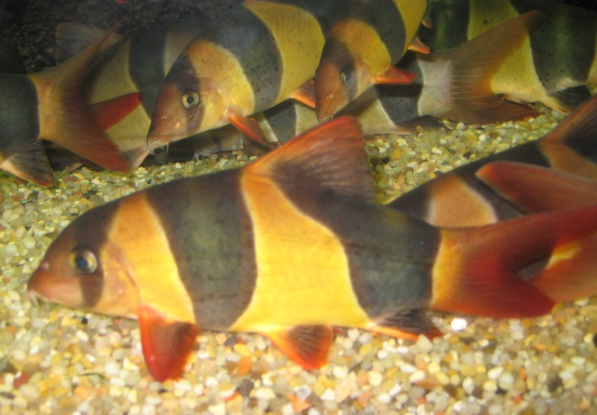
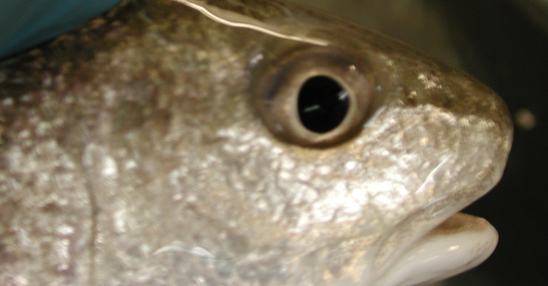
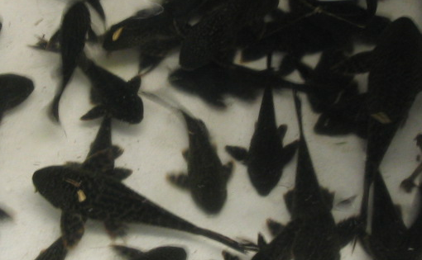
Aquaculture includes a large number of species.
Finfish
Freshwater
Saltwater
Shellfish

Slide 4
Fish may be raised (farmed) for
Human consumption (e.g. catfish, salmon, trout, tilapia)
Restoring native populations in the wild
Stocking for fishing
Bait
Aquariums/hobby

Slide 5
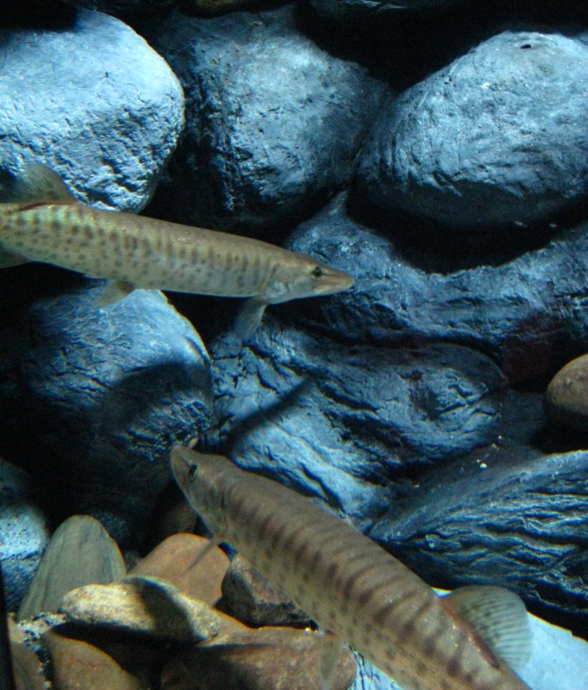
Freshwater-reared finfish
Coldwater species
Family Salmonidae
Coolwater species
Includes walleye, muskellunge and perch
Warmwater species
Includes catfish, tilapia, many ornamental fish

Slide 6
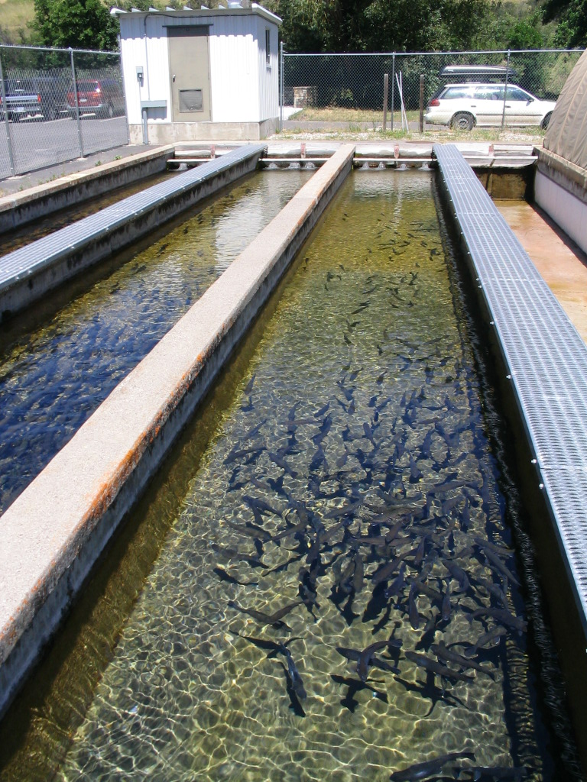
Rearing systems
Flow-through systems
Recirculating systems
Ponds
Netpens
There is also a need for a sedative that can be used streamside.

Slide 7
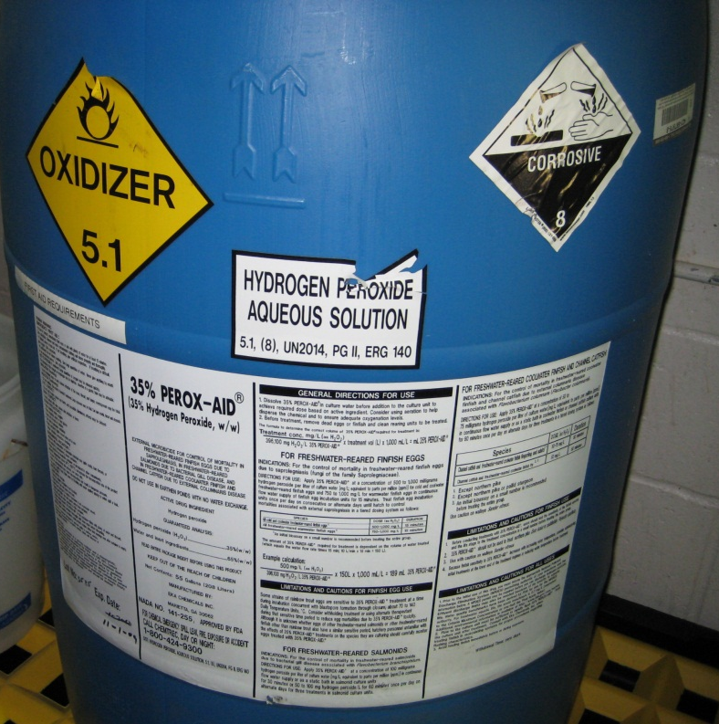
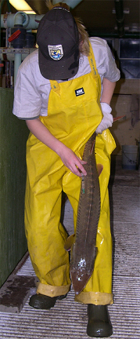
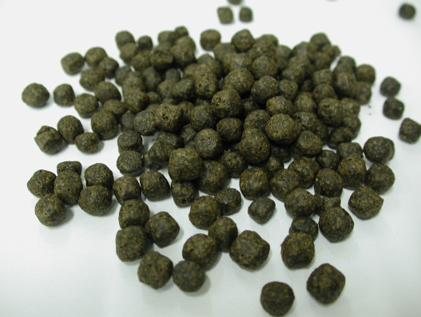
Routes of administration
Medicated feed
Immersion
Injection

Slide 8
Most common indications
Control of mortality associated with a specific bacterial pathogen
Treatment and control of a parasite
Spawning aid
Sedation or anesthesia
Skeletal marking
Claims may be for specific life stages.

Slide 9
Judicious Use of Antimicrobials

Slide 10
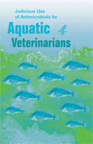
Educational material published in cooperation with the American Veterinary Medical Association

Slide 11
International working groups
Joint FAO/OIE/WHO Expert Consultation on Antimicrobial Use in Aquaculture and Antimicrobial Resistance (2006)
Codex Alimentarius Ad-Hoc Task Force on Antimicrobial Resistance (2007-2010)
FAO Expert Workshop on Improving Biosecurity through Prudent and Responsible Use of Veterinary Medicine (Antimicrobials) in Aquatic Food Publication (2009)

Slide 12
OIE Aquatic Animal Health Code
Recommendations for Members to address the selection and dissemination of resistant micro-organisms and antimicrobial resistance determinants from the use of antimicrobial agents in aquatic animals
Chapters adopted:
Chapter 6.2- Introduction to the recommendations for controlling antimicrobial resistance
Chapter 6.3- Principles for responsible and prudent use of antimicrobial agents in aquatic animals
Chapter 6.4- Monitoring of the quantities and usage patterns of antimicrobial agents used in aquatic animals
Chapter 6.5- Development and harmonisation of national antimicrobial resistance surveillance and monitoring programmes for aquatic animals

Slide 13
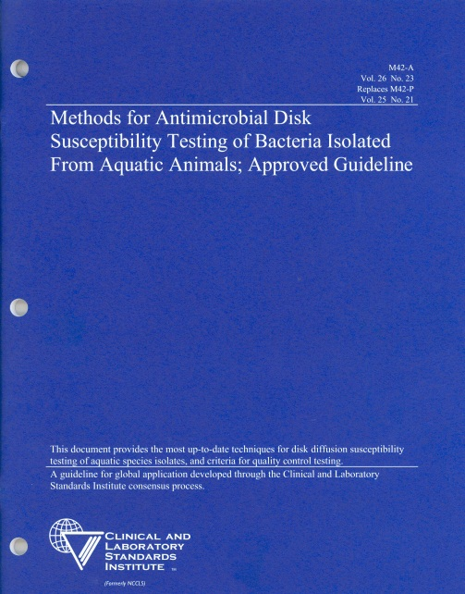
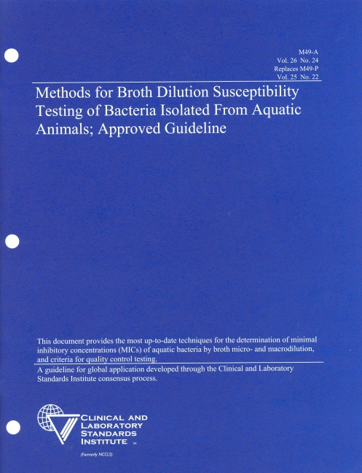
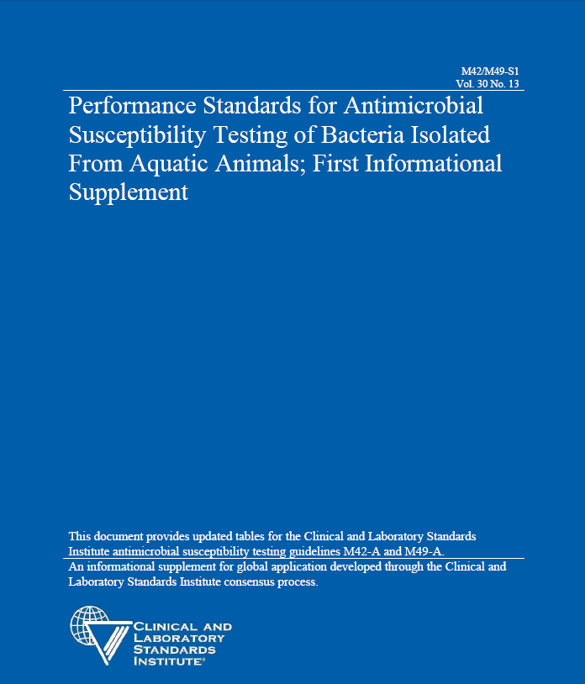
Clinical and Laboratory Standards Institute
Aquaculture Guidelines for In Vitro Antibiotic Susceptibility Testing
Disk diffusion testing
MIC testing
Interpreting test results

Slide 14
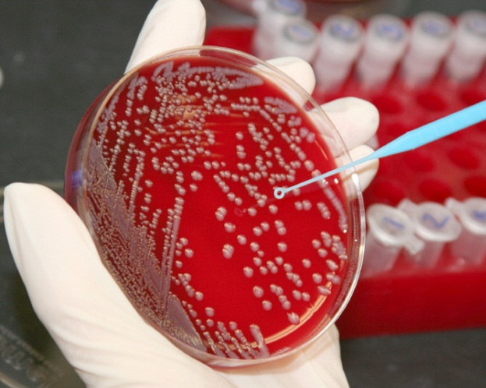
Ongoing Research (CLSI)
Standardizing methods and criteria for interpreting test results for fastidious bacterial pathogens of fish including:
Flavobacterium columnare/psychrophilum
Streptococcus spp. (including S. phocae)
Vibrio spp.

Slide 15
Sources of Information

Slide 16
Listings of approved drugs
US Code of Federal Regulations
CVM website
“Animal Drugs @ FDA” database
Aquaculture drugs page
The Index of Legally Marketed Unapproved New Animal Drugs for Minor Species is also available on the CVM website on a separate page.

Slide 17
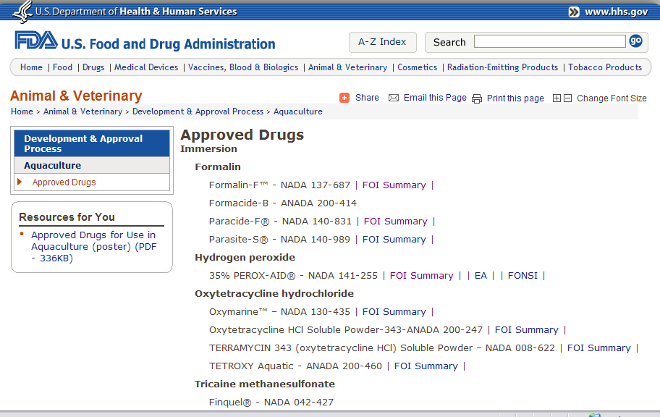

Slide 18
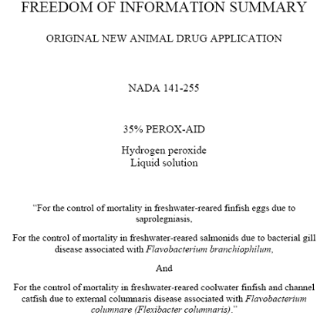
Approval documents
Available on the CVM website or by written request to FDA:
Freedom of Information Summaries
Environmental Assessments and Findings of No Significant Impact or Environmental Impact Statements

Slide 19
Public Master Files
Established to share resources intended to support drug approvals using public information
Listed on the FDA/CVM website

Slide 20
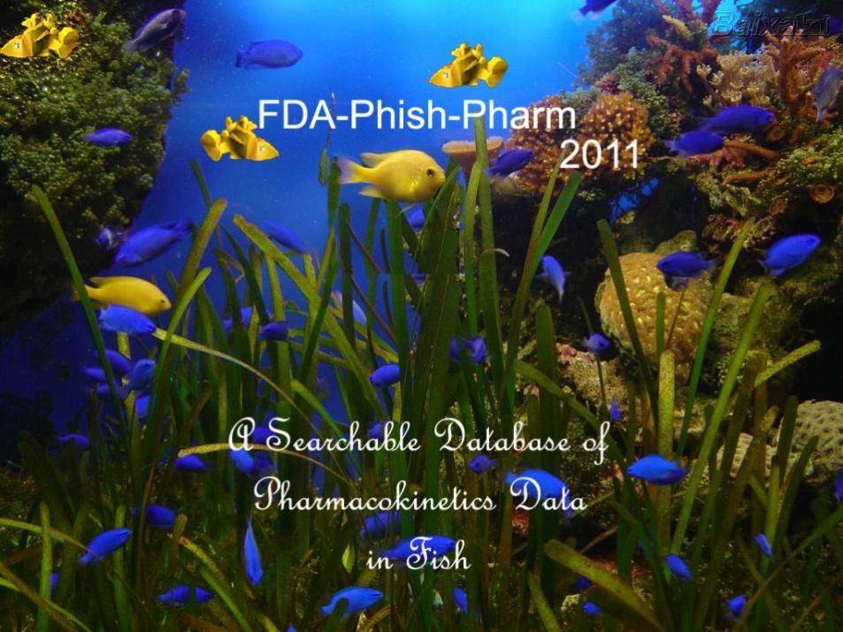
Phish-Pharm: Searchable Database of Pharmacokinetic Data in Aquatic Animals Free On FDA’s website http://www.fda.gov/AnimalVeterinary/ScienceResearch/ToolsResources/Phish-Pharm/default.htm

Slide 21
Components of the database (Phish-Pharm)
This database consists of more than 500 articles that include data from 90 species (64 genera) of fish
Data fields include:
genus, species
water temperature
average animal weight
sample types analyzed
drug (or chemical) name
dosage, route of administration
metabolites identified
methods of analysis
PK parameters: protein binding, clearance, volume of distribution in a central compartment (Vc), volume of distribution at steady-state (Vd), drug half-lives (t½)

Slide 22

To conclude
Additional videos in this series are informative
Additional information is available on our website
We encourage collaboration

