Slide 1
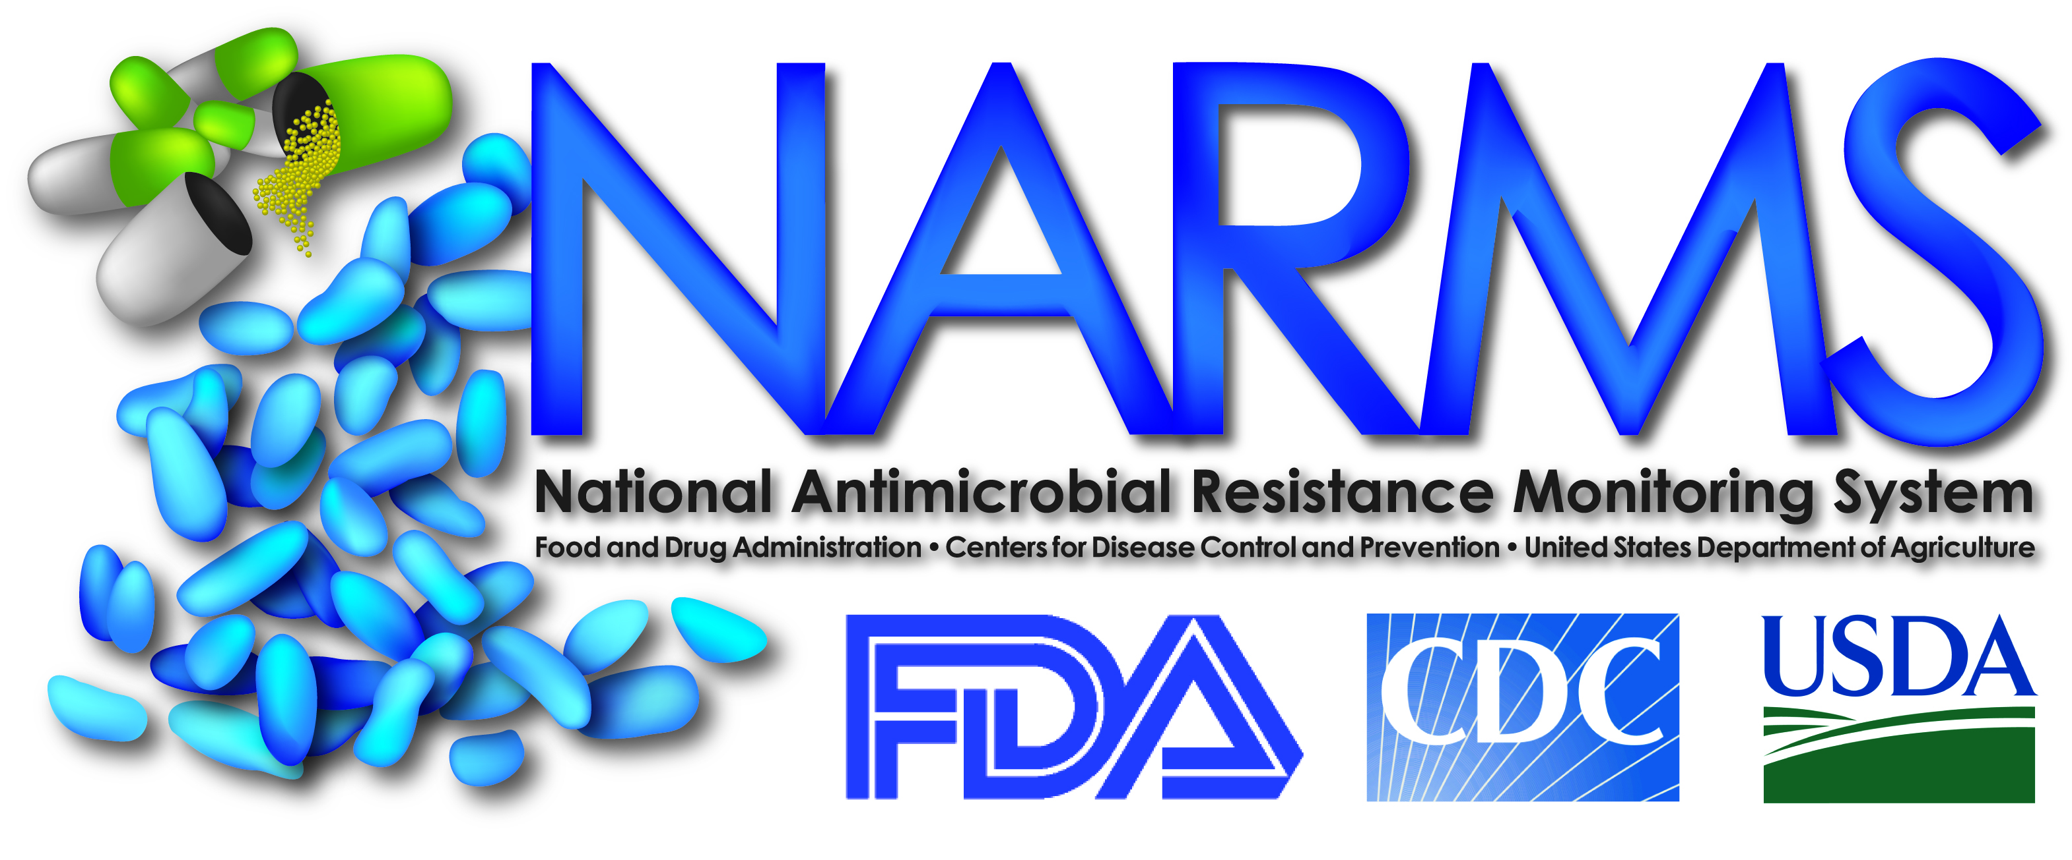
The National Antimicrobial Resistance Monitoring System
Patrick McDermott, Ph.D.
Director, The National Antimicrobial Resistance Monitoring System
U.S. Food & Drug Administration
Center for Veterinary Medicine
Office of Research
Laurel, MD USA

Slide 2
Uses of Antimicrobials in Food Animal Production Where Food & Drugs Collide
Therapy - to treat diseased animals
Metaphylaxis - to control outbreaks of disease
Prophylaxis - to prevent infections
Feed efficiency - to increase feed efficiency (sub-therapeutics, growth promotants, health maintenance)
Most controversial, since drugs are administered continuously to health animals
Complicated by overlapping prevention claims
CVM does not consider this as prudent use

Slide 3
CVM Strategy
Multi-pronged approach that includes:
Enhanced surveillance activities (NARMS) 1996
Revised safety assessment process (GFI #152) 2003
Revised guidelines to phase out production claims (GFI #209) 2012
Industry guidance on phasing out production claims (GFI #213) 2012
Update on veterinary feed directive 2012
Expanded research activities
Education/outreach activities
Participation in international activities (WHO, PAHO, OIE, Codex)
Notes:
2

Slide 4
Challenges of Integrated Surveillance for Antimicrobial Resistance
Gathering and integrating information is expensive and laborious
Burden of illness and food consumption data are needed for design and prioritization of pathogens and commodities
Sound sampling scheme along the food chain is critical
Cooperation of, and good communication between, agriculture and public health sectors
Collaboration and information sharing between laboratorians epidemiologists and public health officials within and across sectors

Slide 5
Challenges of Integrated Surveillance for Antimicrobial Resistance
Political/financial support - Requires recognition of the public health issues and the need for ongoing risk assessments
Remain flexible in order to stay current
Establish a process for review and enhancement
Understanding the implications of the data and the need for research
Publishing findings to different audiences in a timely manner
Using the data to formulate sound public health policy
International harmonization and cooperation

Slide 6
NARMS Objectives
Dedicated to the protection of human and animal health
Through integrated monitoring of foodborne AMR
Dedicated to the protection of human and animal health
Through integrated monitoring of foodborne AMR
Monitor trends in antimicrobial resistance among foodborne bacteria from humans, retail meats, and animals
Disseminate timely information on antimicrobial resistance to promote interventions that reduce resistance among foodborne bacteria
Conduct research to better understand the emergence, persistence, and spread of antimicrobial resistance
Assist the FDA in making decisions related to the approval of safe and effective antimicrobial drugs for animals

Slide 7
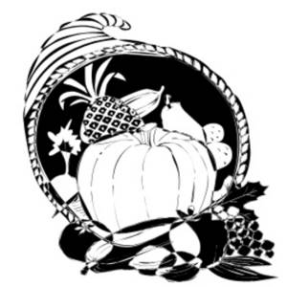
Under Revision
Human Population
Retail Meats
Animal Population
10 FoodNet States & PDH
ORA Imported Foods
NAHMS
Farm
FSIS Abattoir
HAACP (W, E, MW)
Eastern FSIS
Abattoir
Physician Visit
Local Lab
State Lab
State Lab
Report
Report
Report
USDA
CDC
FDA
Campylobacter
NARMS Integrated
Report
Salmonella
Enterococcus
E. coli
Notes:
CDC For Salmonella: started with 14 sites in 1996 and was nationwide by 2003. Includes 53 labs in all 50 states for Salmonella. For Campylobacter – started with 5 sites in 1997 and now from all 10 FoodNet sites
USDA – FSIS HAACP Salmonella isolates are collected at federally inspected slaughter and processing plants (from carcass rinsates, carcass swabs, and ground products), and sent to the Western, Eastern, and Midwestern labs, then forwarded to the ARS lab in Athens, GA. The other three NARMS organisms are isolated only from chicken carcasses received at the Easter FSIS lab.
FDA – Tests retail meats from 14 States in 2013. Each state collects 10 packages each of pork chops, chicken breasts, ground turkey and ground beef on a monthly schedule and cultures for all 4 NARMS bacteria.

Slide 8
Salmonella Serotype Distributions – 2010
Notes:
Understanding the serotypes predominant in different food animal species can help understand the sources of salmonellae infecting humans.

Slide 9
Ceftriaxone Resistance by Serotype
*
*2011 is preliminary
Notes:
NARMS data show how important resistances are spreading in different serotypes, information that can help identify use practices and environments where mitigations might be implemented.

Slide 10
Salmonella Resistant to Ceftriaxone: 1996-2009
Notes:
Resistance trends in salmonellae from specific animal reservoirs helps understand the sources of resistance. Here we see that ceftriaxone-resistant is common in cattle sources.

Slide 11
Salmonella Newport Resistant to Ceftriaxone: 1996-2009
Notes:
Combining serotype information shows that cattle are a likely source of ceftriaxone-resistant S. Newport specifically.

Slide 12
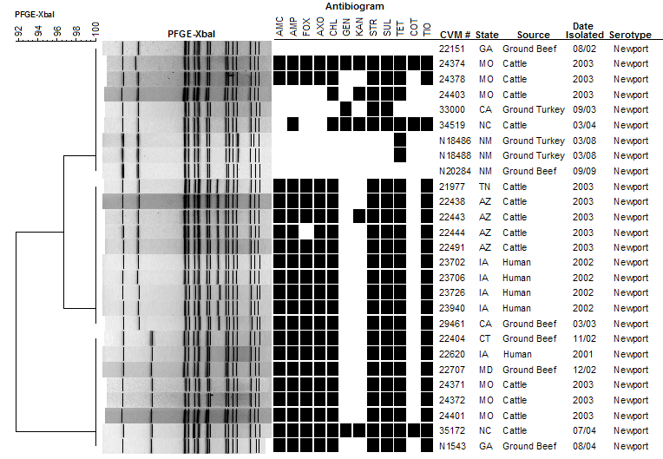
MDR-AmpC of S. Newport from Animals, Meats and Humans
A
B
C
Notes:
Pulsed field gel electrophoresis (PFGE) uses enzymes to cleave DNA into fragments, forming a pattern of DNA bands. This information is used to compare Salmonella strains for genetic relatedness. When combined with other information such as source, date, geographic location, antibiotic resistance and serotype, this information can greatly aid in understanding the evolution and spread of resistance and help in outbreak investigations.

Slide 13
NARMS/PulseNet
Salmonella and Campylobacter isolates undergo further molecular characterization
PFGE analysis
Follow CDC guidelines for PFGE analysis
Data is shared with PulseNet
CVM PulseNet database has more than 12,000 data entries, including
8,380 Salmonella
3,439 Campylobacter
547 E. coli
69 Vibrio
Isolates can be used for future research projects
Attribution
Virulence studies
Antimicrobial resistance studies
Method development

Slide 14
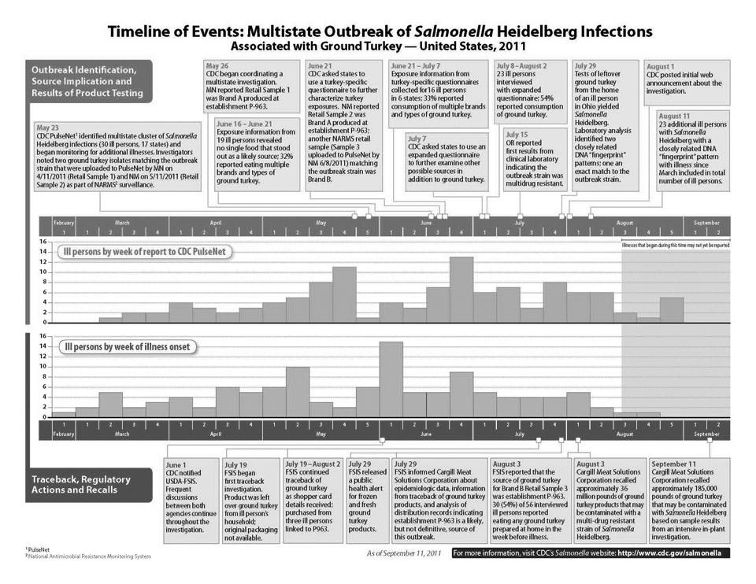
Notes:
This slide shows how the NARMS database was used in a major outbreak to help identify the food source carrying the outbreak strain of Salmonella Heidelberg.

Slide 15
NARMS Research to Support FDA’s Mission
Determine the genetic diversity within bacterial populations to understand the movement of bacteria through the food chain
Collaborations with CFSAN-MRC and CFSAN-College Park
US-EU consortium on NGS
Characterize genetic mechanisms of resistance
Collaborations with many partners at universities (Univ. MD) and government (CFSAN, CDC, USDA)
Examine the role of animal feeds in the ecology of resistance
ORA - feeds and imports surveillance

Slide 16
History of the National Antimicrobial Resistance Monitoring System (NARMS) and Related Regulatory Activities
First annual NARMS executive
report
published (2/07)
Joint meeting of VMAC and Anti-Infective Drugs Advisory Committee—surveillance recommended (5/94)
NARMS external review at CDC (8/04)
NARMS Strategic Plan 2012-2016
published (5/12)
FDA Science Board NARMS review (4/07)
NARMS History
NARMS animal testing began, USDA
FDA Science Board review of CVM research, with NARMS follow-up (8/09)
NARMS retail meat testing began, FDA
NARMS human testing began, CDC
NARMS expert review at FDA
(6/05)
1994 1995 1996 1997 1998 1999 2000 2001 2002 2003 2004 2005 2006 2007 2008 2009 2010 2011 2012
Sarafloxacin approved for poultry (8/95, 10/95)
Sarafloxacin approvals
for poultry withdrawn (4/01)
GFI #152 Evaluating Safety of New Animal Antimicrobial Drugs (10/03)
Initial cephalosporin ELU prohibition order published (7/08)
Related Regulatory Activities
Campylobacter risk assessment (10/00)
Enrofloxacin approval for poultry
withdrawn
(9/05)
Revised cephalosporin ELU prohibition order (published 1/12, effective 4/12)
Enrofloxacin approved for poultry (10/96)
NOOH for enrofloxacin in poultry published (10/00)
Draft GFI #209 Judicious Use of Medically Important Antimicrobial Drugs in Food-Producing Animals (6/10)
Cefquinome
VMAC meeting
(9/06)
Tulathromycin
VMAC meeting
(10/04)
NARMS scientific public meeting
CVM FDA Center for Veterinary Medicine
ELU Extralabel use
GFI Guidance for industry
NOOH Notice of opportunity for hearing
VMAC Veterinary Medicine Advisory Committee
Hatchery survey conducted by CVM due to cephalosporin resistance in NARMS Salmonella isolates (9/01)
Final GFI #209,
draft GFI #213 (aligning product
use conditions)
published (4/12)
Virginiamycin risk assessment (11/04)
Notes:
This slide shows the history of NARMS and regulatory activities (items below arrow) related to NARMS data.

Slide 17
Strengths of NARMS
Comprehensive susceptibility data can be used for regulatory decision making, including pre-approval of new animal antibiotics
Most extensive national program for integrated laboratory based surveillance of bacteria in foods
Only national program that provides routine isolates for analysis
Provides ongoing baseline data on the prevalence of specific pathogens in the food supply
Leverages existing public health infrastructure
Partnership with FoodNet, PulseNet, USDA-FSIS, and ORA

Slide 18
Strengths NARMS
Is a recognized model for international capacity building and technical standards
Infrastructure for hypothesis-driven food hazard analyses
Robust intramural and extramural research activities broadly valuable to understanding microbial food safety
A rich source of reference data valuable for outbreak detection and response
Strong stakeholder support
Dedicated and exceptional staff of Microbiologists and Epidemiologists

Slide 19
Acknowledgments
NARMS FDA
NARMS CDC
NARMS USDA
Dr. Heather Tate
Dr. Shaohua Zhao
Dr. Daniel Tadesse
Jason Abbott
Sherry Ayers
Sonya Bodeis-Jones
Emily Crarey
Sharon Friedman
Stuart Gaines
Carol Henderson
Claudine Kabera
Claudia Lam
Sampa Mukherjee
Jonathan Sabo
Thu Thuy-Tran
Shenia Young
Dr. Jean Whichard
Dr. Beth Karp
Dr. Maria Karlsson
Dr. Jason Folster
Dr. Felicita Medalla
Regan Rickert
Kevin Joyce
Rebecca Howie
Allison O’Donnell
Jared Reynolds
Julian Grass
Melissa Pitcher
Andre McCullough
Julia Taylor
Dr. Paula Fedorka-Cray
Jovita Haro
Dr. Jonathan Frye
Dr. Charlene Jackson
Takiyah Ball
Tiffanie Woodley
Jodie Plumblee
Dr. Mary Torrence

Slide 20
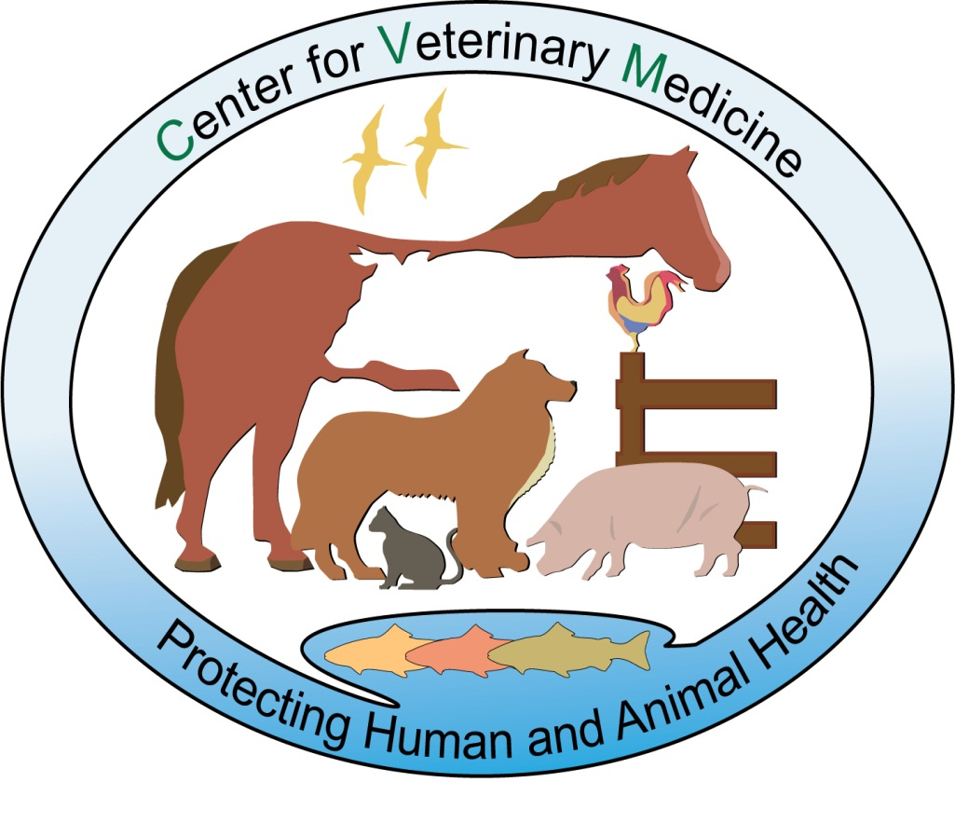
http://www.fda.gov/AnimalVeterinary/SafetyHealth/AntimicrobialResistance/ NationalAntimicrobialResistanceMonitoringSystem/default.htm

