Slide 1

An Overview of Minor Use & Minor Species Issues in the U.S.A.
Meg Oeller, DVM Office of Minor Use & Minor Species Animal Drug Development
FDA/CVM Rockville, MD Summer, 2012

Slide 2

Today’s Questions
What are Minor Uses & Minor Species?
Why are they important?
What are the challenges?
What is needed for approval?
What laws and policies exist to increase drug availability?
What incentives are available?
What partnerships exist?

Slide 3
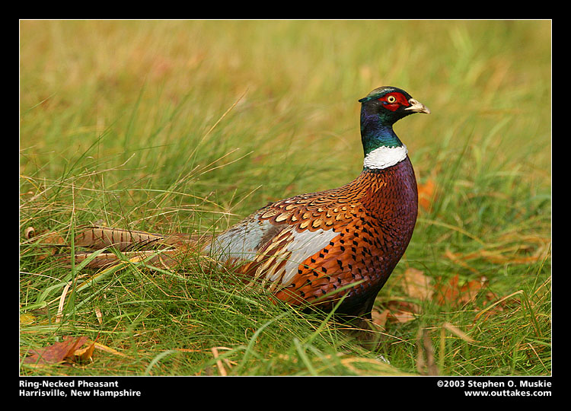
What are Minor Uses & Minor Species (MUMS)?

Slide 4

Definitions
Minor Species – ALL animals other than humans that aren’t major species

Slide 5
Important Minor Species in the USA
Sheep & Goats
Farmed Deer & Bison
Gamebirds (pheasant, partridge, quail)
Food fish (catfish, salmon, trout, tilapia…)
Crustaceans (shrimp, lobsters)
Honey bees
Pet birds, Ornamental Fish, Ferrets
Zoo animals & Wildlife

Slide 6

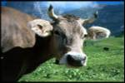





Major Species in the USA
Cattle
Swine
Chickens
Turkeys
Horses
Dogs
Cats

Slide 7
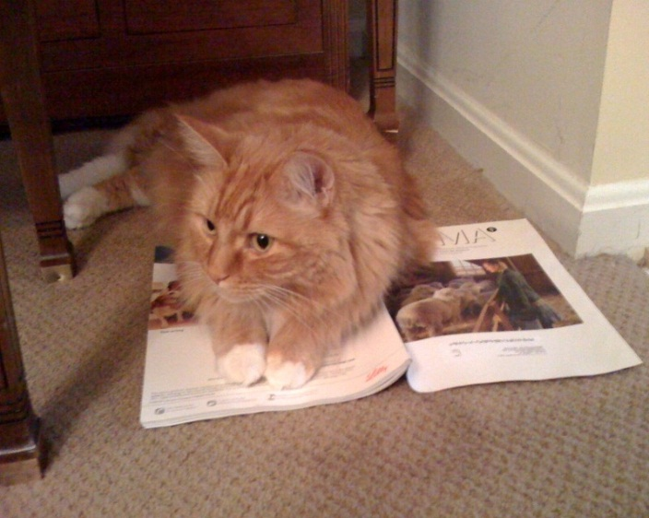
Minor Use in a Major Species
The intended use of a drug in a major species for an indication that occurs infrequently and in only a small number of animals, or in limited geographic areas and in only a small number of animals annually.

Slide 8
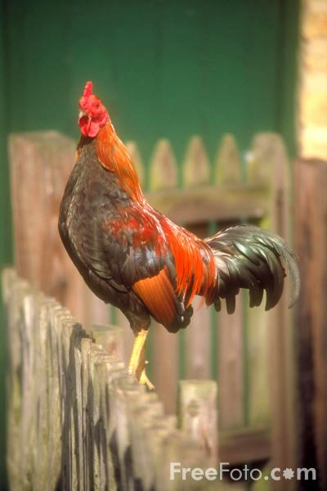
The Small Numbers are:
50,000 Horses
70,000 Dogs
120,000 Cats
310,000 Cattle
1,450,000 Pigs
14,000,000 Turkeys
72,000,000 Chickens

Slide 9
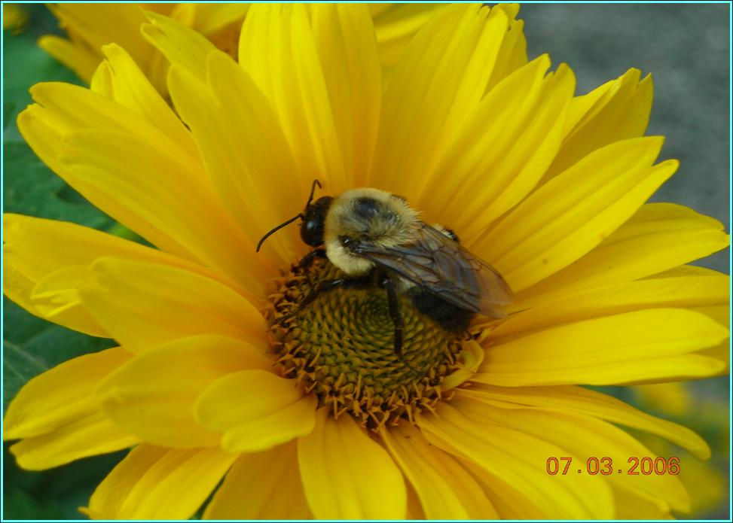
Why are Minor Species Important?

Slide 10
Value to U.S. Agriculture (U.S. Economic Impact)
Dairy Goats $461,000,000
Rabbits $873,000,000
Meat Goats $1,092,000,000
Deer $3,152,000,000
Aquaculture $3,193,000,000
Sheep $4,728,000,000
Gamebirds $5,253,000,000
Honey Bees $16,810,000,000
TOTAL $35,562,000,000

Slide 11
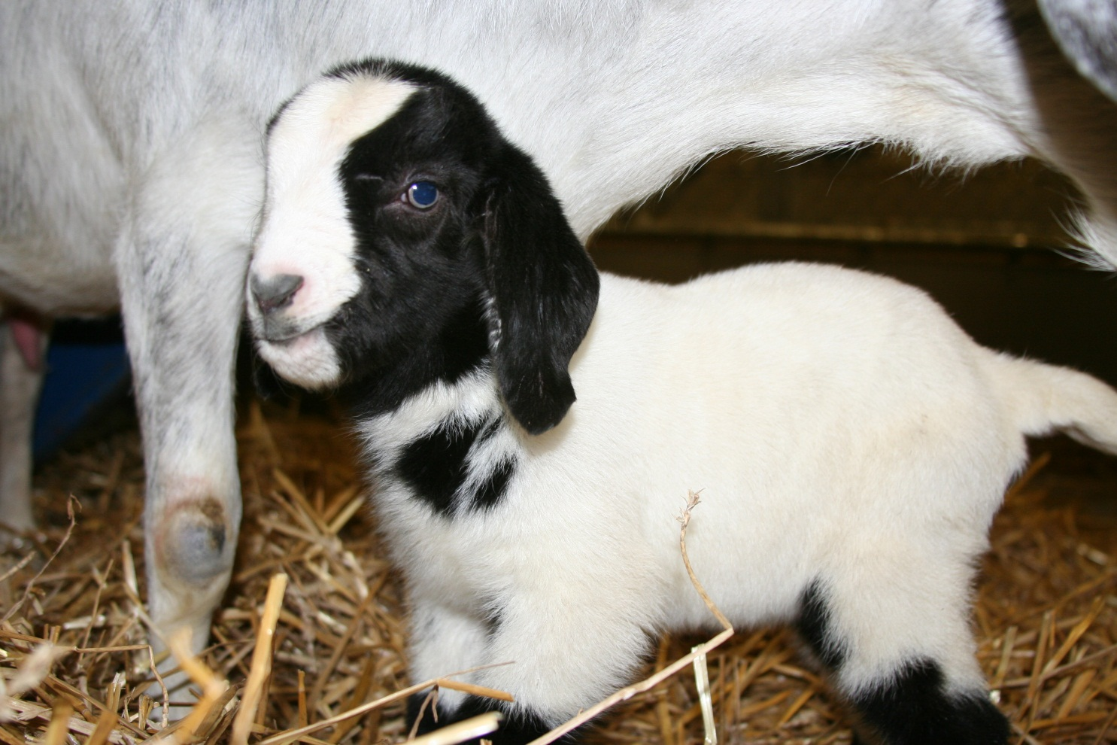
What are the Challenges?

Slide 12
Number of Original NADA Approvals for Minor Species
53 - Sheep - 25 drugs
13 - Goats - 8 drugs
1 for Salmon
7 - Catfish - 5 drugs
14 - Finfish - 10 drugs
3 for Pheasants
2 for Partridges
10 for Quail - 5 drugs
7 - Bees - 4 drugs
4 - Ducks
4 for Shrimp/lobster
1 for Bison
Some not marketed
Most minor species have 0 drugs approved
Compare to > 400 for cattle & for swine or > 500 for dogs

Slide 13

Why do MUMS Drugs Need Help With Drug Approval?
Drug approval is expensive
Drug approval is specific
Markets for these uses are small
e.g., 6 million sheep in the U.S. is a small population of animals

Slide 14
Drug Approvals for MUMS are important
Even if legal extra-label use is an option, an approval provides
Species specific dosing information
Accurate withdrawal times
Extra-label use is not legal for medicated feeds – often the only practical way to treat minor species (aquaculture, game birds…).
Limited enforcement discretion.

Slide 15
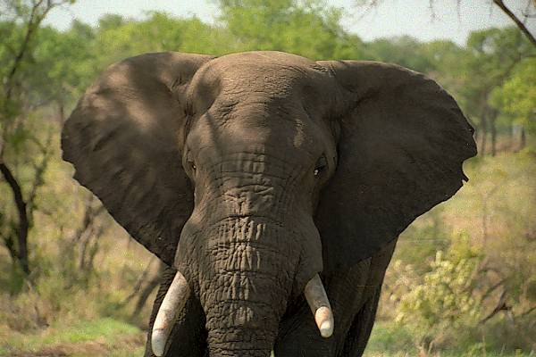
What Is Needed for Approval?

Slide 16
A New Animal Drug Application (NADA) contains:
Effectiveness technical section
Target Animal Safety
Human Food Safety (for food-producing spp.)
Environmental Assessment
Chemistry, Manufacturing, & Controls
Labeling
All Other Information (AOI)
Freedom of Information Summary (FOI)

Slide 17

What Laws & Policies Exist to Increase Drug Availability for MUMS?

Slide 18

Laws
Food, Drug, & Cosmetic Act amended by:
AMDUCA
ADUFA
MUMS Act

Slide 19
The Laws Spelled Out
AMDUCA – Animal Drug Use Clarification Act of 1994 – legalized extra-label use.
ADUFA – Animal Drug User Fee Act of 2003 – allows collection of fees to support the drug approval process.
MUMS Act – Minor Use & Minor Species Animal Health Act of 2004 – provides incentive programs & Indexing.

Slide 20
CVM Policies & Programs
Some data extrapolation allowed.
Flexibility in meeting requirements.
Use of literature.
Incentive programs.
Liaison to USDA’s minor use animal drug program – NRSP-7 (National Research Support Project #7).
Indexing as an alternative.

Slide 21
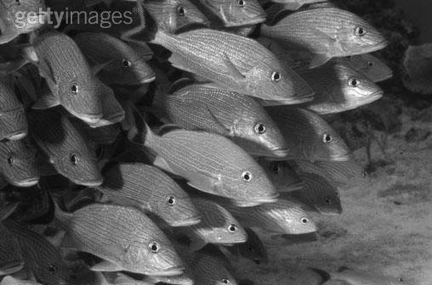
What incentives exist for Approvals?

Slide 22

Incentives to sponsors
Designation
Exclusive marketing rights
MUMS grants
User fee waivers
Conditional approval
NRSP-7 Liaison
Other outreach services

Slide 23
For more details see:
Designation list:
http://www.fda.gov/AnimalVeterinary/ DevelopmentApprovalProcess/MinorUseMinorSpecies/ucm125445.htm
NRSP-7 Program:
http://www.nrsp7.org

Slide 24
Indexing – an alternative
The index of legally marketed unapproved drugs for minor species.
Only for non-food producing minor species (not minor uses).
Not approved for this use.
Based on evaluation by an outside expert panel acceptable to CVM.
No extra-label use.
Much faster and less expensive.

Slide 25
The Index List
See:
http://www.fda.gov/AnimalVeterinary/ DevelopmentApprovalProcess/Minor UseMinorSpecies/ucm125452.htm

Slide 26
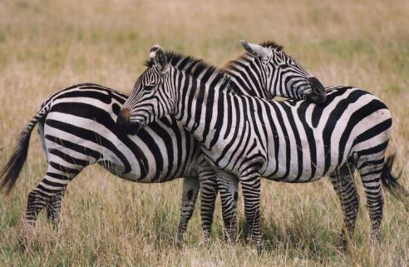
What Partnerships Exist to Support Approvals?

Slide 27
Who else can help and how?
Since pharmaceutical sponsors may not be motivated to seek these approvals, other stakeholders have tried to help.
An effective way is to lower the cost of the approval through providing needed data to support safety and effectiveness.
Interested parties include: other government agencies, university researchers, & producer groups.

Slide 28
Who does what?
The pharmaceutical company must:
Provide the Manufacturing technical section
Provide labeling
Draft an FOI Summary
Provide AOI
File the New Animal Drug Application (NADA)
An outside group can provide the technical sections for:
Effectiveness
Target animal safety
Human food safety
Environmental safety

Slide 29
How does this work?
Investigational New Animal Drug (INAD) files established.
Public research partners submit protocols & study reports to their files.
Pharmaceutical sponsor’s file is proprietary – not made public – contains manufacturing, labeling, and other information.

Slide 30
Public Master File
As each technical section is completed it is posted on the FDA website.
See: http://www.fda.gov/AnimalVeterinary/ DevelopmentApprovalProcess/Minor UseMinorSpecies/ucm279384.htm
Research partners are credited and multiple entities can work on a single project.

Slide 31

APPROVAL!!
The Pharmaceutical Company files a New Animal Drug Application (NADA) using its own (already accepted) technical sections by reference and the new technical sections from the PMF - also by reference.
A minimal cost approval for the sponsor.

Slide 32
In Conclusion
Minor species and minor uses have many unmet needs for legally available new animal drugs.
These species are important.
Many incentives, policies, and programs exist to assist.
Legal status provides important label information to promote safe and effective use.

Slide 33
For Further Information
Contact:
The International Programs Staff
and browse our website:
http://www.fda.gov/AnimalVeterinary/DevelopmentApprovalProcess/MinorUseMinorSpecies/default.htm

Slide 34
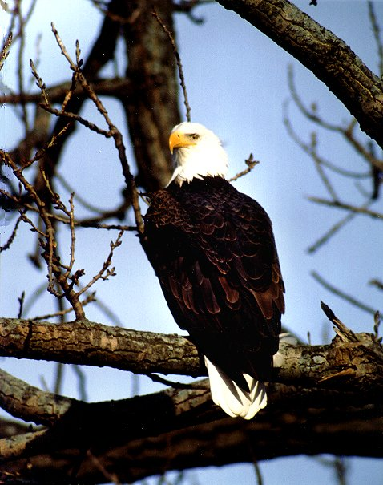
Thank you!

