Slide 1

Human Food Safety of New Animal Drugs: Residue Chemistry
Julia A. Oriani, PhD
Division of Human Food Safety
Residue Chemistry Team

Slide 2
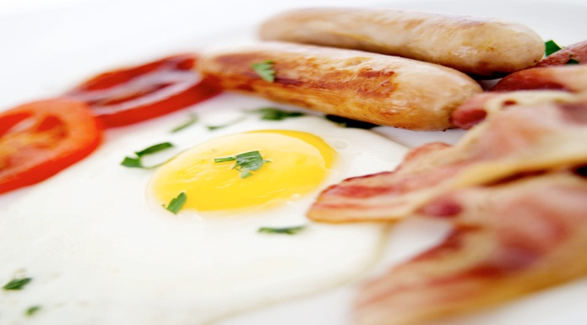
Human Food Safety Evaluation
The purpose of a human food safety evaluation is to determine when the edible tissues in food-producing animals treated with a new animal drug are safe for humans to consume.
Notes:
2

Slide 3
Human Food Safety Evaluation
The evaluation of safety is based on risk assessment principles
Risk = Hazard x Exposure
Hazard: toxicity, antimicrobial resistance
Exposure: potential human exposure to drug residues through consumption of edible tissues

Slide 4
Human Food Safety Assessment
Toxicology
ADI,
Safe Concentrations
Microbial Food Safety
Antimicrobial
Resistance,
human intestinal flora
Residue Chemistry
Tolerance/MRL,
Regulatory Method
Withdrawal Period,
Milk Discard Time

Slide 5
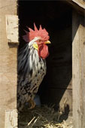
Residue Chemistry Topics
Residue Chemistry Studies
Total residue and metabolism study to establish tolerance
Tolerances vs. MRLs
Tissue residue depletion study to calculate withdrawal period
Import Tolerances

Slide 6
Objective of Residue Chemistry Studies
Mitigate the hazard identified in the toxicology or microbial food safety studies by controlling exposure.
Risk = Hazard x Exposure

Slide 7

Definition of Residue:
Any compound present in the edible tissues after treatment with the new animal drug.
Includes parent drug, metabolites, and any substance formed in or on food.
The definition is broad enough to include resistant bacteria.
Notes:
First, it’s important to define what a residue is. The definition of a residue is shown in this slide. A residue is the compound present in the edible tissues after treatment with the drug. Residues are the parent drug, metabolites, and any substances formed in or on food. The definition is broad enough to include resistant bacteria.

Slide 8
Edible tissues for all food-producing animals:
Muscle
Liver
Kidney
Fat/Skin
Milk
Eggs
Honey

Slide 9
VICH Safety Guidelines Implemented as FDA/CVM Guidance for Industry (GFI)
VICH GL# | CVM GFI# | Subject
GL46 | GFI 205 | Metabolism Study to Determine the Quantity and Identify the Nature of Residues (MRK)
GL47 | GFI 206 | Comparative Metabolism Studies in Laboratory Animals
GL48 | GFI 207 | Marker Residue Depletion Studies To Establish Product Withdrawal Periods
GL49 | GFI 208 | Validation of Analytical Methods used in Residue Depletion Studies

Slide 10
Residue
Chemistry
Studies
1. Total Residue
and Metabolism Study
2. Comparative
Metabolism Study
3. Analytical Methods
4. Tissue Residue
Depletion Study
laboratory
laboratory
Field conditions
Marker Residue
Target Tissue
Tolerance
Withdrawal Period
Milk Discard Time

Slide 11
Total Residue and Metabolism Study
laboratory study
radiolabeled drug administered to target animal
1-1.5X the proposed dose
proposed route of administration
intended duration of treatment/steady state
edible tissues are collected and analyzed for total residues and for metabolic profile

Slide 12
Total Residue and Metabolism Study
measures total residues (close to 100%) in edible tissues.
identifies metabolic profile (parent drug, metabolites) in edible tissues.
determines the marker residue.
determines the target tissue.

Slide 13
Total Residue and Metabolism Study
Definition of MARKER RESIDUE
The parent drug or metabolite in a known relationship to the concentration of total residue in the edible tissue
Tilmicosin (parent)
22,23-dihydroavermectin B1a (metabolite)
Definition of TARGET TISSUE
The edible tissue selected to monitor for the total residues in the food-producing animal – unique to FDA
Generally, the edible tissue from which residues deplete most slowly
Often, liver or kidney
Rarely, muscle or fat

Slide 14
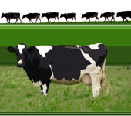
Definition of Tolerance
The concentration of the marker residue in the target tissue at the time the total radiolabeled residue in the target tissue has depleted to less than the target tissue safe concentration (total residues permitted in each tissue).

Slide 15
Selecting a Tolerance – Depletion of Total Radiolabeled Residues to Safe Concentration and Depletion of Marker Residue to Tolerance
1000.0
Total Radiolabeled Residues
100.0
Safe Concentration
10.0
Drug Concentration
1.0
Marker Residue
Tolerance
0.1
0.01
1
2
3
4
5
Time (days)

Slide 16
Example: Setting the Tolerance for Pirlimycin Mean total radioactivity in milk of cows receiving two doses of 50 mg pirlimycin/quarter
Milking Time | Total Residues (ppm)
Dose 1 + 12 hours | 19.50
Dose 1 + 24 hours | 2.67
Dose 2 + 12 hours | 18.4
Dose 2 + 24 hours | 2.03
Dose 2 + 36 hours | 0.43
Dose 2 + 48 hours | 0.17
Safe concentration for total pirlimycin residues in milk = 0.4 ppm
Metabolism data showed that total residues in milk were
95% parent pirlimycin and <5% sulfoxide metabolite.
Marker residue for pirlimycin in milk is assigned as pirlimycin parent.
The tolerance for pirlimycin in milk was established at 0.4 ppm
(95% x 0.4 = 0.38).

Slide 17
Tolerances in nontarget tissues
Can assign tolerance in a nontarget tissue if data are provided.
Allows safety evaluation of nontarget tissue for clearance of product into food supply
Residues below the nontarget tissue tolerance are not indicative of safety of residues in other tissues.
Injection site muscle, milk, eggs, and honey are always considered to be nontarget tissues.
For example, the target tissue for flunixin is liver but we have tolerances in milk and muscle.

Slide 18
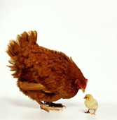
How are tolerances used?
Provide a link to the toxicology data (ADI)
Establish safety of edible tissues
If residues are below the tolerance, tissue is safe
If residues are above the tolerance, residues are violative.
Used to calculate tissue withdrawal period/milk discard time.

Slide 19
Tissues are safe to consume when residues are below the tolerance
Violative Residues
Safe Residues
Violative Residues – above the tolerance
Safe Residues –
below the tolerance
tolerance

Slide 20
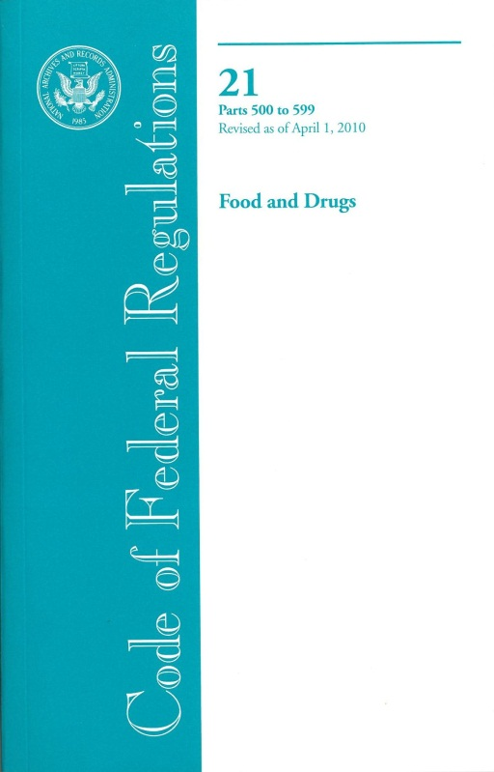
Where are tolerances and ADIs found?
Tolerances and ADIs are published in the U.S.A. Code of Federal Regulations (21 CFR 556).
http://ecfr.gpoaccess.gov
Notes:
The tolerance is our legal safety limit for residues in edible tissues of food animals. The tolerance concentrations are published in 21 CFR 556.
The withdrawal period is the amount of time between the last treatment of the food animal and when it is safe to consume the edible tissues. Residues have depleted to below the tolerance.

Slide 21

Tolerances and MRLs
Tolerances ≠ MRLs
Procedures differ
Regulations differ
Policies differ
Data are used differently in the assessment.

Slide 22
Tolerances vs. Codex MRLs

Slide 23

Different Exposure Assessments for Tolerances and MRLs
Tolerances are calculated from the ratio of marker residues to total residues.
Tolerances are tied to method. Tissue residue concentrations are not corrected for recovery.
Injection site tissue is not a target tissue.

Slide 24
Injection site tissue
FDA does not use injection site as a target tissue.
Injection site tissue cannot be reliably located at slaughter.
New formulations tend to minimize marring of the carcass.
The 2nd injection site sample (ring tissue) required by the EU is not collected as a separate sample in the U.S.A.

Slide 25
FDA adjusts the target tissue tolerance for injection site residues
We determine the timepoint when residues at the injection site deplete to:
10x the muscle safe concentration, or
Acceptable Single-Dose Intake (ASDI)
We determine the concentration of the marker residue in the target tissue at that timepoint.
A tolerance for the marker residue in the target tissue is assigned so that, when the marker residues in the target tissue are below the tolerance, injection site residues are safe.

Slide 26
Minor Species Food-Producing Animals
Tolerances may be extrapolated from major to minor species.
Minor species food-producing animals are those other than cattle, swine, chickens, turkeys.
Examples are fish, rabbits, pheasants, honey bees (honey).
If an approval exists in a comparable major species food-producing animal (e.g., cattle for sheep or goats), then only the tissue residue depletion study and analytical method are needed.

Slide 27
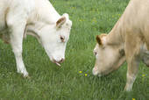
Tissue Residue Depletion Study
Objective: Conduct a residue depletion study under field conditions and use the regulatory method to determine when the marker residue depletes to below the tolerance.
- determine the withdrawal period or
milk discard time

Slide 28
Tissue Residue Depletion Study
Animals (usually market size)
Dosed according to proposed product label
highest dose
longest duration of treatment
Sample animals at timepoints after drug is withdrawn
Collect and analyze tissues for drug residues

Slide 29
Withdrawal Period and Milk Discard Time
Definition: The time interval between the last administration of a sponsored compound and when the animal can be safely slaughtered for food or the milk can be safely consumed.
The calculation involves an upper tolerance limit and confidence interval.
U.S.A. uses a 99th percentile upper tolerance limit
Other countries use a 95th percentile upper tolerance limit.
Most countries use a 95% confidence interval.

Slide 30
Example: Setting Milk Discard Time for Pirlimycin Mean pirlimycin in milk of cows receiving two doses of 50 mg pirlimycin/quarter
Milking Collection (hours) | Pirlimycin (ppm)
12 | 8.41 + 9.04
24 | 0.88 + 0.80
36 | 0.23 + 0.18
48 | 0.11 + 0.06
60 | 0.07 + 0.04
72 | 0.05 + 0.03
The data were analyzed to determine the statistical tolerance limit
for the 99th percentile of the population with 95% confidence.
At 36 hours milk discard time, pirlimycin residues in milk will have
depleted to below the 0.4 ppm tolerance.

Slide 31
Depletion of tulathromycin residues (CP-60,300)
from swine and cattle tissues – demonstrating that depletion curves
vary by animal species and tissue

Slide 32
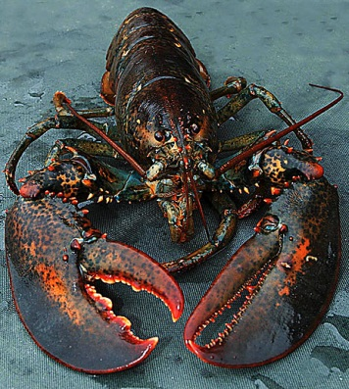
Import Tolerances
Address trade issues
Provide a way for food to be imported with residues from a drug
that is not approved in U.S.A.
doesn’t have a tolerance
for which approval in U.S.A. will not be sought
disease may not exist in U.S.A.
animals may not be raised in U.S.A.

Slide 33
Import Tolerances
Proposed rule published January 25, 2012
http://www.gpo.gov (Federal Register Doc No: 2012-1430)
We have received import tolerance requests and have completed reviews.
No import tolerance have been established because regulations have not been finalized.

Slide 34

Import Tolerance
Currently, we expect an import tolerance request to include:
Human food safety information to allow a tolerance to be established
Analytical method for measuring residues in tissues
Environmental Assessment
Information on where the drug is lawfully used

Slide 35
International Harmonization of Import Tolerances
If a Maximum Residue Limit (MRL) has been established by the Codex Alimentarius Commission (Codex MRL), only summary reports of human food safety studies are needed.
If no Codex MRL has been established, full study reports are needed.
Notes:
From proposed regs

Slide 36
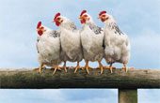
Summary
A human food safety evaluation is part of the approval process for animal drugs intended for use in food-producing animals.
A risk assessment approach is used to evaluate human food safety of animal drug residues.
The hazard from animal drugs is identified and characterized from microbial food safety and toxicological information, and the exposure of the hazard to humans is mitigated by information from residue chemistry studies.

