Slide 1
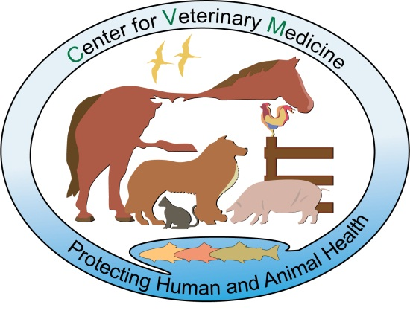
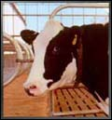
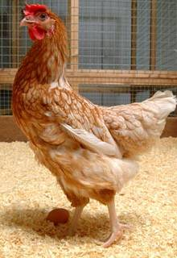
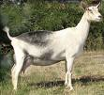
Regulation of Animal Biotechnology at FDA: An Overview
Eric Schulze, PhD
Animal Biotechnology Interdisciplinary Group
Center for Veterinary Medicine
U.S. Food and Drug Administration
Notes:
There are four images, each set into one corner of the slide. The top left image shows the CVM logo, a rendering of several agricultural animals and the CVM mission statement: Protecting Human and Animal Health. The top right image is of the head of a dairy cow. The bottom left image is of a common rooster in a pen. The bottom right image is of goat [GE?]

Slide 2
CVM-ABIG Presentations
Overview of Animal Biotechnology
Regulatory Process

Slide 3
Overview of Animal Biotechnology
Introduction - Animal Biotechnology
Animal Cloning
Genetically Engineered (GE) Animals

Slide 4
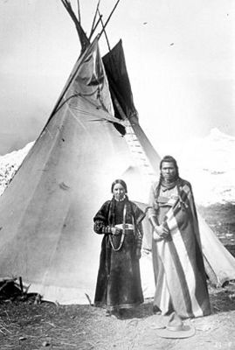
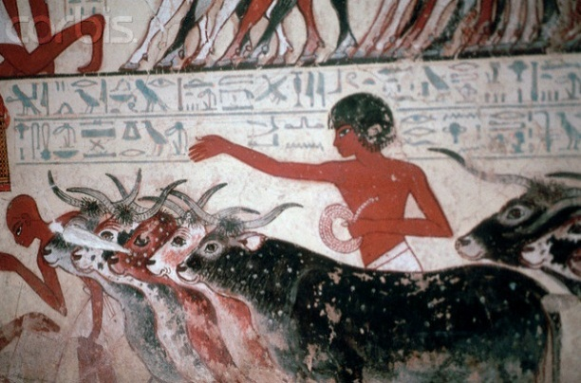
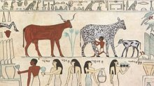
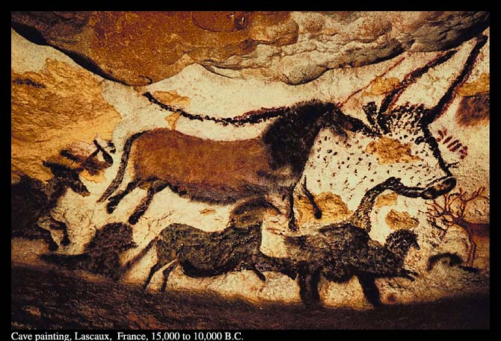
Human and Animal Interactions
Food (Milk, Meat, Eggs, Blood, Rennet)
Locomotion/Mechanical Power
Companionship/Rodent Control/
Protection/Herding
Fiber (Feathers, Wool, Hides)
Fuel (Dung, Bones)
Shelter (Hides, Bones)
Medicines (Insulin, Heparin)
Notes:
The slide contains four images. The bottom left image depicts a cave drawing by primitive man. The cave drawing indicates man’s attempt to domesticate or selectively breed livestock early in human civilization. The top left image depicts a Native American couple standing in front of a traditional teepee. The top middle image depicts an ancient Egyptian wall painting that shows a young Egyptian man tending to livestock. The top right image depicts another ancient Egyptian wall painting that depicts several Eqyptians tending to livestock.

Slide 5
What’s Different Now?
Improvements in isolating/characterizing naturally occurring desirable traits by chromosomal mapping, other technologies
Accelerated introduction of naturally occurring desirable traits by assisted reproductive technologies
Introduction of new traits by using tools of modern biotechnology → genetic engineering

Slide 6
Assisted Reproductive Technologies (ARTS)
Natural Breeding
Selective Breeding
AI ± Frozen Semen
In Vitro Fertilization
Embryo
Split
Animal Cloning
Likelihood of Desired Genetic Outcome for Naturally Occurring Traits
Notes:
This slide contains a stretched out right triangle that widens from a point into a cathetus (leg) of the triangle going from the left hand side to the right. The triangle widens to compliment the text beneath the triangle that states “Likelihood of Desired Genetic Outcome for Naturally Occurring Traits”. In other words, the assisted reproductive technologies are arranged in increasing order of probability of obtaining the desired traits, from natural breeding to animal cloning.

Slide 7

Genetic Engineering Is a Tool Separate From ARTS
Natural Breeding
Selective Breeding
AI ± Frozen Semen
In Vitro Fertilization
Embryo
Split
Animal Cloning
Likelihood of Desired Genetic Outcome
Genetic Engineering
Animals With Non-Heritable Constructs
Animals With Heritable Constructs
Notes:
The image in the top left is the same image from the previous slide. It is smaller, and placed in the corner. Below this image is a dotted line, dividing the slide into two parts. Below the dotted line is an image of a cartoon genetically engineered pig. She herself contains a stylized image of the molecular structure of DNA. Within the picture of the star is an image of a five-pointed star. The star indicates any genetic alteration with an intended purpose. The entire pig image represents a stylized version of any genetically engineered animal.

Slide 8
The Methods Are Different
Assisted Reproductive Technologies
Genetic Engineering
Accelerates the Introduction of Naturally Occurring Desirable Traits into Herds
Introduces Specific, Desirable Traits That May Or May Not Be Naturally Occurring
Notes:
Two text boxes, shaded grey, separate the two concepts on this slide. On the left, assisted reproductive technologies (Accelerates the Introduction of Naturally Occurring Desirable Traits into Herds), sits next to the other box, genetic engineering (Introduces Specific, Desirable Traits That May Or May Not Be Naturally Occurring).

Slide 9

Animal Biotechnology
(from the Regulator’s Perspective)
Natural
Breeding
Selective
Breeding
AI ± Frozen
Semen
Embryo
Split
Cloning
in vitro
Fertilization
Cloning
Animal cloning is on a continuum with other ARTs
Genetic Engineering
Genetic Engineering
Genetic engineering is different; occupies different risk space
Animals with
Non-Heritable
Constructs
GE Animals with
Heritable Constructs
Animals with
Non-Heritable
Constructs
GE Animals with
Heritable Constructs
Notes:
This slide contains three stylized valentine’s hearts next to the “natural breeding” text box. The molecular structure of DNA sits next to the “genetic engineering” text box. The images are meant to highlight the amount of precision desired when considering a risk evaluation for a novel biootechnology. Below the “genetic engineering” text box, are two arrows that point to two text boxes reading “animals with non-heritable constructs” and “GE animals with heritable constructs”.

Slide 10
Overview of Animal Biotechnology
Introduction - Animal Biotechnology
Animal Cloning
Genetically Engineered (GE) Animals

Slide 11
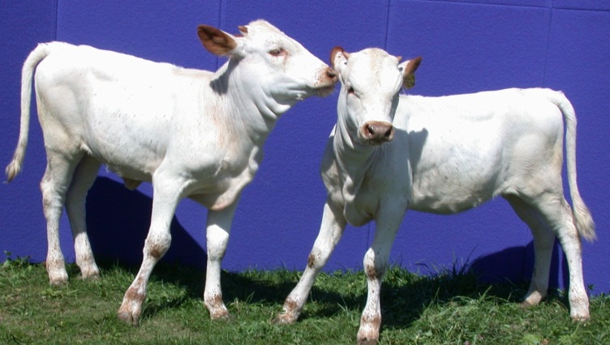

Clones v GE Animals
≠
Clones may be thought of as “Twins separated in time”.
GE animals have altered or additional genetic material.
GE animals can be produced via NT, but for regulatory purposes, are considered as "GE" not "clones“.
Notes:
The slide contains two images: On the left is an image of two cloned cows, both of calf age. There is a red circle encompassing both of them. Below that image is a text box reading “Clones may be thought of as “Twins separated in time”. On the right is an image of a chimeric mouse (indicated by the hair color mosaicism). It too is encircled by a red circle. Below that image is a text box reading “GE animals have altered or additional genetic material.” Between the images is a “not equal to” sign. The images as a whole are meant to reinforce the concept that animal clones and GE animals do not occupy the same risk space, even if the GE animal is cloned.

Slide 12
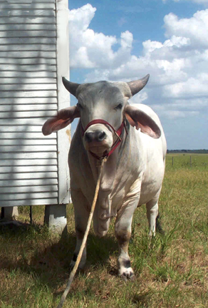
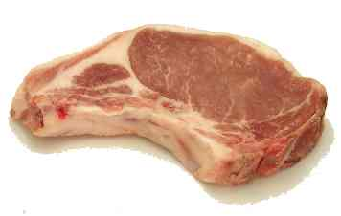
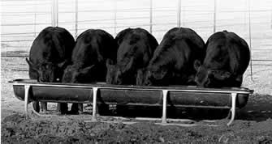
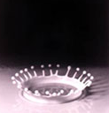
Animal Cloning-
FDA Risk Assessment
Food safety
Animal health
Weight of evidence evaluation
Notes:
This slide contains four images: On the top right is an image of a cloned cow. The bottom left is an image of five clones cattle eating at a trough. The middle image is of a cut of raw beef sirloin, and the remaining image is a still photo of drop of cow’s milk falling into a pool of milk.

Slide 13
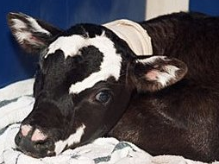
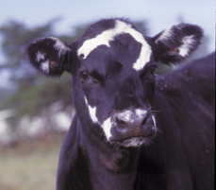
Animal Cloning - RA Conclusions:
Risks to Animals
Most adverse outcomes early in life
No unique risks; Increased frequency
LOS seen in cattle and sheep
  Surrogate dams
  Clones
No apparent health risks after juvenile period.
Notes:
The slide contains two images: The top image is of a cloned calf lying with its head down on the ground. The bottom image is of a healthy adult cloned cow.

Slide 14
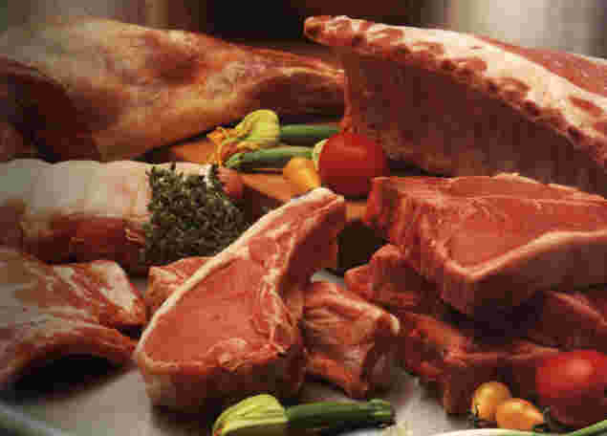
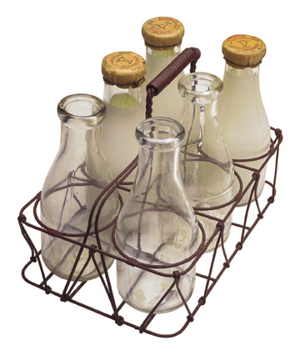
Animal Cloning - RA Conclusions:
Food Consumption Risks
Clones: Food from cattle, swine, and goat clones that meet federal and state requirements is as safe as food from conventional animals that meets the same requirements
Clone Progeny: Food from clone offspring poses no additional risk compared with food from other animals
“As safe as food we eat every day”
Notes:
The slide contains two images. The bottom left image contains a collection of raw beef primals and subprimal cuts amidst several raw vegetables. The bottom right image contains a picture of a mid 20th century milkman handcart containing three empty and three full milk jugs. Between the two images is a text box reading ““As safe as food we eat every day.”

Slide 15
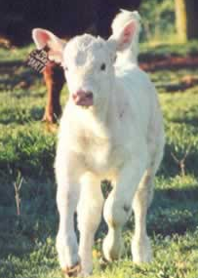
Animal Cloning - Current Status
Final release January 15, 2008
  USG has no further scientific concerns
USDA working with industry for “smooth and orderly market transition”
  Continues voluntary moratorium on introduction of food from clones into food supply
  Supply chain management plan driven by industry
Notes:
The slide contains one image depicting a trotting calf.

Slide 16
Overview of Animal Biotechnology
Introduction - Animal Biotechnology
Animal Cloning
Genetically Engineered (GE) Animals

Slide 17
From Tools to Traits………
Conformation
↑ Productivity
QTL
Meat/milk
composition
Disease
resistance
MAB
Breeding
Hardiness
CNV
Meat/milk
quality
Agricultural
Fertility/
Fecundity
GWAS
Environmental
footprint
Environmental
Tolerance
Genomics
Disease
models
organs
Prote-
omics
cells
tissues
Xenotransplant
Metab-
olomics
Biomedical/High Value
HiVal Products
Biopharm
Nuclear
transfer
Phenotype
assays
biologics
Micro
injection
devices
drugs
Notes:
This slide depicts a flowchart that starts on the left hand side, flowing to the right. The left hand side contains numerous text boxes, each representing several different types of biotechnological methods that can be used to produce a GE animal. The image of the GE animal is the same image of the stylized GE pig as was found in slide seven. The GE pig then can be used to produce many different types of products depending on the traits desired. The slide is divided in half horizontally by a dotted line that indicates that certain technologies can be used for agricultural or biomedical purposes.

Slide 18
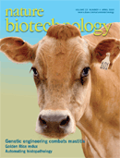
GE Animal: Products (1)
Enhanced Food Quality/Agronomic Traits/Environmental Benefits
  Cows Producing Milk with Long Shelf Life/Digestibility
  Omega-3 Fatty Acid Pork
  Milk for Cheese Making
Animal Health
  Mastitis-Resistant Dairy Cows
  BSE-Resistant Cattle
  Other disease resistance
Notes:
This slide contains an image of a Nature Biotechnology scientific journal cover. On the cover is an image of cloned cow.

Slide 19
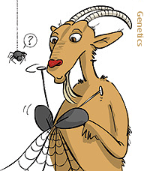
GE Animal: Products (2)
Products for Human Therapeutic Use
  Chickens/Cattle/Goats for pharmaceutical production
  Swine as Xenotransplantation Sources
  Cattle/Goats producing anti-biowarfare agents
Mixed-Use High-Value Products
  Goats producing spider silk
  Cows producing highly specific
  antibody:functional molecule products
Notes:
This slide contains a clip art style rendering of a goat, knitting a spider web with spider silk the goat itself has produced. A spider hanging in front of the goat looks on in utter confusion.

Slide 20
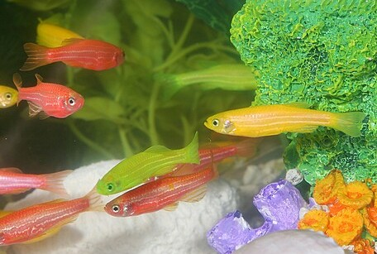
GE Animals: (3)
Companion Animals
  GloFish
Notes:
The slide contains one image of a school of GE GloFish.

Slide 21
Links to the Website
GE Animals
http://www.fda.gov/animalveterinary/developmentapprovalprocess/
geneticengineering/geneticallyengineeredanimals/default.htm
Cloning
http://www.fda.gov/AnimalVeterinary/SafetyHealth/AnimalCloning/default.htm

Slide 22

Contact Information
Adrianne.Jacobs@fda.hhs.gov
Notes:
The slide contains the FDA logo and the CVM logo.

Slide 23
Acronyms
AI: Artificial Insemination
ARTS: Assisted Reproductive Technologies
BSE: Bovine Spongiform Encephalopathy
CNV: Copy Number Variation
GE: Genetically Engineered
GWAS: Genome-Wide Association Studies
LOS: Large Offspring Syndrome
MAB: Marker Assisted Breeding
NT: Nuclear Transfer
QTL: Quantitative Trait Loci
RA: Risk Assessment
USDA: United States Department of Agriculture
U.S. FDA: United States Food and Drug Administration
USG: United States Government

