Slide 1


Environmental Impact (Risk) Assessment of
Veterinary Pharmaceuticals
Eric Silberhorn, Ph.D.
Environmental Safety Team
Division of Scientific Support
Office of New Animal Drug Evaluation

Slide 2
Presentation Outline
Development of international guidelines
Phase I: Exposure-based screening
Phase II: Quantitative risk assessment
Underlying principles and science
Basic testing requirements
Risk assessment and risk characterization
U.S. legal mandate (NEPA)
FDA’s regulatory tools and processes

Slide 3
International Harmonization under VICH
International Cooperation on Harmonisation of Technical Requirements for Registration of Veterinary Medicinal Products (VICH for short)
  http://www.vichsec.org
Members: European Union (EU), Japan and U.S.
Observers: Australia, New Zealand and Canada
1st Steering Committee, Paris, 1996
Initial topics
  Quality
  Safety
  Ecotoxicity / Environmental Impact
  Good Clinical Practices
  Anthelmintics

Slide 4
Why Ecotoxicity / Environmental Impact?
US FDA/CVM
  FDA reviewed & revised its environmental impact regulations based on 20+ years of experience
  New regulations implemented August 1997
  Eliminated environmental assessment requirements for certain types of veterinary drugs when they are not expected to significantly affect the environment
European Union
  EU January 1998 Note for Guidance
    Driven by legislation (Directive 2001/82/EEC)
    Required testing for most veterinary drugs
  New requirements in other regions (e.g., Japan, Australia, Canada) for ecotoxicity testing

Slide 5
Why Ecotoxicity / Environmental Impact?
9th ITCVDR* in Prague (1996)
  Changes in regulations & guidance led to major uncertainties
  Highlighted differences in requirements
  Ecotoxicity least harmonized of the initial VICH topics
  Emphasized values of harmonized guidance to regulators & applicants
  Urged acceptance & follow-through on VICH process to harmonize ecotoxicity guidance
  * International Technical Consultation on Veterinary Drug Registration

Slide 6
VICH Ecotoxicity Working Group:
Mandate and Scope
“ to elaborate tripartite guidelines on the design of studies and the evaluation of the environmental impact assessment of veterinary medicinal products [VMPs]. It is suggested to follow a tiered approach based on the principle of risk analysis. Categories of products to be covered by the different tiers of the guideline should be specified. Existing or draft guidelines in the EU, the US and Japan should be taken into account.”

Slide 7
Harmonized Guidance for Environmental Assessment
Environmental Impact Assessments for Veterinary Medicinal Products
Phase I (VICH GL6, CVM Guidance for Industry 89, 2001)
  http://www.fda.gov/downloads/AnimalVeterinary/GuidanceComplianceEnforcement/GuidanceforIndustry/UCM052424.pdf
Phase II (VICH GL38; CVM Guidance for Industry 166, 2006)
  http://www.fda.gov/downloads/AnimalVeterinary/GuidanceComplianceEnforcement/GuidanceforIndustry/UCM052500.pdf
These guidance documents were developed by VICH to harmonize the data requirements and basic risk assessment process for approval of veterinary drug products in participating nations

Slide 8
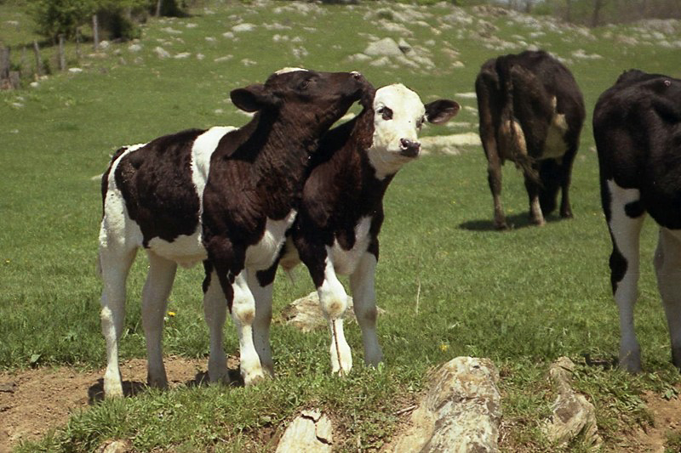
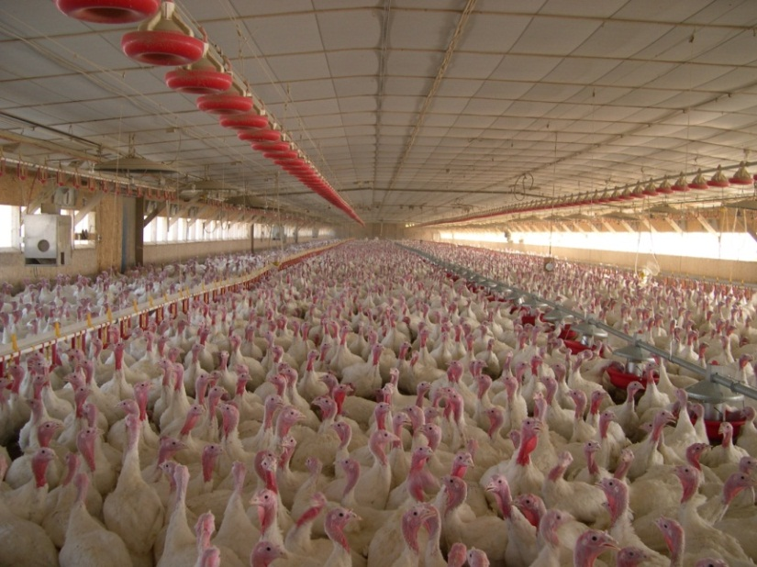
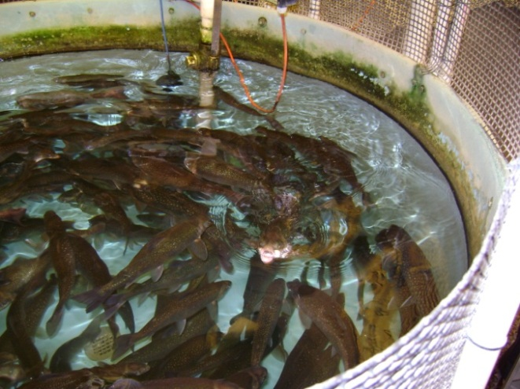
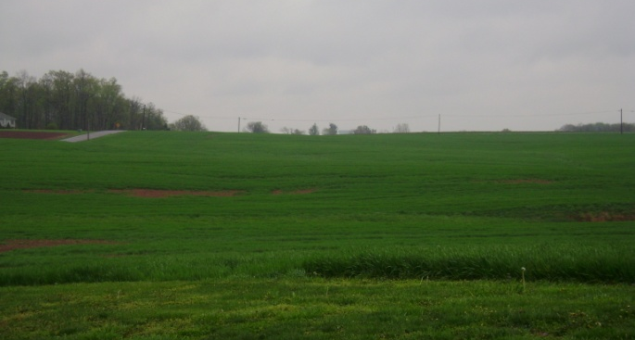
Veterinary Use Scenarios
Pasture Animals
Intensively Reared Animals
Aquaculture
Storage

Slide 9
Risk = chance of losing something we value
Risk = probability of an adverse outcome (impact)
Risk = Hazard x Exposure
Hazard = intrinsic toxic properties
Environmental Risk Assessment = systematic scientific characterization of potential adverse effects (impacts) resulting from environmental exposures to a hazardous agent or situation
Risk Assessment Principles Underlying the VICH Guidelines

Slide 10
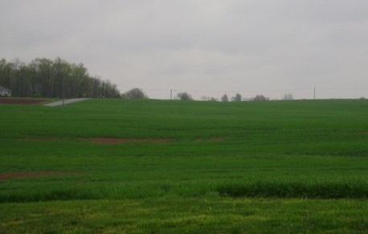

Phase I Guidance:
Exposure-based Screening
Goal: Merge existing legal EU criteria with 1997 US regulations (i.e., categorical exclusions)
Question-based analysis (exposure assessment)
  If little/no exposure, then little/no risk
  Questions based on the use scenario
Conditions where limited exposure is expected
Further environmental assessment (and testing) is not needed if certain criteria are met

Slide 11
Phase I - Highlights
Underlying premise: impacts will not occur if there is limited environmental exposure
Little or no experimental environmental fate & effects data needed to conduct the assessment; degradation data optional
Non-food animals … may stop with Phase I
Naturally occurring substances … may stop
Minor species … may stop, depending on specific indication(s)/animal management conditions
“Small” number of animals treated … may stop

Slide 12
Phase I - Highlights
Extensively metabolized substances … may stop
If the Predicted Environmental Concentration (PEC) < 100 μg/kg trigger value for soil exposure … assessment may stop based on previous environmental assessment experience (no effects )
PEC < 1 μg/L trigger value for aquatic exposure (controlled discharge)… may stop based on previous environmental assessment experience
Ecto- & endoparasiticides for pasture animals must proceed to Phase II
Aquaculture drugs used without a controlled discharge (e.g., open water net pens) must proceed to Phase II

Slide 13
Phase II Guidance:
Quantitative Risk Assessment
Describes basic risk assessment process to be used for each use scenario:
  Exposure assessment, effects assessment, risk characterization and risk management
Tiered approach to testing and assessment
  Tier A (acute effects testing)
  Tier B (chronic/reproduction effects testing)
  Tier C (refined analyses)
Start with Tier A and proceed to next tier only if a unacceptable risk(s) is indicated

Slide 14
Phase II Guidance:
Quantitative Risk Assessment
Specifies recommended laboratory studies that vary with the use scenario of the drug
  physicochemical properties,
  environmental fate, and
  effects on invertebrates, fish, plants, microorganisms
Tests should follow OECD Guidelines if available
Measurement endpoints include:
  mortality, immobilization, reproduction, growth, and nitrogen and carbon transformation

Slide 15

Phase II: Quantitative Risk Assessment Using Risk Quotients
Effects
Assessment
Exposure
Assessment
Proposed Use
Single species
toxicity data
Environmental
release
Safety Assessment Factor (AF)
Fate/Distribution
Predicted Environmental Concentration (PEC)
Predicted No Effect Concentration (PNEC)
Risk
Characterization
RQ = PEC / PNEC
If RQ ≥1 → assessment moves to next tier
Notes:
This flow chart shows the three primary components of a quantitative risk assessment: exposure assessment, effects assessment, and risk characterization. Based on the proposed drug use, the exposure assessment begins with the release of the drug into the environment, and while taking into account the drug's fate and distribution, develops a predicted environmental concentration (PEC). The effects assessment begins with toxicity data for single species and applies an assessment factor (AF) to it resulting in a predicted no effect concentration (PNEC). The risk characterization includes development of a risk quotient (RQ) that is calculated by dividing the PEC by the PNEC. If RQ ≥1 → assessment moves to next tier.

Slide 16
Exposure Assessment
Use Pattern
Chemical & Environmental Fate Properties
(metabolism, excretion, solubility, degradation in manure/soil/water, adsorption to soil, etc.)
Manure loading rate, storage, water use and management
PEC
Notes:
16
Diagram outlining the processes involved with developing a predicted environmental concentration (PEC) starting with the use pattern of a drug and taking into account its chemical and environmental fate properties as well as other factors that affect the amount of drug in the environment.

Slide 17

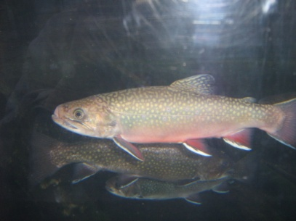
Exposure Assessment
Duration
Frequency
Seasonal Distribution
Dose
Chemical Use
Number of Animals Treated
Species & Diseases
Administration route (e.g., feed, injection, bath)
Notes:
17
Diagram showing typical factors that can affect chemical use and exposure assessment, specifically the following: dose, duration, frequency, seasonal distribution, species and diseases, the administration route (e.g., feed, injection, bath), and the number of animals treated.

Slide 18

Effects Assessment
Laboratory tests (single species; standardized tests)
Acute tests in Tier A
Chronic tests in Tier B
Terrestrial studies may also be needed depending on the drug use scenario
Terrestrial studies may also be needed depending on the drug use scenario
+
+
algae
water flea
fish
Model Aquatic Ecosystem
Notes:
Diagram of a model aquatic ecosystem containing algae, a water flea (Daphnia), and fish.

Slide 19
TIER A Studies
Physical-chemical Studies
Water Solubility
Dissociation Constant
UV-Visible Absorption Spectrum
Melting Temperature
Vapour Pressure
Octanol/Water Partition Coeff.
Environmental Fate Studies
Soil adsorption/desorption
Degradation in soil
Degradation in aquatic systems
Photolysis (optional)
Hydrolysis (optional)
Aquatic Effects Studies
Algae growth inhibition
Daphnia acute immobilization
Fish acute toxicity
Includes testing of saltwater species if relevant for drug use
Terrestrial Effects Studies
Microorganisms (N transformation)
Terrestrial plants growth
Earthworm subacute/reproduction
Dung fly and beetle larvae (for certain ectoparasiticides)
Environmental Fate Studies
Soil adsorption/desorption
Degradation in soil
Degradation in aquatic systems
Photolysis (optional)
Hydrolysis (optional)
Aquatic Effects Studies
Algae growth inhibition
Daphnia acute immobilization
Fish acute toxicity
Includes testing of saltwater species if relevant for drug use
Terrestrial Effects Studies
Microorganisms (N transformation)
Terrestrial plants growth
Earthworm subacute/reproduction
Dung fly and beetle larvae (for certain ectoparasiticides)

Slide 20
Tier B Studies
Terrestrial Effects Studies
Earthworm chronic
Terrestrial plants growth – 2 additional species + sensitive spp. from Tier A
Nitrogen fixation - extension of Tier A study for an additional 100 days
Environmental Fate Study
Bioconcentration in fish
Aquatic Effects Studies
Daphnia or crustacean reproduction
Fish, early-life stage
Sediment invertebrate toxicity
Includes testing of saltwater species if relevant to drug use/disposal pattern
Aquatic Effects Studies
Daphnia or crustacean reproduction
Fish, early-life stage toxicity
Sediment invertebrate toxicity
Includes testing of saltwater species if relevant to drug use/disposal pattern
Notes:
Terrestrial Effects Studies
Earthworm chronic
Terrestrial plants growth – 2 additional species + sensitive spp. from Tier A
Nitrogen fixation - extension of Tier A study for an additional 100 days
Aquatic Effects Studies
Daphnia or crustacean reproduction
Fish, early-life stage toxicity
Sediment invertebrate toxicity
Includes testing of saltwater species if relevant to drug use/disposal pattern
Environmental Fate Study
Bioconcentration in fish

Slide 21
Risk Characterization
Risk screening based on a risk quotient (RQ)
PEC = Predicted Environmental Concentration
PNEC = Predicted No Effect Concentration
  PNEC = Effects endpoint ÷ Assessment Factor (AF)
    Lab to field extrapolation
    Interspecies and intraspecies differences in sensitivity
    Acute to chronic extrapolation
If RQ < 1 = Unlikely Risk; If ≥ 1 proceed to next tier
Exposure level
(PEC)
No effect level (PNEC)
Risk Characterization
RQ = PEC / PNEC
Notes:
Diagram showing how a risk quotient (RQ) is calculated by dividing the exposure level (PEC) by the no effect level (PNEC).

Slide 22
PNECs for TIER A
Surface water Endpoint AF
algae (96 h) EC50 100
invertebrate (48 h) EC50 1000
fish (96 h) LC50 1000
Soil
earthworm (chronic) NOEC 10
higher plants (3 species) EC50 100
microorganisms (28 days) < 25% of control
Dung (pasture animals)
dung fly EC50 100
dung beetle EC50 100

Slide 23
PNECs for TIER B
Surface water Endpoint AF
algae (96 h) NOEC 10
invertebrate (21 d) NOEC 10
fish (28 d) NOEC 10
sediment species (varies) NOEC 10
Soil
earthworm no recommendation
higher plants (more species) NOEC 10
microorganisms (100 days) < 25% of control
Bioaccumulation
BCF > 1000 l/kg ⇨ investigate secondary poisoning

Slide 24
Tier C – Further Assessment
Specialized Laboratory and/or Field Testing
  Pulsed exposure studies
  Microcosm and mesocosm studies
  In-stream studies
  Test additional species
Refined Risk Analysis
  Species sensitivity distribution analysis
  Probabilistic exposure analyses
  Specialized environmental fate modeling
Risk Mitigation and Management (Labeling)
  Use and/or disposal restrictions
  Mandatory treatment requirements
  Water quality benchmarks for use in effluent discharge permitting

Slide 25
FDA Regulatory Process for Conducting Environmental Reviews

Slide 26
National Environmental Policy Act (NEPA, 1969)
Legal Mandate: Basic U.S. Charter for the protection of the environment
NEPA requires all US Federal agencies to consider the potential environment impacts of their actions
21 Code of Federal Regulations (CFR) Part 25 – Environmental Impact Considerations for FDA

Slide 27
Regulatory Tools Under NEPA
Categorical
Exclusion
(CE)
Environmental Assessment (EA)
Environmental Impact Statement (EIS)
Exclusion from the need to prepare an EA or EIS based on specific conditions, criteria, or types of actions
Concise analysis document prepared to determine whether the proposed action will cause significant environmental effects
Complex analysis of the effects of the proposed action and any alternatives to it that is prepared with public input and participation
Notes:
Categorical Exclusion (CE)
Exclusion from the need to prepare an EA or EIS based on specific conditions, criteria, or types of actions
Environmental Assessment (EA)
Concise analysis document prepared to determine whether the proposed action will cause significant environmental effects
Environmental Impact Statement (EIS)
Complex analysis of the effects of the proposed action and any alternatives to it that is prepared with public input and participation

Slide 28



Categorical Exclusions
Actions which the agency has predetermined do not individually or cumulatively have a significant effect on the human environment; and therefore, ordinarily do not require the preparation of an EA or EIS
If FDA believes an action may result in Extraordinary Circumstances, preparation of an EA is needed
e.g.,
Approval of drugs intended for use in non-food animals

Slide 29
Environmental Assessments
Defined in 21 CFR* 25.40(a), …an EA is a concise public document that serves to provide sufficient evidence and analysis for an agency to determine whether to prepare an Environmental Impact Statement (EIS) or a Finding of No Significant Impact (FONSI).
  * CFR = U.S. Code of Federal Regulations

Slide 30
FONSI and EIS
FONSI
Decision document that briefly presents the reasons why an action will not have a significant effect on the human environment
EIS
Extensive analysis document prepared with public input that provides a full and fair discussion of an action’s significant environmental impacts plus those of reasonable alternatives

Slide 31
Overview of CVM Process
Proposed Action (e.g., new drug use)
Environmental
Assessment (EA)
Phase II –
Tier A, B, or C
as appropriate
Meets criteria
Categorical Exclusion
Finding of No Significant Impact (FONSI)
Acceptable risk
Unacceptable risk
Risk Mitigation Options
Environmental Impact Statement (EIS) &
Record of Decision (ROD)
Unacceptable risk
Notes:
Flowchart showing an overview of the CVM regulatory process for environmental impact assessment. The flowchart starts with a proposed action (for example an approval of a new drug use) which may be granted a categorical exclusion if it meets appropriate criteria or it could trigger the need for preparation of an environmental assessment (EA) if the action does not meet the criteia for categorical exclusion. The outcome of the EA is either an acceptable risk or an unacceptable risk. If the risk is acceptable, this leads to preparation of a Finding of No Significant Impact , also known as a FONSI. If he risk is unacceptable, various risk mitigation options may be evaluated. If this evaluation indicates that risks are acceptable with mitigation, a FONSI is prepared. If the risks continue to be unacceptable, an Environmental Impact Statement (EIS) and Record of Decision (ROD) are prepared.

Slide 32
Types of Actions Potentially Requiring Preparation of an EA
New Animal Drug Applications (NADAs)
Supplemental NADAs (new indications)
Food Additive Petitions
Import Tolerances
Generic drug applications (normally excluded)
Note: Drug sponsors are typically required to conduct testing and prepare the EA under FDA’s direction; however, FDA is ultimately responsible for the scope and content of the EA

Slide 33
Format of an EA
Generally follows the risk assessment process
    Description of proposed action
    Hazard identification
    Exposure characterization
    Effects characterization
    Risk characterization
    Risk mitigations / management
  Appropriate for public display and allow the public to understand the agency’s analysis
  Does not contain confidential business information

Slide 34
Public Availability of
Environmental Assessments
CVM Environmental Assessments
  Following an approval, the EA and FONSI are placed on public display and can be accessed through CVM’s environmental website:
  http://www.fda.gov/AnimalVeterinary/DevelopmentApprovalProcess/EnvironmentalAssessments/default.htm

Slide 35
For Further Information
  http://www.fda.gov/AnimalVeterinary/DevelopmentApprovalProcess/EnvironmentalAssessments/default.htm
  http://www.vichsec.org/en/guidelines.htm

