Slide 1
Overview of CVM Bioresearch Monitoring
Vernon D. Toelle, Ph.D.
Team Leader
Pre-Market Compliance and
Administrative Actions Team
(BIMO Team)

Slide 2
Bioresearch Monitoring (BIMO)
An Agency-wide inspectional process focused on data quality of safety and efficacy studies. These studies are submitted during the approval/review process for food and medical products regulated by FDA.
Inspections of non-clinical safety studies in the late 1970s became impetus for the development of the BIMO processes

Slide 3
BIMO Compliance Programs
Compliance programs for which CVM issues inspectional assignments are:
  Clinical Investigator (CI),
  Good Laboratory Practice (GLP) and
  Sponsors, Contract Research Organizations and Monitors (S/M).

Slide 4
Overview of CVM’s BIMO Program (cont.)
Inspections of Studies can occur in 7 major species :
  Horses, Cats, Dogs – Non-Food animals.
  Cattle (Dairy and Beef), Swine, Chicken, Turkeys – Food animals.
Can also occur in minor species
  Aquaculture, other birds (poultry) and other pets

Slide 5
Overview of CVM’s BIMO Program
(cont.)
Animal Feeds, Production Drugs, Therapeutic for Food Animals, Therapeutic for Non-Food Animals, and Human Food Safety Divisions in CVM can all request BIMO inspections to be conducted for studies they are currently or about to review. Other review oriented groups can request inspections as well.

Slide 6
Other Relevant Issues
We do not regulate Animal Vaccines (USDA does, 9 CFR 100) used in disease immunization, but we do regulate “other” biologics as drugs.
No pre-approval requirements for Veterinary Devices
Production Drugs -- products marketed to enhance economic performance

Slide 7
CVM Assignment Processing
Directed CI assignments requests are initiated from the review divisions and sent to BIMO team for processing.
  Can be “real-time” or data audit requests
Surveillance Sponsor/Monitor assignments are initiated by BIMO team.
  Input sought from review divisions
Assignments are tracked in ORA field and CVM databases.

Slide 8
Office of Regulatory Affairs (i.e. The Field)
5 Regions, 20 District Offices
CVM BIMO inspections are distributed disproportionally across the USA. More inspections tend to happen in Southwest and Central Region areas (more animal agriculture in those areas) than other Regions.
BIMO monitors in each district manage workload

Slide 9
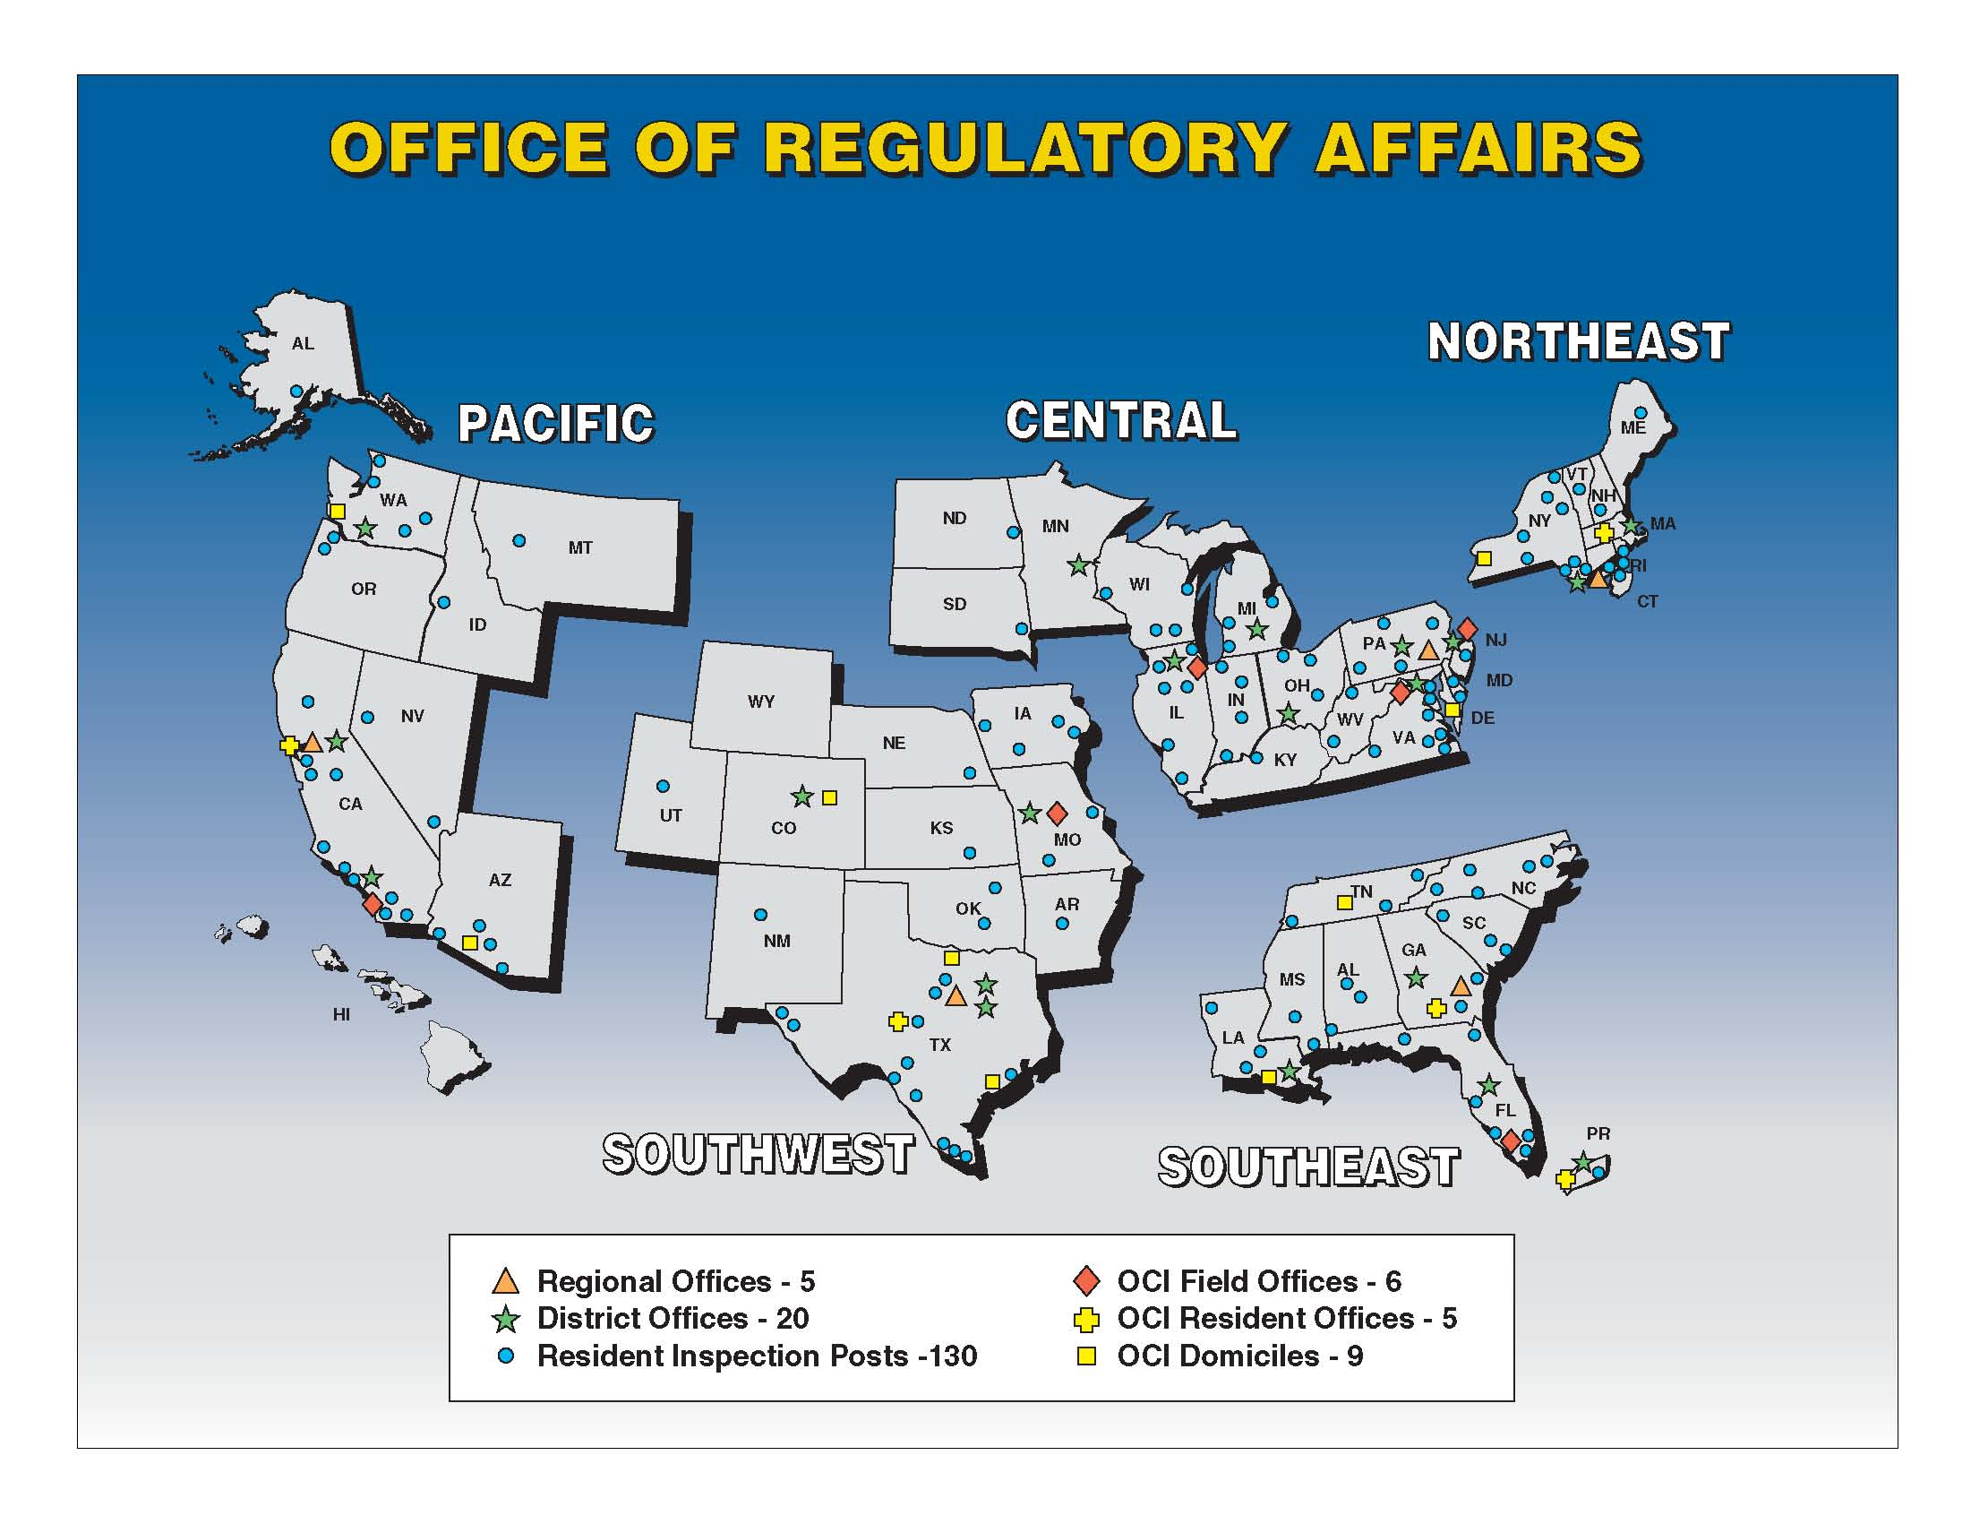
Notes:
ORA (Office of Regulatory Affairs) currently consists of Five Regions.
Northeast Region
Central Region
Southeast Region
Southwest Region
Pacific Region
These regions currently contain 20 District Offices, 175 resident posts and 13 field laboratories.
The proposed transformation plans include consolidating the management of 20 district offices to 16 offices and the closing of 7 field laboratories. The district consolidations will be:
Detroit and Cincinnati with Cincinnati reporting to Detroit.
Philadelphia and New Jersey with New Jersey reporting to Philadelphia.
Kansas City and Denver with Denver reporting to Kansas City.
Florida and San Juan with San Juan reporting to Florida.
With this restructuring and consolidation, ORA field staff will be obligated to provide the same quality of work, in the same timeframes, but with less staff and funds for travel. It will be very important for the Centers to provide as much “direction” and “prioritization/consolidation” to the inspections that we are asking the field to cover.
Which leads me into …

Slide 10
Documents sent to Field with an Assignment
Protocols usually provided
Drug shipment notices
A Drug sponsor’s submitted reports
  Final reports
  Raw/source data

Slide 11
ORA Field Inspections
A field Consumer Safety Officer (CSO) typically conducts an inspection at a site (CI, GLP, or S/M) for ~ one week.
If there are objectionable conditions (i.e. violations of the regulations) the CSO can issue a form 483.
An Establishment Inspection Report (EIR) is written regardless of whether a 483 is issued.

Slide 12
EIR processing in CVM
Initial review conducted by BIMO team
Scientific reviews conducted by pre-approval divisions.
  Reviewers recommend a classification
  EIRs used to determine data acceptability for approval packages (NADAs).
Final Classifications determined by BIMO team

Slide 13
BIMO Administrative and Regulatory Actions
Study Data Rejection
Untitled and Warning Letters
Disqualification
Application Integrity Policy

Slide 14
Helpful FDA BIMO Weblinks
http://www.fda.gov/ICECI/EnforcementActions/BioresearchMonitoring/default.htm
BIMO General Items
http://www.fda.gov/ICECI/ComplianceManuals/ComplianceProgramManual/ucm255614.htm
BIMO Compliance Programs

