Slide 1

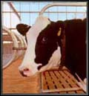
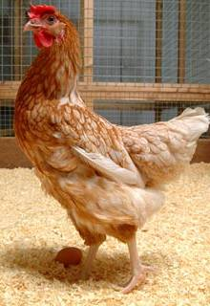
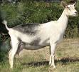
Regulation of Genetically Engineered Animals at FDA: A Risk-Based Approach
Malini M. Wileman, PhD, RAC
Animal Biotechnology Interdisciplinary Group
Center for Veterinary Medicine
U.S. Food and Drug Administration

Slide 2
Today’s Presentation
Regulatory Process
  Statutory Authority
  Review Process

Slide 3
Today’s Presentation
Regulatory Process
  Statutory Authority
  Review Process

Slide 4
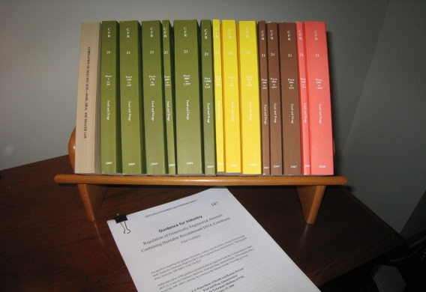
History of Regulation of GE Animals in the U.S. Government
1986 Coordinated Framework
2001 OSTP Case-studies
2009 Guidance For Industry 187
  Heritable and non-heritable rDNA constructs

Slide 5

Goal/Structure of Guidance
Three parts
Clarification of FDA’s continued regulation of GE
animals under NADA provisions of FFDCA, and NEPA
Congruence with existing regulations 21 CFR 511 (INAD) and 21 CFR 514 (NADA)
Recommendations on how sponsors can prepare data and information for FDA to review

Slide 6

Key Concepts -1
Statutory/Scope
Definition of “article”
  rDNA construct intended to affect the structure or function of the animal
“All GE animals derived from the same tx event contain the same article, and subject to evaluation under a single new animal drug application.”
No products in commerce without FDA approval (minor exceptions → enforcement discretion)

Slide 7

Key Concepts -2
Risk-Based Approach
Each GE Animal/rDNA construct event poses unique risk(s)
  Specific set of risk questions
  Specific set of data/information driven responses
Case-by-case evaluation for each transformation event (i.e., each “article”)

Slide 8

Two Paths
Default assumption: INAD/NADA approach
  All species traditionally consumed as food
  All scenarios not considered “low risk”
Certain low risk scenarios may be eligible for enforcement discretion

Slide 9

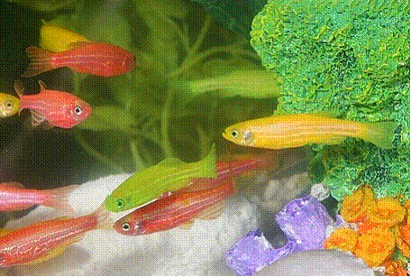
Enforcement Discretion
Non-food animals raised and used in contained and controlled conditions
Non-food animals evaluated, on a case-by-case basis, for risk, including environmental risk

Slide 10
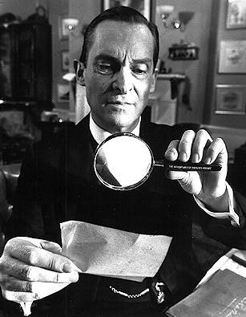
Real Time Review Partnership
Open an INAD file
Opens path for confidential communications
21 CFR § 511.1b
Allows for certain activities during development
  Animal (drug) shipments/labeling
  Record keeping
  Disposition

Slide 11
Today’s Presentation
Regulatory Process
  Statutory Authority
  Review Process

Slide 12


Reviews
Risk-Based Decision-Making
  Case-by-case evaluation of risk and level of review
Interactive review
  Group of experts with overlapping expertise
  “Peer-review” discussion

Slide 13
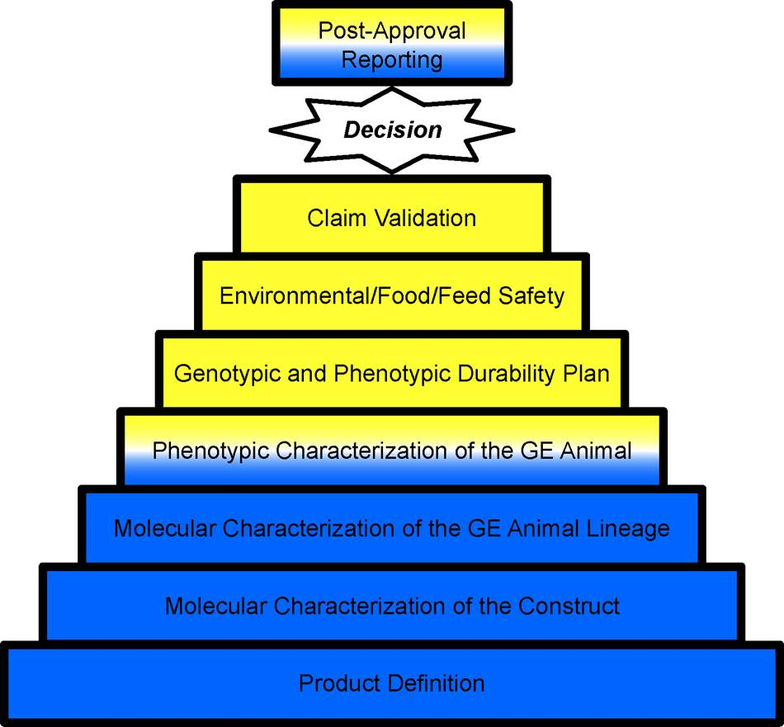
Product Definition
Describes the animal, construct, and proposed claim as basis for hazard identification.

Slide 14
Molecular Characterization: Construct
Are there sequences likely to contain potential hazards to the animal, humans or animals consuming food from that animal, or the environment? e.g., mobilizable sequences from viruses endemic in that species?

Slide 15
Molecular Characterization:
GE Animal Lineage
Does the insertion of the rDNA construct pose a hazard to the animal, humans or the environment?

Slide 16
Phenotypic Characterization
Direct and indirect risks posed to the GE animal?
(e.g., can surveying the health and other phenotypic characteristics of the animal inform us with respect to risk to the animal and potential human food safety concerns?)

Slide 17
Durability Plan
Are the genotype or phenotype of the animal changing over the lifespan in a way that would affect the risk(s) associated with the product?
Is there a plan for monitoring stability to anticipate or identify those changes?

Slide 18
Food/Feed Safety
IF INTENDED FOR FOOD/FEED
Risk of direct or indirect adverse outcomes associated with the consumption of the GE animal as food or feed?
IF NOT INTENDED FOR FOOD/FEED
Evidence provided to demonstrate that investigational or post-commercialized GE animals will not enter the food supply?
Regulatory method.

Slide 19
Environmental Safety
Direct or indirect effects from introduction of the GE animal into the environment?
Basis for satisfying NEPA requirements.

Slide 20
Claim Validation
Does the GE animal meet the claim established in the product definition?

Slide 21
Real Time Review
Interactions with Sponsors
Early interactions with Sponsors
Discuss nature of submissions; data/information to prepare
Submission Review
Assignment of reviews to subject area experts
Prepare preliminary review by in-depth reviewers
Peer review by group
Unanimous decision to move forward
Prepare report of review

Slide 22
Conclusions
U.S. FDA regulates GE animals under FFDCA and NEPA
Risk-based hierarchical method of review
Close interaction between FDA and sponsors for a real-time review of submissions

Slide 23

Contact Information
Adrianne.Jacobs@fda.hhs.gov

Slide 24
Acronyms
CFR: Code of Federal Regulations
FFDCA: Federal Food Drug and Cosmetic Act
GE: Genetically Engineered
GFI: Guidance for Industry
INAD: Investigational New Animal Drug
NADA: New Animal Drug Application
NEPA: National Environmental Policy Act
OSTP: White House Office of Science and Technology Policy
rDNA: Recombinant Deoxyribonucleic Acid
TX: Transformation
U.S. FDA: United States Food and Drug Administration

