Slide 1

Human Food Safety of New Animal Drugs: Toxicology Assessment
Tong Zhou, Ph.D., DABT
Division of Human Food Safety
Office of New Animal Drug Evaluation
Center for Veterinary Medicine
US Food and Drug Administration

Slide 2
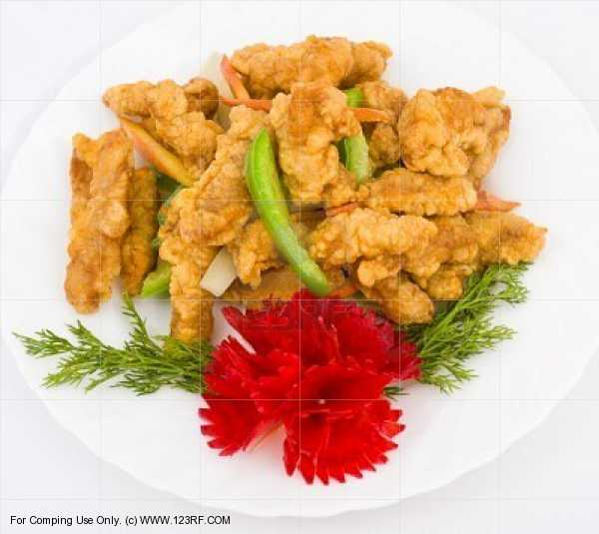
Talk Outline
Overview of human food safety evaluation
Toxicology assessment principles
Toxicology assessment of animal drugs in food animals
Examples

Slide 3

Talk Outline
Overview of human food safety evaluation
Toxicology assessment principles
Toxicological assessment of animal drugs for food animals
Examples

Slide 4

Human Food Safety Evaluation
The purpose of a human food safety evaluation is to determine when the edible tissues in food-producing animals treated with a new animal drug are safe for humans to consume.
Notes:
4

Slide 5
Human Food Safety Evaluation
The evaluation of safety is based on risk assessment principles
Risk = Hazard x Exposure
Hazard: toxicity, antimicrobial resistance
Exposure: potential human exposure to drug residues through consumption of edible tissues

Slide 6
Human Food Safety Assessment
Toxicology
ADI,
Safe Concentrations
Microbial Food Safety
Antimicrobial
Resistance
Residue Chemistry
Tolerance/MRL,
Regulatory Method
Withdrawal Period,
Milk Discard Time

Slide 7
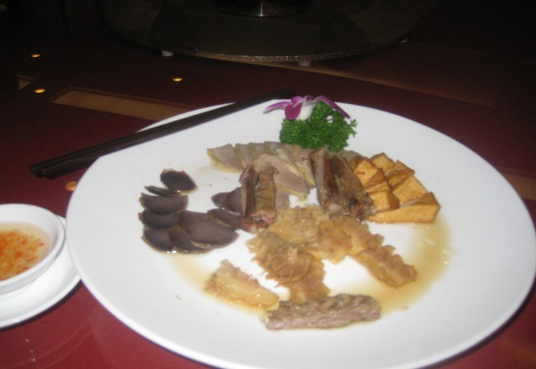
Talk Outline
Overview of human food safety evaluation
Toxicology assessment principles
Toxicology assessment of new animal drugs in food animals
Examples

Slide 8
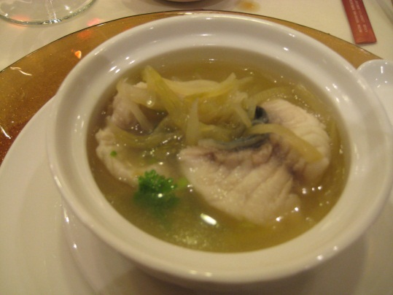
Toxicology
Paracelsus (1493-1541):
“All things are poison and nothing without poison; only the dose makes that a thing is not a poison.”
Casarett & Doull’s Toxicology:
Toxicology is a study of the adverse effects of chemicals on living organisms.

Slide 9

Toxicology Assessment
Hazard Identification
Chronic & acute effects
Toxicological endpoints
Hazard Characterization (Dose-Response)
Determine a No-Observed-Effect-Level (NOEL) and safe level of exposure to humans

Slide 10
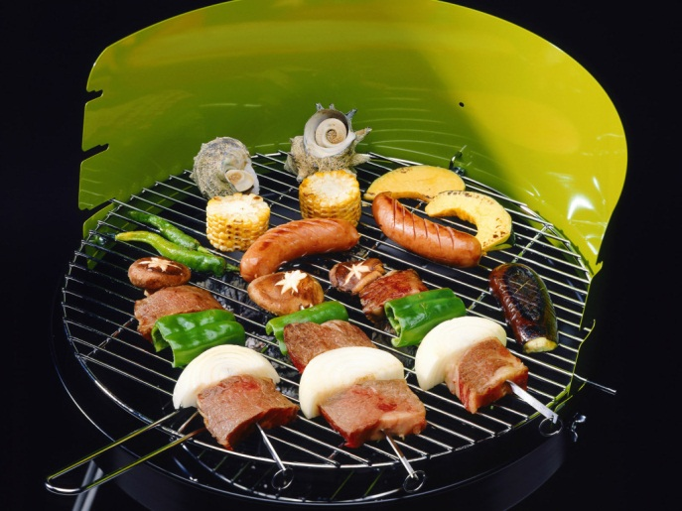
Toxicology Assessment
Toxicological Endpoints:
Hepatic toxicity
Renal/nephrotoxicity
Reproductive toxicity
Developmental toxicity
Neurotoxicity (central or peripheral)
Respiratory tract toxicity
Immunotoxicity
Dermal sensitization
Dermal irritation

Slide 11

Toxicology Assessment
Safe Level of Exposure
Determine NOELs (or BMDLs- benchmark dose lower bound) from dose-response curves obtained from toxicology studies
Determine the uncertainty factors to extrapolate the results from animal studies to humans.

Slide 12
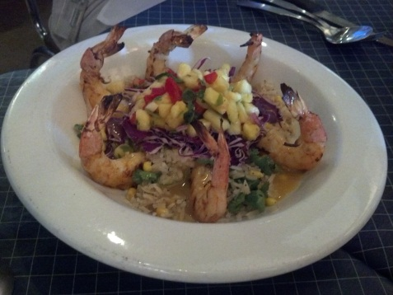
How Toxicity Is Assessed
Animal studies
Systemic toxicity studies (such as clinical signs and symptoms, clinical pathology, histopathology)
Special functional tests (e.g., reproductive performance, immune system function, neurological tests)
Human studies
Epidemiological studies
Human clinical studies
Case reports

Slide 13

Talk Outline
Overview of human food safety evaluation
Toxicology assessment principles
Toxicology assessment of new animal drugs in food animals
Examples

Slide 14
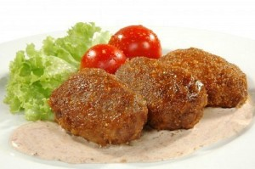
Toxicology Assessment
Identify and characterize any potential adverse health effects
Risk = Hazard X Exposure
Risk = Hazard X Exposure

Slide 15
Toxicology Assessment
The general approach is to
Establish a human Acceptable Daily Intake (ADI) level for total drug residues in edible tissues based on toxicology testing
Determine if the compound is a carcinogen
Calculate the safe concentration value for total residues in each edible tissue

Slide 16
Toxicology Testing
Normally toxicology information is obtained through toxicology testing
All toxicology testing (except in vitro genotoxicity studies) is conducted through oral exposure in surrogate laboratory species
Tested substance: parent drug substance, or when needed, its metabolite(s), excipient(s), or formulated drug product

Slide 17


Toxicology Testing
VICH Guidance No. 33 (CVM GFI NO. 149) http://www.vichsec.org/pdf/05_2004/Gl36_st7_F_rev.pdf

Slide 18
Recommended Testing Approach
Toxicology
Testing
Basic Toxicology
Studies
Additional
Toxicology
Studies
Special
Studies
Two 90-day Subchronic One 1-year Chronic
2-Gen Reproductive in rats
One or 2 Developmental
A battery of Genotox Studies
Effects on human gut flora,
Carcinogenicity
Immunotoxicity
Neurotoxicity, pharmaco-
logical effects
Mode of action

Slide 19
VICH Safety Guidelines Implemented as FDA/CVM Guidance for Industry (GFI)
VICH GL# | CVM GFI# | Subject
GL33 | GFI 149 | General Approach to Testing
GL31 | GFI 147 | Repeat-Dose (90-day) Toxicity Testing
GL37 | GFI 160 | Repeat-Dose (Chronic) Toxicity Testing
GL22 | GFI 115 | Reproductive Toxicity Testing
GL32 | GFI 148 | Developmental Toxicity Testing
GL23 | GFI 116 | Genotoxicity Testing
GL28 | GFI 141 | Carcinogenicity Testing

Slide 20
NOEL for Toxicological ADI Determination
No-observed-effect-level or NOEL: The highest dose level of a drug tested that produces no observable effects
Obtained from the oral toxicology studies
Selected from the study with the most appropriate endpoint

Slide 21
Toxicological ADI for Total Residues
Toxicological ADI =
Toxicological ADI= NOEL/ Safety Factor
Safety factor is determined by the type of the study, species examined and toxicity endpoint (usually 100 to 1000-fold).
The Benchmark Dose Lower Bound (BMDL) approach may also be used.
Example: NOEL = 0.125 mg/kg bw/day
toxicological ADI = 0.125/100 = 0.00125 mg/kg bw/day
= 1.25 µg/kg bw/day

Slide 22
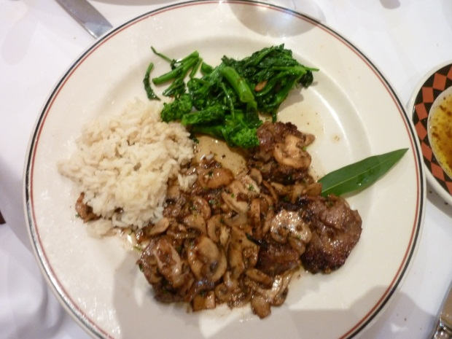
Final ADI
For a non-antimicrobial drug
Final ADI = toxicological ADI
For an antimicrobial drug
If toxicological ADI < microbiological ADI,
then Final ADI = toxicological ADI
If microbiological < toxicological ADI,
then Final ADI = microbiological ADI

Slide 23
Allocation of ADI
ADI represents the amount of drug residues that can safely be consumed per day over a human’s lifetime without adverse effects
For drugs used in dairy cows and/or laying hens, ADI is partitioned amongst the edible tissues (muscle, liver, kidney, fat), milk and eggs
Otherwise, allocate the full ADI to the edible tissues (muscle, liver, kidney, and fat)
Example: ADI = 10 µg/kg bw/day; partition 60% for milk, 10% for eggs, and 20% for tissues
allocated ADI: 6 µg/kg bw/day (milk); 1 µg/kg bw/day (egg), and
2 µg/kg bw/day (tissues)

Slide 24
Safe Concentration (SC)
ADI x Average Human BW (kg)
SC =
Food Consumption (g)
SC= [ADI x Average Human BW (kg)] / Food Consumption (g)
Provide total drug residues allowed in each edible tissue
Calculated using the ADI (or partitioned ADIs when applicable) and distributed amongst the edible tissues (muscle, liver, kidney and fat), milk and eggs using food consumption values

Slide 25
Food Consumption Values
Apply across all species.
Assume that if people will consume a full portion of a meat product from one species, they will not consume a full portion of a meat product from other species the same day.
Anticipate that people may eat meat with eggs or meat with milk, or meat with dairy and eggs, i.e., people could eat a full serving of meat and drink a full serving of milk and eat a full serving of eggs all on one day.

Slide 26
Food Consumption Values
Edible Tissue/Product | Food Consumption (per person per day)
Muscle | 300 g
Liver | 100 g
Kidney | 50 g
Fat/skin | 50 g
Eggs | 100 g
Milk | 1.5 L

Slide 27
Safety of the Injection Site
Assumes that consumption of injection site is a rare event
Safe concentration of the injection site muscle
Past approach allowed up to 10-times the muscle safe concentration
ASDI (acceptable single dose intake) approach
Acute toxicity data driven (allergenicity study, acute toxicity studies) & safety factor

Slide 28
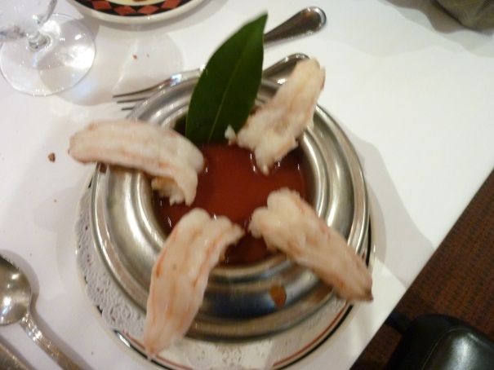
Talk Outline
Overview of human food safety evaluation
Toxicology assessment principles
Toxicology assessment of new animal drugs in food animals
Examples

Slide 29

Examples of ADI and SC Determinations
Ractopamine (non-antimicrobial)
Enrofloxacin (antimicrobial)

Slide 30
Ractopamine (NADA 140-863)
Summary of Toxicology Studies Conducted to Establish the Toxicological ADI
Type of Toxicology Study | Tested Species | Dose (mg/kg/day) | NOEL (mg/kg/day)
90-day oral | Mouse | 0, 25, 175, 1250 | 25
90-day oral | Rat | 0, 1.3, 14.3, 154.8 | 1.3
Two-generation Reproduction | Rat | 0, 0.15, 1.4, 15, 160 | 15
14-day oral | Dog | 0, 0.05, 0.15, 1.5 | 0.05
1-year oral | Dog | 0, 0.112, 0.224, 5.68 | NA
90-day gavage | Monkey | 0, 0.125 | 0.125
6-week gavage | Monkey | 0, 0.25, 0.5, 4.0 | 0.25
1-year oral | Monkey | 0, 0.125, 0.5, 4.0 | 0.125
2-year oral oncogenicity | Mice | 0, 35, 175, 1085 | 320
Single dose oral | Man | 5 - 40 mg total dose | 0.1

Slide 31
Ractopamine (NADA 140-863) - Toxicological ADI Determination
The 1-year oral study in the monkey was selected as the study with the lowest appropriate NOEL for determining the toxicological ADI.
Toxicological ADI = NOEL/Safety Factor = [(0.125mg/kg bw/day)/100] = 0.00125 mg/kg bw/day = 1.25µg/kg bw/day

Slide 32
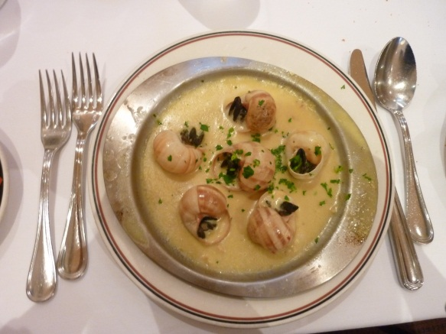
Ractopamine (NADA 140-863) – ADI Determination
Toxicological ADI = 1.25 µg/kg bw/day
An microbiological ADI is not needed.
Final ADI = toxicological ADI
= 1.25 µg/kg bw/day

Slide 33
Ractopamine (NADA 140-863) – Calculation of Safe Concentrations
Edible Tissue | Food Consumption (g) | Calculated SC (ppm)
Muscle | 300 | 0.25
Liver | 100 | 0.75
Kidney | 50 | 1.5
Fat | 50 | 1.5

Slide 34
Enrofloxacin (NADA 141-068) – Determination of a Toxicological ADI
Summary of Toxicology Studies Conducted to Establish the ADI
Study Type | NOEL (mg/kg bw/day)
Subchronic oral toxicity study in dogs | 3
Chronic toxicity and carcinogenicity study in mice | 323
Chronic toxicity in rats | 5.3
Two-generation reproductive toxicity study in rats | 125
Embroyotoxicity/teratogenicity study in rabbits | 25

Slide 35
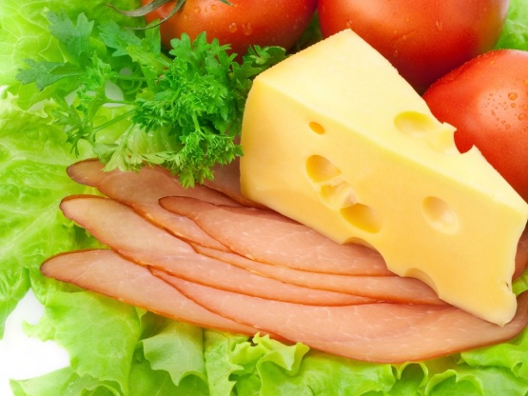
Enrofloxacin (NADA 141-068) – Determination of the Final ADI
Toxicological ADI = 0.003 mg/kg bw/day (or 3 µg/kg/day)
Microbiological ADI = 34.65 µg/kg bw/day
Final ADI = 0.003 mg/kg bw/day

Slide 36
Enrofloxacin (NADA 141-068) – Calculation of Safe Concentrations
Edible Tissue | Food Consumption (g) | Calculated SC (ppm)
Muscle | 300 | 0.6
Liver | 100 | 1.8
Kidney | 50 | 3.6
Fat | 50 | 3.6

Slide 37
Summary – HFS Toxicology Assessment
Toxicology assessment is to identify and characterize any potential adverse human health effects that may be caused by consumption of edible tissues from food-producing animals treated with drugs.
Generally, as a result of toxicology assessment, a human ADI for total drug residues is established and the safe concentration for each edible tissue is calculated.

Slide 38
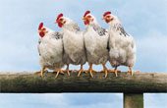
Summary – Human Food Safety
A human food safety evaluation is part of the approval process for animal drugs intended for use in food-producing animals.
Risk assessment approach is used to evaluate human food safety of animal drug residues.
The hazard from animal drugs is identified and characterized from microbial food safety and toxicological information, and the exposure of the hazard to humans is mitigated by information from residue chemistry studies.
Notes:
38

Slide 39
References
FDA/CVM GFI No. 3, General Principles for Evaluating the Safety of Compounds Used in Food-Producing Animals (http://www.fda.gov/downloads/AnimalVeterinary/GuidanceComplianceEnforcement/GuidanceforIndustry/UCM052180.pdf)
VICH Guidances (http://www.vichsec.org, VICH GL33 etc.)
OECD Guidelines for the Testing of Chemicals, Section 4- Health Effects (http://oberon.sourceoecd.org/vl=1329034/cl=31/nw=1/rpsv/cw/vhosts/oecdjournals/1607310x/v1n4/contp1-1.htm)
Federal Food, Drug, and Cosmetic Act (http://www.fda.gov/opacom/laws/fdcact/fdctoc.htm)
Code of Federal Register, Title 21, 500 series (http://www.gpoaccess.gov/cfr/index.html)

Slide 40



Thank You!
Thank you!

